Slide 1

SMART MERCHANT SUPPORT PLATFORM FOR AGENCY BANKING AND PROCUREMENT
RIT-26-139

Slide 2
Introduction
In Sri Lanka, many rural micro-merchants such as grocery shop owners, small retail sellers, and village traders still operate using manual methods.
They record:
  sales in notebooks
  expenses manually
  supplier balances verbally
  stock checking by memory
  banking transactions by physically visiting banks
This creates major business problems:
  poor financial visibility
  frequent stock-outs
  Weak supplier management
  time lost for banking activities
  poor procurement decisions
  Difficulty proving income to banks
Even though digital banking exists, most small merchants are still disconnected from formal financial systems because existing tools are expensive, internet-dependent, and not designed for rural conditions.
This creates a major market gap.

Slide 3

Core Research Problem
Problem Statement
Rural micro-merchants lack an integrated system that supports:
  financial record management
  inventory monitoring
  agency banking operations
  smart procurement decisions
within low-connectivity environments.
Because of this:
  business decisions are reactive
  working capital is poorly managed
  profits are reduced
  formal financial access becomes difficult

Slide 4

Proposed Solution
This research proposes:
An Offline-First Digital Agency Banking and Smart Procurement Support System
The system includes 4 connected components:
  Digital Financial Ledger
  Offline Inventory & Supplier Management
  Simulated Agency Banking Operations
  Smart Procurement Decision Support
These modules work together to convert informal merchant activities into a structured digital workflow.

Slide 5

Component 1
Digital Financial Ledger Module
Concept
This module records:
  cash sales
  digital payments
  expenses
  supplier payments
  agency banking transactions
Everything is stored in one unified digital ledger.
Gap Solved
  Credit Invisibility Gap
  Merchants cannot prove their income because records are manual and fragmented.
  Banks cannot verify their real financial activity.
IT22266682 - Aponsu P.S

Slide 6

Component 1
Digital Financial Ledger Module
Solution
The system creates:
  transaction transparency
  monthly reports
  formal financial history
This supports financial trust and business visibility.
Novelty
  Unified Informal-to-Formal Financial Transformation
  This module converts informal handwritten records into structured digital financial proof.
  This helps rural merchants become financially visible to formal institutions.
  This is stronger than simple bookkeeping.
IT22266682 - Aponsu P.S

Slide 7

Component 2
Inventory and Supplier Management Module
Concept
This module manages:
  stock levels
  reorder alerts
  supplier records
  supplier balances
using an offline-first system.
It works even without a stable internet.
Gap Solved
Stock-Out Blindness Gap
Merchants only realize stock shortages after customers ask for products.
This causes:
  lost sales
  customer dissatisfaction
  supplier disputes
IT22152978 - Pramudith K.G.S

Slide 8

Component 2
Inventory and Supplier Management Module
Solution
The system provides:
  low-stock alerts
  reorder notifications
  supplier tracking
  digital supplier history
This prevents reactive stock management.
Novelty
Offline-First Architecture for Rural Business Environments
  Most inventory systems depend on a constant internet.
  This research is specifically designed for rural Sri Lankan merchants, where the internet is unstable.
  This increases real-world usability.
IT22152978 - Pramudith K.G.S

Slide 9

Component 3
Simulated Agency Banking Operations Module
Concept
The merchant acts as a local banking agent (simulation only).
They handle:
  customer deposit requests
  transaction recording
  service commission tracking
  digital workflow simulation
No real banking API integration is required.
This is prototype-based validation.
Gap Solved
Liquidity Access Gap
In rural areas:
  customers travel long distances for banking
  merchants lose time visiting banks
  financial services are not easily accessible
This reduces productivity.
IT22050212 - Karunaweera L.M

Slide 10

Component 3
Simulated Agency Banking Operations Module
Solution
The system simulates merchants becoming:
Local Banking Touchpoints
This improves:
  convenience
  transaction efficiency
  financial accessibility
Novelty
Agency Banking Integrated with Daily Merchant Operations
Most systems treat banking and shop operations separately.
This research combines both.
The merchant becomes both:
  retailer
  financial service point
This is a strong innovation.
IT22050212 - Karunaweera L.M

Slide 11

Component 4
Smart Procurement Decision Support Module
Concept
This module helps merchants decide:
  When to reorder
  Which supplier to choose
  when prices are favorable
  How to reduce procurement costs
It acts as a decision support system.
Gap Solved
Procurement Inefficiency Gap
Most merchants buy stock based on urgency or habit.
This causes:
  late purchasing
  high prices
  unreliable suppliers
  reduced profits
IT22268730 - Ruwani P.A.M.J

Slide 12

Component 4
Smart Procurement Decision Support Module
Solution
The system compares:
  supplier price
  delivery speed
  reliability
  market opportunities
and recommends the best decision.
Novelty
Rule-Based Smart Procurement Without Machine Learning
Instead of using complex AI models,
The system uses:
  supplier scoring
  reorder rules
  price opportunity logic
This creates explainable and practical intelligence that is easier to validate academically.
IT22268730 - Ruwani P.A.M.J

Slide 13
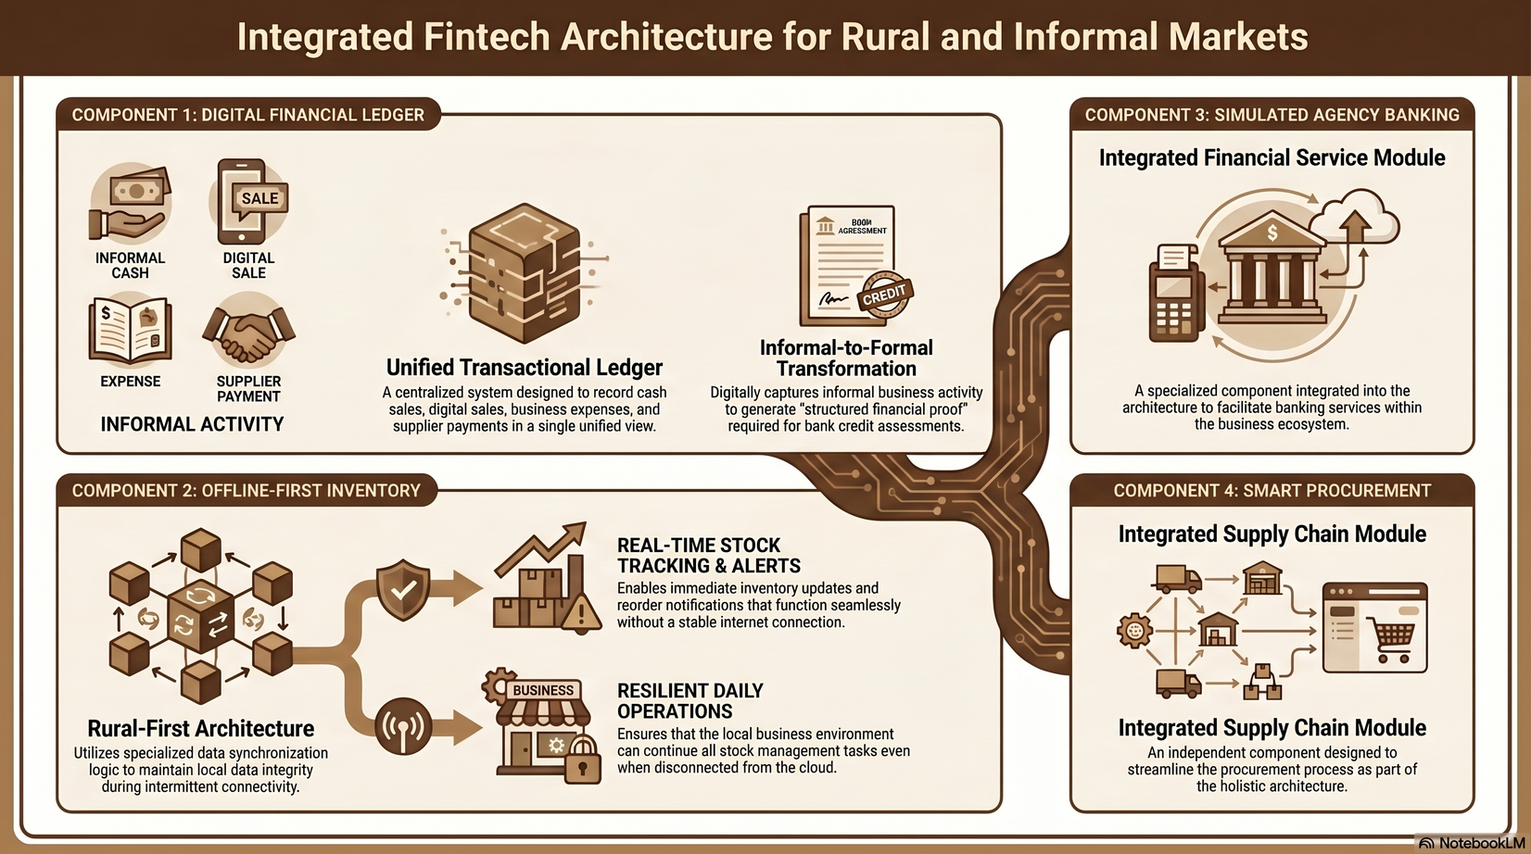
Full System Workflow
RIT-26-139

