Slide 1

Design and Evaluation of an Offline-First Digital Agency Banking and Smart Procurement Support System for Rural Micro-Merchants in Sri Lanka

Slide 2
Introduction & Background
Many rural micro-merchants in Sri Lanka still operate using manual methods:
•
Sales recording using notebooks
•
Stock checking from memory
•
Manual expense tracking
•
Physical bank visits for transactions
•
Supplier balances managed verbally
Result: Traditional practices create major operational inefficiencies.

Slide 3


Current Business Challenges
Operational Issues
Financial Issues
•
Frequent stock-outs
•
Poor financial visibility
•
Weak supplier coordination
•
Time lost for banking activities
•
Poor procurement decisions
•
Difficulty accessing formal finance
This directly affects profitability and business growth.

Slide 4
Research Gap: Why Existing Solutions Fail
Most current digital tools are developed with an "urban-first" mindset:
Expensive
Internet Dependent
Urban Design
Low Connectivity
Rural merchants remain disconnected from formal financial systems due to infrastructure mismatch.

Slide 5

Core Research Problem & Impact
Problem Statement
Rural micro-merchants lack an integrated system that supports financial record management, inventory monitoring, agency banking, and procurement within low-connectivity environments.
Business Consequences
•
Reactive decision-making
•
Reduced profits
•
Poor working capital management
•
Weak financial discipline

Slide 6



Proposed Research Solution
Offline-First Digital Agency Banking and Smart Procurement Support System
1. Digital Financial Ledger
3. Simulated Agency Banking
2. Offline-First Inventory
4. Smart Procurement System

Slide 7
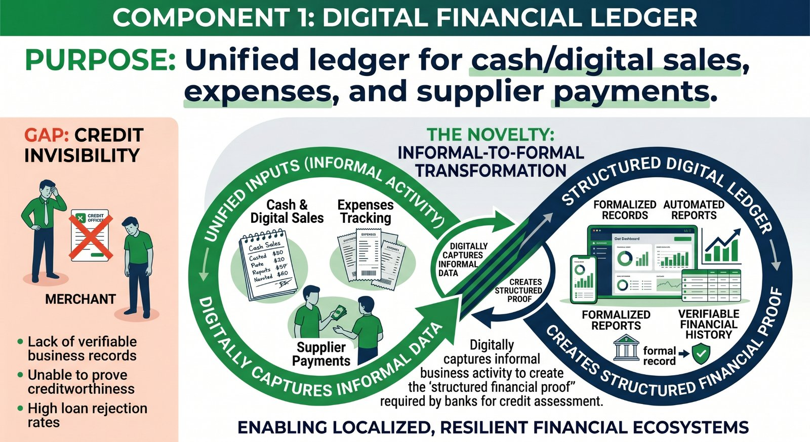


Component 1: Digital Financial Ledger
Purpose
The Novelty
Unified ledger for cash/digital sales, expenses, and supplier payments.
Informal-to-Formal Transformation:
Digitally captures informal business activity to create the "structured financial proof" required by banks for credit assessment.
Gap: Credit Invisibility

Slide 8
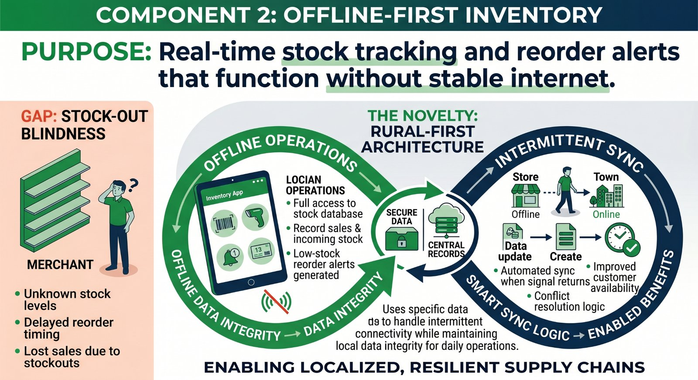
Component 2: Offline-First Inventory
Purpose
Real-time stock tracking and reorder alerts that function without stable internet.
The Novelty
Rural-First Architecture:
Specific data synchronization logic designed to handle intermittent connectivity while maintaining local data integrity for daily operations.
Gap: Stock-Out Blindness

Slide 9
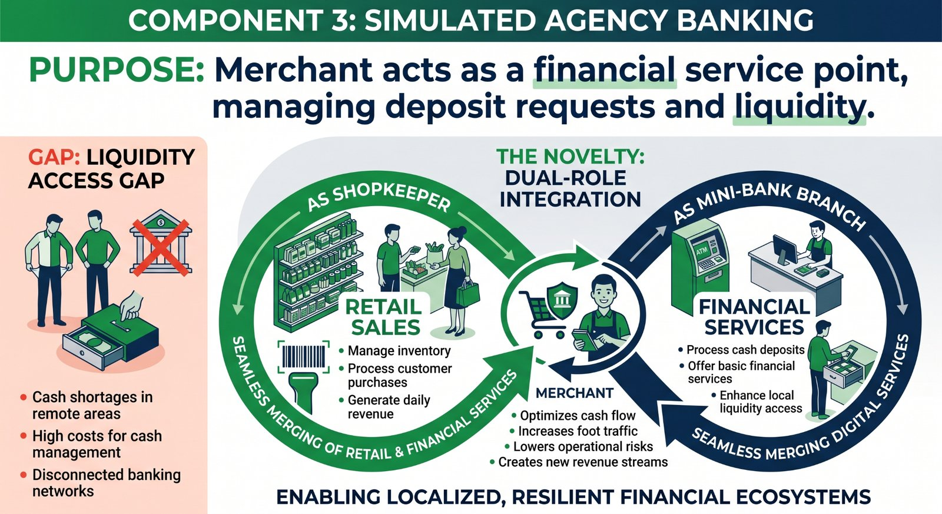
Component 3: Simulated Agency Banking
Purpose
The Novelty
Merchant acts as a financial service point, managing deposit requests and liquidity.
Dual-Role Integration:
Seamlessly merging retail sales with financial services so the merchant is both a shopkeeper and a mini-bank branch.
Gap: Liquidity Access Gap

Slide 10
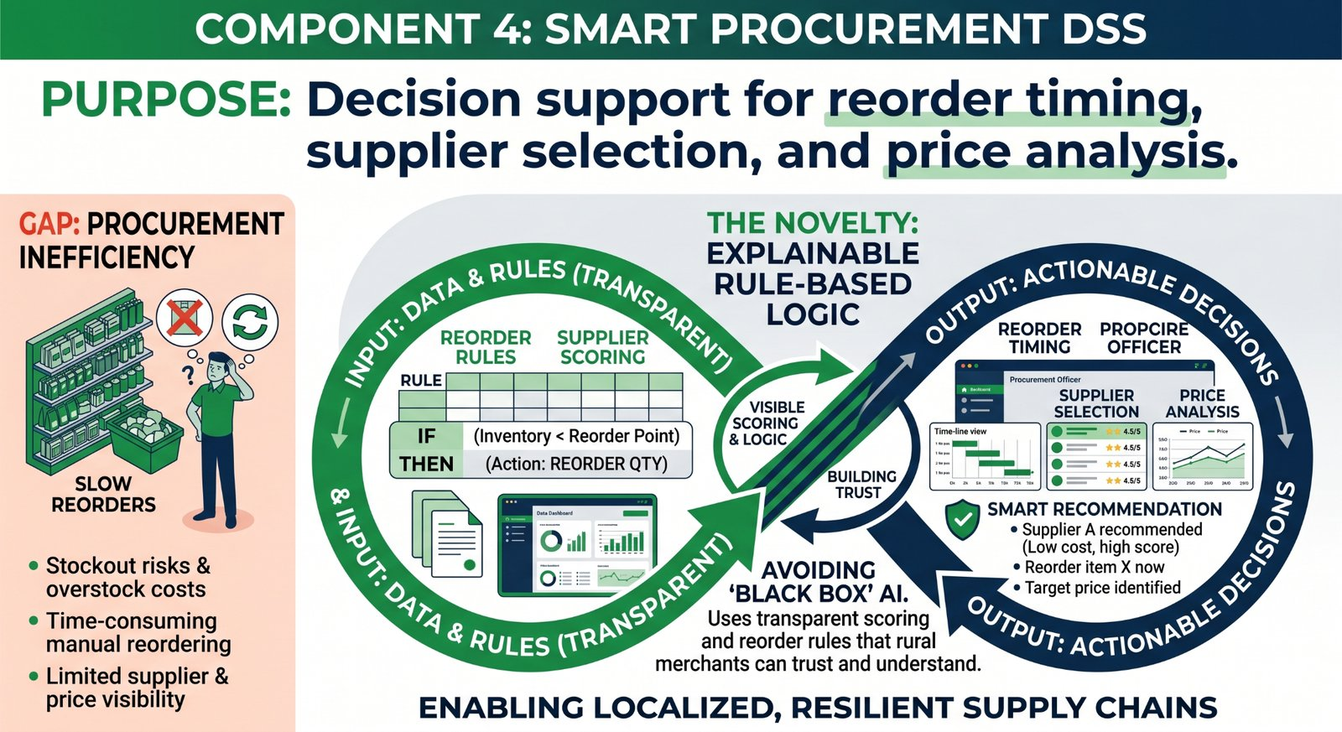
Component 4: Smart Procurement DSS
Purpose
The Novelty
Decision support for reorder timing, supplier selection, and price analysis.
Explainable Rule-Based Logic:
Avoiding "Black Box" AI. Uses transparent scoring and reorder rules that rural merchants can trust and understand.
Gap: Procurement Inefficiency

Slide 11
Research Contributions
Component | Research Novelty
Financial Ledger | Informal-to-Formal Financial Digitization
Inventory Module | Offline-First Rural Architecture
Agency Banking | Merchant + Banking Dual-Role Integration
Procurement DSS | Explainable Rule-Based Intelligence

Slide 12
Research Methodology
Design Science Research
Evaluation Strategy
Focusing on the creation and evaluation of an IT artifact to solve a practical problem.
•
Prototype-Based Evaluation
•
Socio-Technical Design
•
Integrated System Testing
"This is not just an app , it is a research artifact."

Slide 13

Final Value Proposition
"Transforming rural micro-merchants from informal shopkeepers into digitally empowered financial participants through offline-first agency banking and smart procurement support."
THANK YOU

