Slide 1
HOUSE PRICE PREDICTION USING MACHINE LEARNING

Slide 2
Group Members Information
Sathish Sattenapalli - 700743037
Poojitha Reddy Ganta - 700726910
Bhavana Vadiyala - 700740309

Slide 3
Role/Responsibilities and Contribution in project
Name | Responsibilities
Bhavana Vadiyala | Visualizing the data patterns using matplotlib and seaborn, analyzing the data using graphs worked for final report preparation along with teammates
Poojitha Reddy Ganta | Loading the dataset to feed the model. Since the dataset contains a large amount of records to reduce the training time cleaned the dataset for training the model.
Sathish Sattenpalli | Implemented different machine learning models on the dataset to get the desired outcome and pick the best model to predict house prices.

Slide 4
MOTIVATION
Accurately estimating house prices is of paramount importance in the real estate market, as it enables buyers, sellers, and investors to make informed decisions.
Buyers can evaluate the affordability of properties, compare prices across different locations, and identify potential undervalued or overvalued houses.
Similarly, sellers can greatly benefit from accurate house price predictions

Slide 5
OBJECTIVES
Develop and implement machine learning models for house price prediction.
Evaluate the performance of different regression algorithms.
Investigate the impact of house characteristics on price prediction.
Provide insights and recommendations for real estate stakeholders.
Contribute to the advancement of house price prediction research.

Slide 6
RELATED WORK
In the realm of house price prediction, extensive research has been conducted to leverage machine learning techniques and regression algorithms. Several studies have explored the application of Decision Tree Regression, Linear Regression, KNN Regression, and Random Forest Regression in predicting house prices based on various house characteristics. So, we have researched few IEEE papers and explored through it to get sufficient knowledge to implement our model.

Slide 7
PROBLEM STATEMENT
Real estate property values are intricately correlated with our economy. Despite this, despite the abundance of data available, we do not have precise estimates of house costs. So, the objective of this study is to apply machine learning to forecast the selling values of homes based on a variety of economic parameters.
The customer currently approaches a real estate agent to handle his or her investments and recommend appropriate estates for his investments. However, this approach carries some risk because the agent could make a mistaken estate prediction and lose the customer's capital as a result. The manual process still utilized in the market is inefficient and dangerous. There is a need for an updated, automated system to address this flaw.
The housing price prediction problem is the issue we intend to resolve in this project. We must anticipate the estimated price of the house based on several characteristics, including the square footage, age of the house, number of bedrooms, number of rooms, and population.

Slide 8
PROPOSED SOLUTION
The proposed framework for house price prediction encompasses key steps, including data preprocessing, feature engineering, model selection, training and evaluation, optimization, and interpretation. By following this framework, real estate professionals can leverage machine learning techniques to accurately predict house prices based on various house characteristics.
In our project we applied different types of machine learning regression models to predict the house prices. We have mainly used Decision tree, Random Forest, Linear regression and KNN regression models in our project.

Slide 9
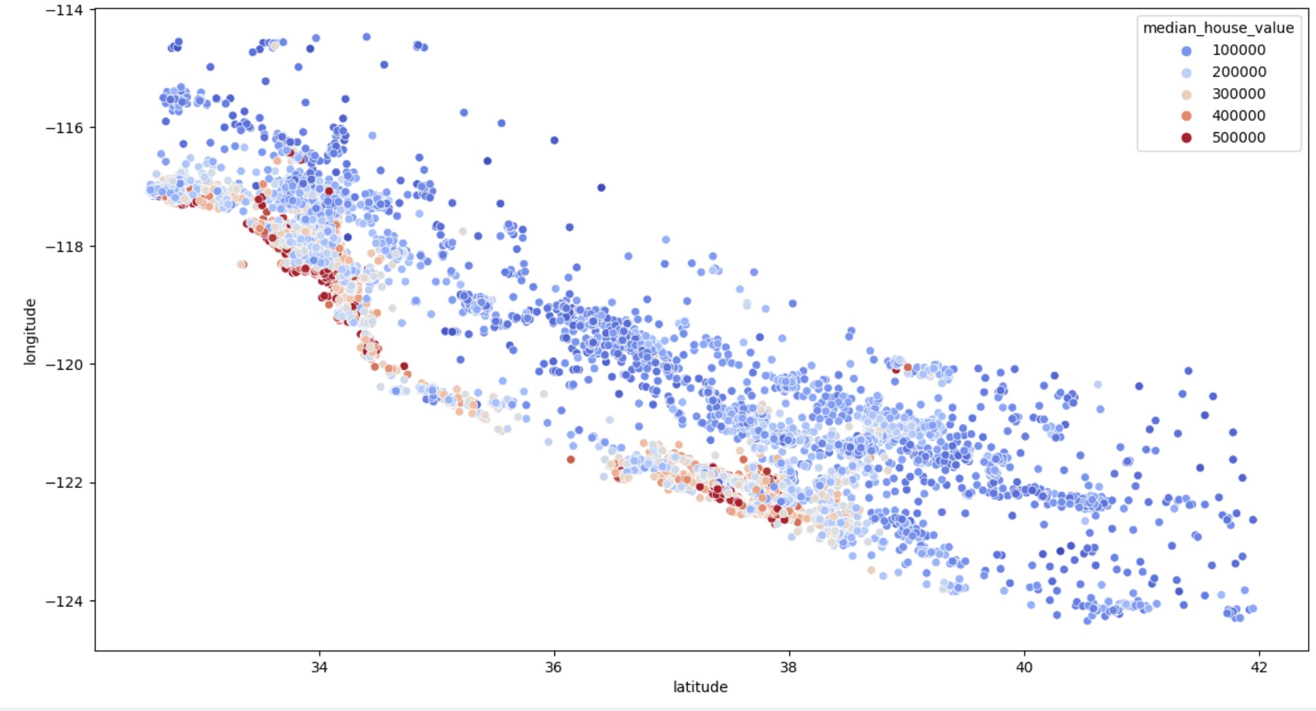
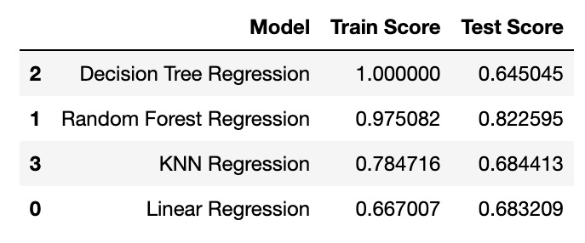
RESULTS
Fig. 1. Prediction accuracy
Fig. 2. California map with house prices based on locations

Slide 10
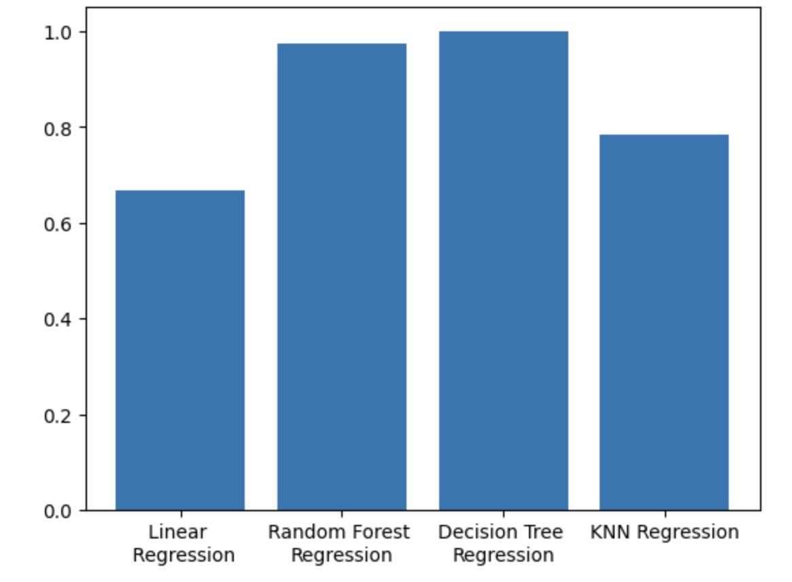
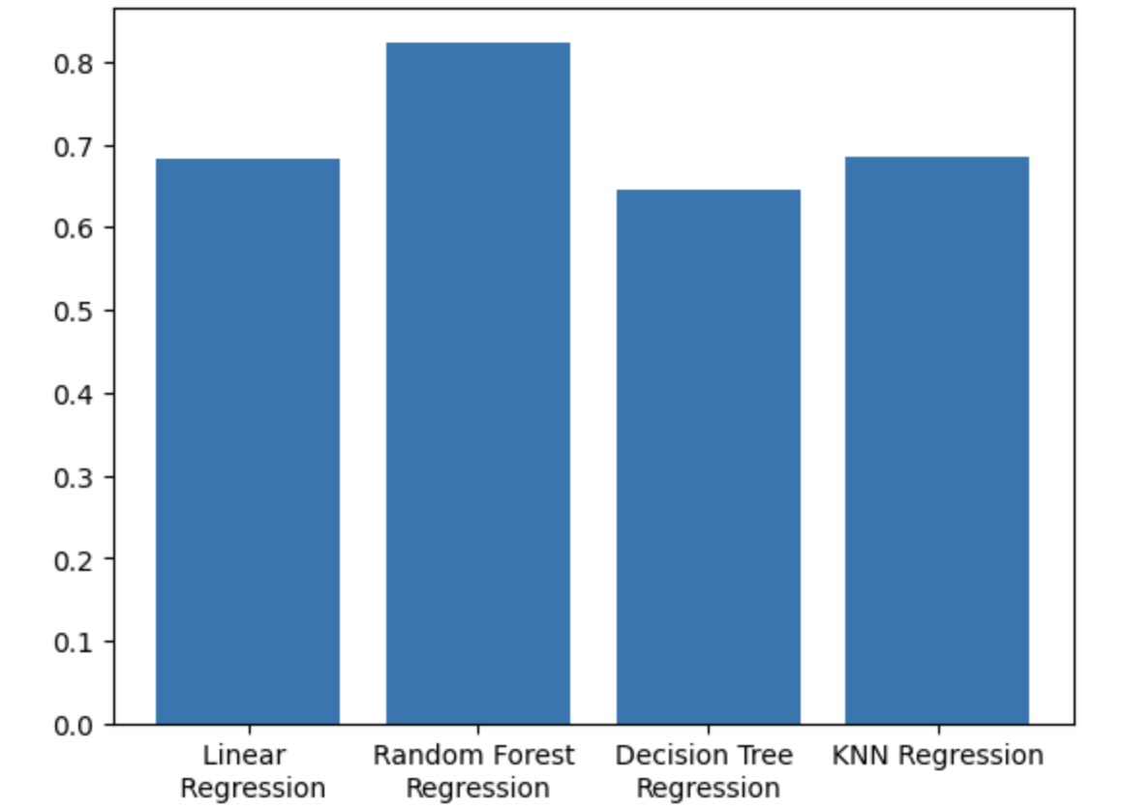
Fig. 3. Train dataset performance
Fig. 4. Test dataset performance

Slide 11
REFERENCES
Vivek Singh Rana, Jayanto Mondal, Annu Sharma, Indu Kashyap,” House Price Prediction Using Optimal Regression Techniques”, 2020 2nd International Conference on Advances in Computing, Communication Control and Networking (ICACCCN).
Manasa J, Radha Gupta, Narahari N S,” Machine Learning based Predicting House Prices using Regression Techniques”, Proceedings of the Second International Conference on Innovative Mechanisms for Industry Applications (ICIMIA 2020) IEEE Xplore Part Number: CFP20K58-ART; ISBN: 978-1-7281-4167-1.

Slide 12
Maida Ahtesham, Narmeen Zakaria Bawany, Kiran Fatima,” House Price Prediction using Machine Learning Algorithm – The Case of Karachi City, Pakistan”,2020 21st Internation Arab Conference on Information Technology (ACIT).
Mansi Jain, Himani Rajput, Neha Garg, Pronika Chawla,” Prediction of House Pricing Using Machine Learning with Python”, Proceedings of the International Conference on Electronics and Sustainable Communication Systems (ICESC 2020) IEEE Xplore Part Number: CFP20V66- ART; ISBN: 978-1-7281-4108-4.

Slide 13
THANK YOU

