Slide 1
KAH
Know About Hardware's

Slide 2
Syllabus
History of Electronics
History of computer
Generation of Computers
KAH Keyboard & mouse
KAH Monitor
KAH Processor
KAH Mother board
KAH HDD & SSD
KAH Ram
KAH OS

Slide 3
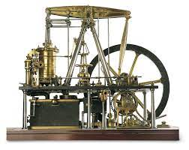
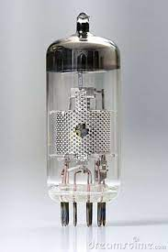
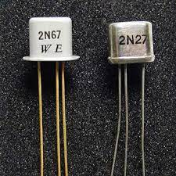
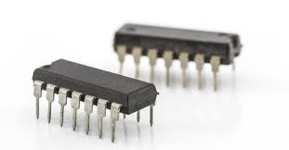
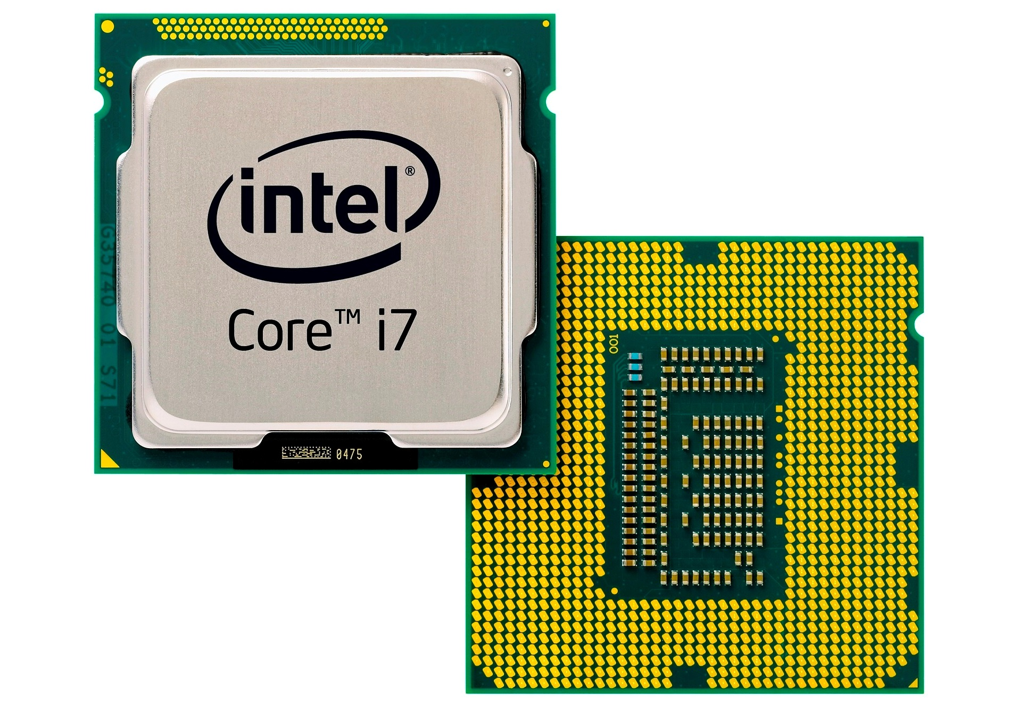
History of Electronics
Steam Engine: Vacuum Tubes: Transistor:
IC(Integrated Circuit): MicroProcessor:

Slide 4
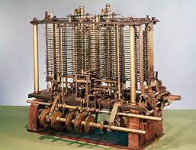
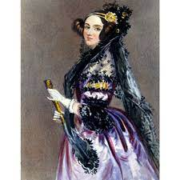
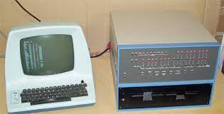
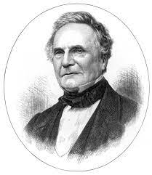
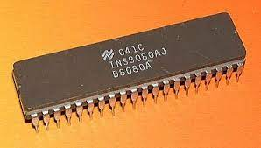
History of computers
Computer History:
The first mechanical computer name is Analytical Engine.
It was developed by Charles Babbage in 1833.
The first computer programmer was Ada Byron in 1840.
MITS(Micro Instrumentation and Telemetry System) made the first personal computer Altair in 1974.
The processor used in first personal computer was Intel 8080, It was developed in 1974.

Slide 5
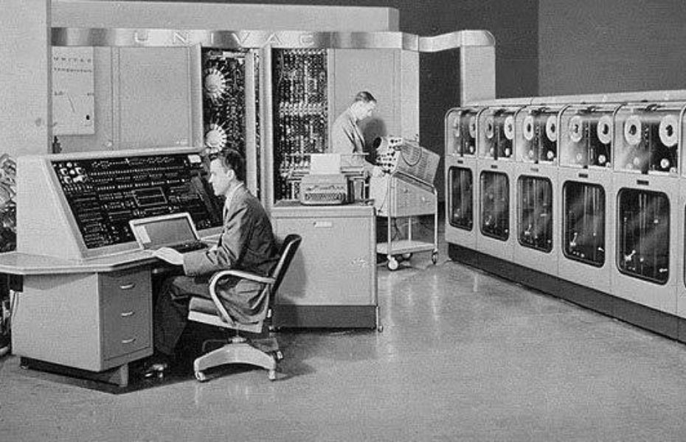
Generation of Computers
First Generation Computer:
Main Electronic component – Vacuum Tube.
Main Memory – Magnetic Drums and Magnetic Tapes.
Programming Language – Machine Language.
Power – Consume lot of energy and produce lot of heat.
Speed – Very slow in speed.
I/O devices – Punched Cards and Paper Tape.
Example – ENIAC, IBM 650 etc….

Slide 6
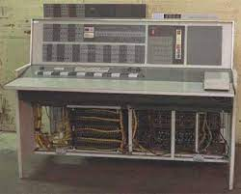
Generations of Computers
Second Generation:
Main Electronic Component – Transistor.
Memory – Magnetic core and Magnetic tape/disk.
Programming Language – Assembly Language.
Power – Low Power consumption.
Speed – Improvement of speed and Reliability.
I/O Devices – Punched cards and Magnetic Tape.
Example – IBM 1401, IBM 7090 etc…

Slide 7
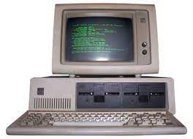
Generations of Computers
Third Generation:
Main Electronic Component – IC(Integrated Circuit).
Memory – Large Magnetic core, Magnetic tape/disk.
Programming Language – High Level Language(FORTRAN, Pascal, C etc…).
Size – Smaller and Cheaper (They were called “minicomputers”).
Speed – Improvement of speed and Reliability.
I/O Devices – Magnetic Tape, Keyboard, Monitor etc...
Example – IBM 360, IBM 370, PDP-11 etc…

Slide 8
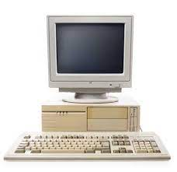
Generations of Computers
Fourth Generation:
Main Electronic Component – VLSI(Very Large Scale Integeration)Micro Processor.
Memory – Semiconductor Memory (RAM, ROM etc…)
Programming Language – High Level Language(Python, JAVA, C# etc…).
Size – Smaller and Cheaper more efficient than Third generation.
Speed – Improvement of speed, accuracy and Reliability.
I/O Devices – Keyboard, pointing devices, printer Monitor etc...
Example – IBM pc, STAR 1000, Apple Macintoss etc…

Slide 9
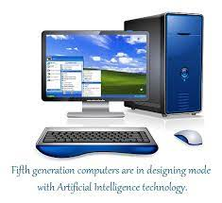
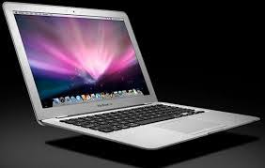
Generations of Computers
Fifth Generation:
Main Electronic Component – ULSI(Ultra Large Scale Integeration)
Micro Processor.
Power – Consumes less power and less heat.
Language – Understandable natural language(Human Language).
Size – Portable and small in size and have huge storage capacity.
Speed – Improvement of speed, accuracy and Reliability.
I/O Devices – Keyboard, Mouse, Trackpad, printer, Monitor etc...
Example – Desktop, Laptop, Mobile Phones etc…

Slide 10
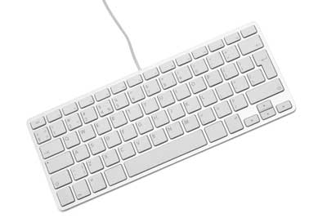
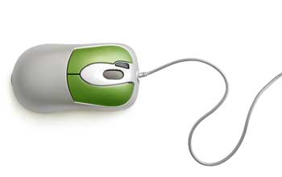
KAH Keyboard & mouse
Keyboard:
Keyboard is the most common and very popular input device.
The layout of the keyboard is like that of traditional typewriter.
Keyboards are two sizes 84 keys or 101 keys.
Mouse:
Mouse is the most popular pointing device.
It is a very famous cursor-control device having a small ball at its base.
The ball senses the movement of the mouse and send the signals
To the CPU.

Slide 11
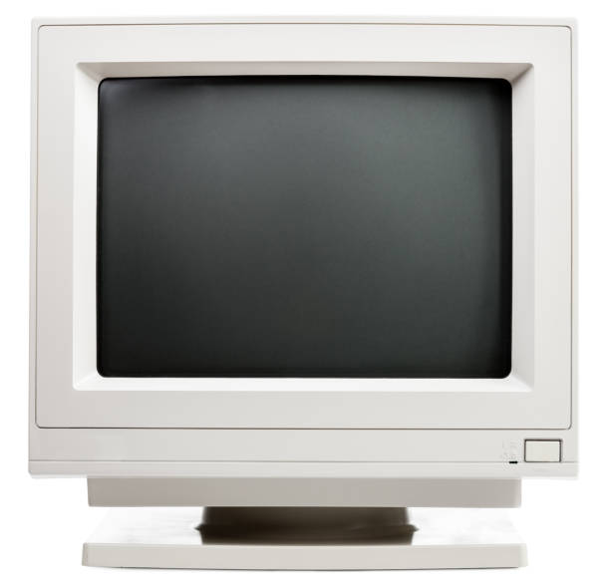
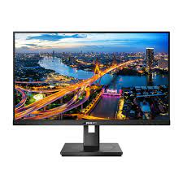
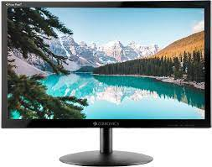
KAH Monitor
Monitor:
A computer monitor is an output device that displays information's in pictorial or textual form.
A computer monitor is also one of the important part of a computer system.
Types of monitors:
CRT(Cathode Ray Tube)
LCD(Liquid Crystal Display)
LED(Light Emitting Diode) CRT LCD LED

Slide 12
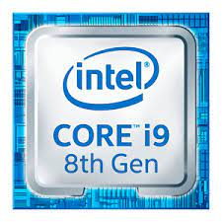
KAH Processor
processor:
An computer processor is also Known as CPU(Central Processing Unit).
It is considered as the brain of the computer.
It performs all type of data processing operations.
It stores data, intermediate results and Instructions.
It controls the operation of all parts of the computer.
Popular processor manufacturer’s are Intel, AMD.

Slide 13
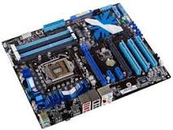
KAH Motherboard
Motherboard:
The motherboard is the backbone of the computer.
It ties all components together at one spot.
Total motherboard functionality is necessary for a computer to work well.
Popular motherboard manufacturers are Intel , AMD, Gigabyte, MSI.

Slide 14
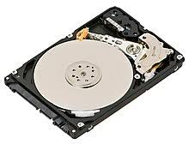
KAH HDD & SSD
HDD(HDD):
HDD Stands for Hard Disk Drive.
An hard disk is an magnetic storage medium for a computer.
It is a flat circular plate made of aluminum or glass and coated with magnetic material.
Hard Disk for personal computers can store terabytes of information.

Slide 15
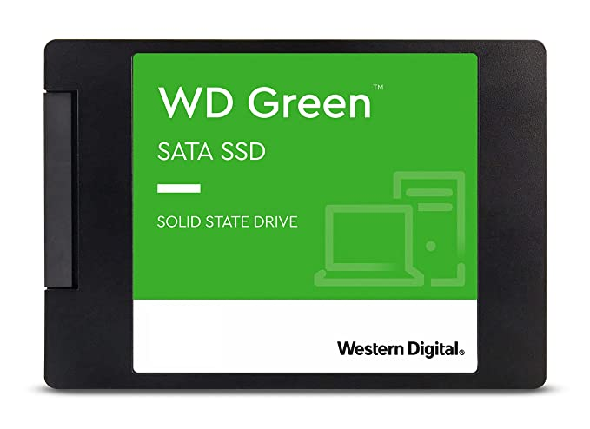
KAH HDD & SSD
SSD(ROM):
SSD Stands for Solid State Drive.
It is smaller and faster than hard disk.
It allows pc to be thinner and more lightweight.
SSDs are most common storage drives today.
SSD is costlier than Hard Disk.

Slide 16
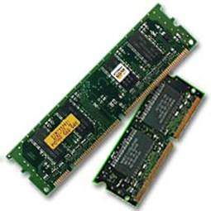
KAH RAM
RAM:
RAM stands for Random Access Memory.
It is a read/write memory which stores data until the machine is working.
It is also known as temporary memory.
Ram is volatile in nature.
Ram is small both in physical size and the amount of data it can hold.

Slide 17
Thank you

