Slide 1
Naming Conventions

Slide 2
Naming conventions
Naming conventions:
Naming Conventions is a rule to follow as you decide what to name your identifiers such as class, package, variable, constant, function etc.
But it is not forced to follow.

Slide 3
Naming Conventions
General rules for python naming conventions:
Rule1: Always give a meaning full name for any of the python objects. Don’t give names like x, y, or z etc.
Rule2: Don’t give space in between object name instead of using underscore(_) when there are more than one-word presents.
Rule3: Better to use camelCase only when it makes sense or else try avoiding more use of camelCase.

Slide 4
Naming conventions
Naming convention for identifiers:
Function:
We should write the python function name with all lower case characters.
Do not use uppercase character while naming a function in python.
Use underscore(_)in between the words instead of space while naming a function.
Example:
def example_function():
print(“This is the way a function must be used”)

Slide 5
Naming conventions
Naming convention for identifiers:
Variable:
You must start variable name with an alphabet or underscore(_) character.
A variable name can only contain Alphanumeric (A-Z, 0-9) and underscore(_).
You cannot start the variable name with a number.
You cannot use special characters with the variable name such as $, %, @, #, &, ^ etc.
Variable names are case sensitive. For example age and Age are two different variables.
Do not use reserve keywords as a variable name for example class, for, def etc.

Slide 6
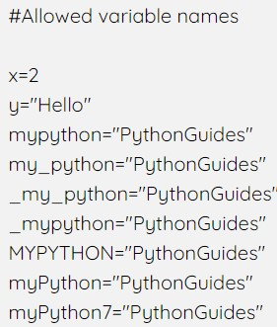
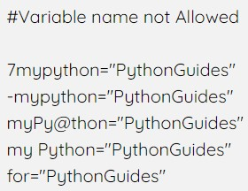
Naming conventions
Naming convention for identifiers:
Variable:
Example:

Slide 7
Naming conventions
Naming convention for identifiers:
Class:
We need to follow the camelCase convention.
When you are writing any classes for an exception then that name should end with “Error”.
If you are calling the class from somewhere or callable then, you can give a class name like a function.
The built-in classes in python are with lowercase.

Slide 8
Naming conventions
Naming convention for identifiers:
Class:
Example:
class MyClass
class Hello
class InputError
class ProperClassNamingConvention

Slide 9
Naming conventions
Naming convention for identifiers:
Package:
You should use all lowercase while deciding a name for a package.
If there are multiple words in your package name then they should be be separated by an underscore(_).
It is always better to use a single word for a package name.
Example:
from mypkg import mod1
from example_package import cars

Slide 10
Naming conventions
Naming convention for identifiers:
Global variable:
You should use all lowercase while deciding a name for a object.
If there multiple words in your global variable name then they should be separated by an underscore(_).
Example:
global my_variable
global user_name
global AGE

Slide 11
Thank You

