Slide 1
History Of Oops

Slide 2
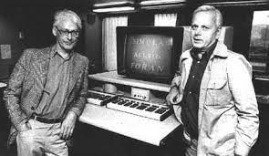

History of Oops
History of Oops:
Many people believe that C++ is the first Oop based language.
Actually, SIMULA 1 (1962) and SIMULA 2 (1967) were the Earliest Object Oriented Languages.
Oops began to flourish after c++ began to entrenched in 1990s.
Ole – Johan Dahi & Kristen nygaard Bjarne Stroustrup
Creators of Simula 1 and Simula 2 Creator of C++

Slide 3
Why Oops was Created
Why oops:
The oop concept was basically designed to overcome the drawback of the previous Programming Methodologies, which were not so close to Real – World Applications.
The Demand was increased, but still conventional methods were used.
This new approach brought a revolution in Programming Methodology field.
Object – Oriented Programming (Oop) is nothing but that which allows the writing of programs with classes and real – time objects.

Slide 4
Advantages of Oops
Advantages of Oops:
By using class we can reuse some facilities rather than building them again and again.
It is possible to have multiple Objects.
Through inheritance we can eliminate unnecessary codes and extend the use of existing classes.
The principle of data hiding helps for security.
It is easy to partition the work in a project based.
Object – oriented systems can be easily upgraded from small to large systems.
Message passing techniques for communication between objects.

Slide 5
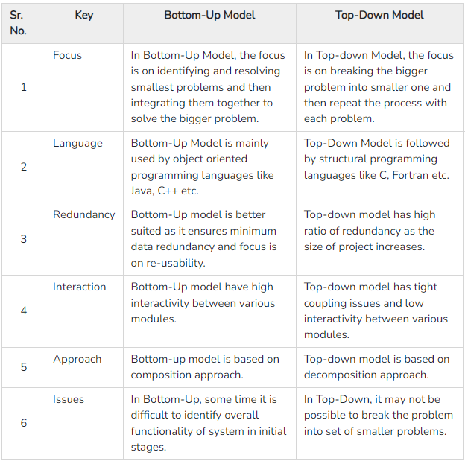
Bottom-Up Vs Top-Down Model

Slide 6
Structured programming Vs Oops
Structured programming | Object oriented programming
Code is divided into modules of functions | Code is made up of classes and objects
Less flexibility and abstraction | More flexibility and abstraction
Difficult to modify / manage | Easy to modify / manage
Main function calls other functions | Objects communicate by passing messages
Data is not secured | Data is secured
Less reusability of code | More reusability of code
Top – Down approach | Bottom – up approach

Slide 7
Terminologies of Oops
Terminologies of Oops:
Classes
Object
Encapsulation
Data Abstraction
Inheritance
Polymorphism

Slide 8
Terminologies of Oops
Classes:
A class is an template used to create objects and to define object data types and methods.
Objects:
An object is an instance of an class. Each object has State (data) and behavior (code).
Encapsulation:
Encapsulation refers to integrating data (variables) and code(methods) into a single unit.

Slide 9
Terminologies of Oops
Data Abstraction:
Data abstraction is a programming and design tool that displays basic information about a device while hiding its internal functions.
Inheritance:
Inheritance is a mechanism in which one class acquires the property of another class.
Polymorphism:
Polymorphism is the ability of any data to be processed in more than one form.

Slide 10
Thank You

