Slide 1
Class and Object

Slide 2
Class and Object
What is a Class?
A class is a user – defined blueprint or prototype from which objects are created.
Classes separates functions and fields based on their categories.
Suppose a class is a prototype of a building.
A building contains all the details about the floor, rooms, door, windows etc..
We can make as many buildings as we want, based on these details.
Hence, the building can be seen as a class and we can create many objects of this class

Slide 3
Class and Object
Syntax:
class ClassName:
# class definition
Example:
class bike:
model = “R3”
brand = “Yamaha”

Slide 4
Class and Object
What is Object?
An Object is an instance of a Class.
A class is like a blueprint while an instance is a copy of the class with actual values.
An object consists of:
State: It is represented by the attributes of an object. It also reflects the properties of an object.
Behavior: It is represented by the methods of an object. It also reflects the response of an object to other objects.
Identity: It gives a unique name of an object and enables one object to interact with other objects.

Slide 5
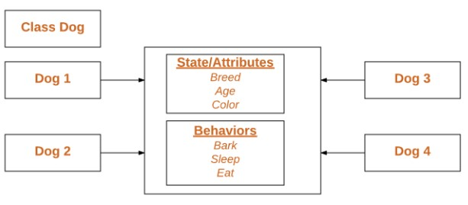
Class and Object
Declaring Class Objects:
When an object of a class is created, the class is said to be instantiated.
All the instances share the attributes and the behavior of the class.
But the values of those attributes are unique for each object.
A single class may have any number of instances.

Slide 6
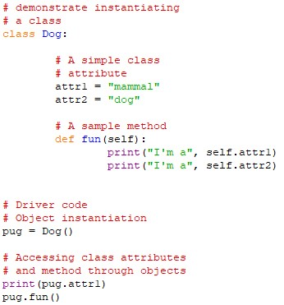
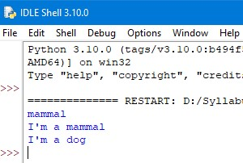
Class and Object
Example:
Code: Output:

Slide 7
Class and Object
Self parameter:
SELF represents the instance of class.
This handy keyword allows you to access variables, attributes and methods of a defined class in python.
The self parameter doesn’t have to be named “self”, as we can call it by any other name.

Slide 8
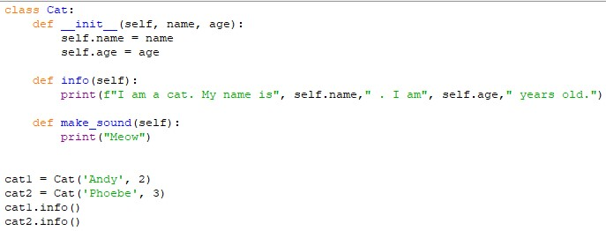
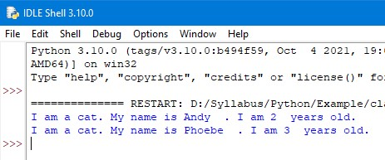
Class and Object
Example:
Code: Output:

Slide 9
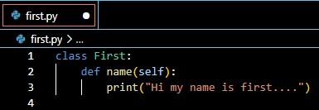
Class and Object
Accessing class from another file:
Step1: create a file named first with class name as First and enter the following code in it.
Step2: then create a file named second in the same folder where first is located.

Slide 10
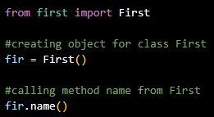
Class and Object
Accessing class from another file:
Step3: Write the following code in the second file to create object for class First.
Step4: Now, run the second file.

Slide 11
Thank You

