Slide 1
Encapsulation

Slide 2

Encapsulation
What is Encapsulation?
Encapsulation is one of the cornerstone concepts of OOP.
Encapsulation is used to wrap up both data and methods into one single unit.
The way that data and methods are organized does not matter to the end – user.
The user is only concerned about the right way to provide input and expects a correct output on the basis of the input provided.

Slide 3
Encapsulation
Importance of Encapsulation:
To hide the internal implementation details of the class.
Can safely modify the implementation without worrying breaking the existing code that uses the class.
Protect class against accidental/ willful stupidity.
Easier to use and understand.

Slide 4
Encapsulation
Encapsulation using public members:
As the name suggests, the public modifier allows variables and functions to be accessible from anywhere within the class and from any part of the program.
All member variables have the access modifier as public by default.

Slide 5
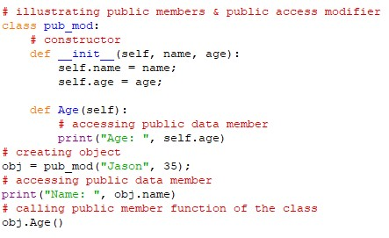
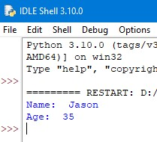
Encapsulation
Example: Output:

Slide 6
Encapsulation
Encapsulation using protected members:
What sets protected members apart from private members is that they allow the members to be accessed within the class and allow them to be accessed by the sub – classes involved.
In python, we demonstrate a protected member by prefixing with an underscore (‘_’) before its name.
If the members have a protected access specifier it can also be referenced then within the class and the subsequent sub-clas.

Slide 7
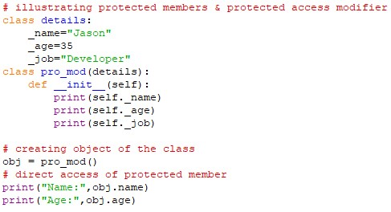
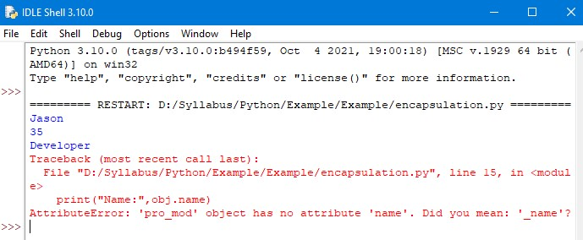
Encapsulation
Example: Output:

Slide 8
Encapsulation
Encapsulation using private members:
The private access modifier allows member methods and variables to be accessed only within the class.
To specify a private access modifier for a member, we make use of the double underscore(‘__’).

Slide 9
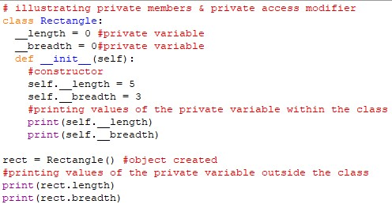
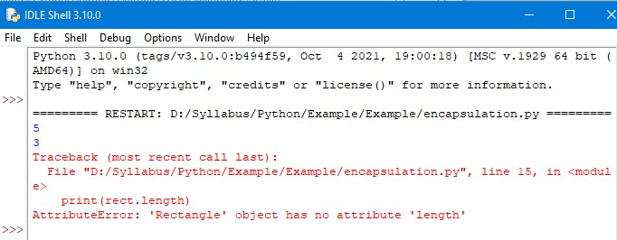
Encapsulation
Example: Output:

Slide 10
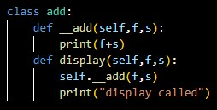


Encapsulation
Example: Output:

Slide 11
Encapsulation
Advantages of Encapsulation:
Code Reusability
Data hiding
Improved Maintainability
Easier to understand
Better control over class properties
Better class design

Slide 12
Thank You

