Slide 1
KAS
Know About Software

Slide 2
Syllabus
Binary Language(0’s & 1’s)
Instruction Sets
Assembly Language
OS
UNIX OS(Assembly language)
C Language
UNIX OS (Using C)
Function oriented
Oops oriented

Slide 3
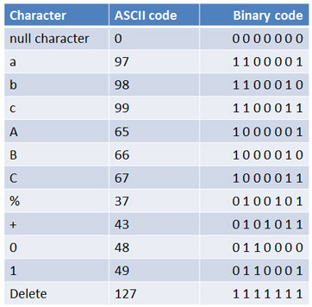
Binary Language
Binary Language:
Binary Describes a numbering scheme in which there are only two possible values for each digit 0 or 1.
These system use this code to understand operational instructions and user input and to present relevant output to the user.

Slide 4
Instruction Set
Instruction Set:
An Instruction set is a group of commands for CPU.
It defines how the CPU is controlled by the Software.
The ISA(Instruction Set Architecture) acts as an interface between the hardware and the software.

Slide 5
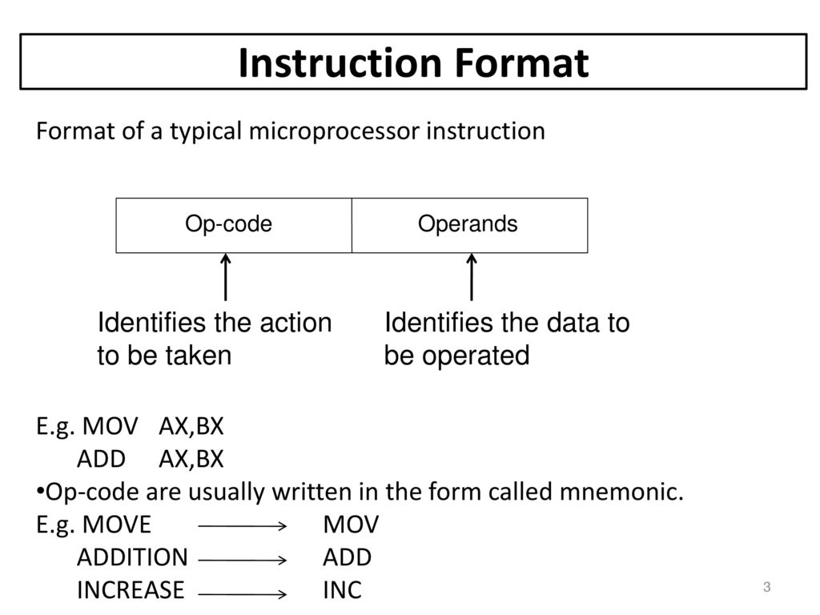
Instruction Set

Slide 6
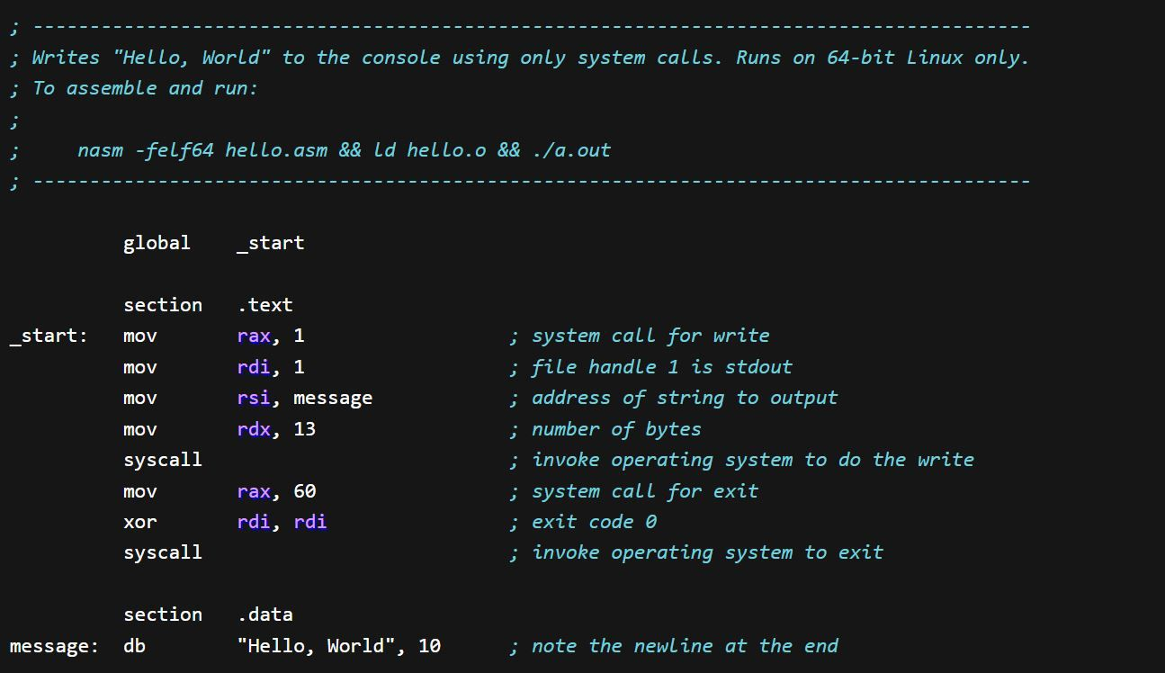
Assembly Language
Assembly Language:
It is an low level programming language that is intended to communicate directly with Computer’s Hardware.
Unlike Machine Language. Assembly Language’s are designed to be readable by Human's.

Slide 7
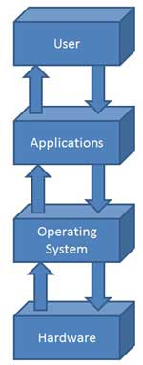
OS
OS:
OS Stands for Operating System.
An Operating System is a program that acts as an interface between the software and hardware.
It is an Integrated set of specialized programs used to manage operations of the computer.
The first OS used for real work is GM-NAA I/O by IBM.

Slide 8
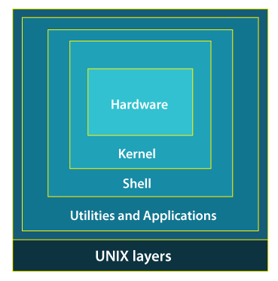
UNIX OS(Assembly Language)
UNIX Operating System:
UNIX is a Powerful Operating System developed by Dennis Ritchie and Ken Thompson.
It was developed in AT&T Bell Laboratories on 1970.
It was written using Assembly Language.

Slide 9
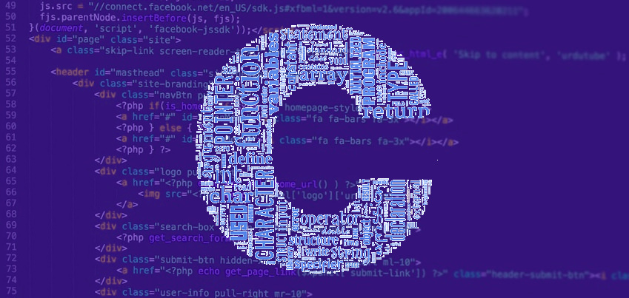
C Language
C Language:
C is an General-Purpose programming language.
It was created by Dennis Ritchie at the Bell Laboratories in 1972.
It is Function Oriented.
It was developed to write UNIX OS.

Slide 10
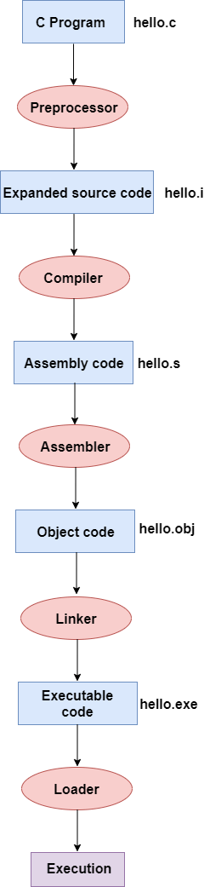
C language
C Programing work flow diagram:

Slide 11
UNIX OS(using C)
UNIX OS(using C):
UNIX OS Code was rewritten using C Programing.
It was rewritten in 1974.
It was rewritten because The code was more compact and it was easier to port to other processors.

Slide 12
Function Oriented
Function Oriented:
Functional programming is a programming technique that requires functional factors required for creating and implementing the programs.
The programming model used in functional programming is declarative programming model.
In functional programming variables and functions are the main elements of the code.
C programing is Function oriented.

Slide 13
Object Oriented
Object Oriented:
Oops(Object oriented program) is an conceptual programming techniques that uses objects as the key.
The Object oriented Programming uses the imperative programming model.
In Object oriented programing the key elements are Objects and Methods.
Java is Object oriented.

Slide 14
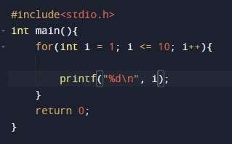
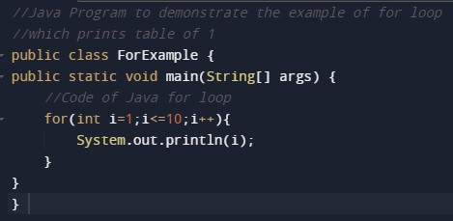
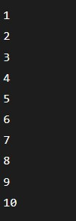
Example
Function: Oops: Output:

Slide 15
Thank You

