Slide 1
Abstract Class

Slide 2
Abstract Class
What is Abstract Class?
An Abstract class can be considered as a blueprint for other classes.
It allows us to create a set of methods that must be created within any child classes built from the abstract class.
An abstract method is a method that has a declaration but does not have an implementation.
When we want to provide a common interface for different implementations of a component, we use an abstract class.

Slide 3
Abstract Class
Why we use Abstract Class:
By defining an abstract class, we can define a common Application Program Interface(API) for a set of subclasses.
This capability is especially useful in situations where a third – party is going to provide implementations, such as with plugins.
It can also help you when working in a large team or with a large code-base where keeping all classes in your mind is difficult or not possible.

Slide 4
Abstract Class
How Abstract Classes work:
By default, Python does not provide abstract classes.
Python comes with a module that provides the base for defining Abstract Base Classes(ABC) and that module name is ABC.
ABC works by decorating methods of the base class as abstract and then registering concrete classes as implementations of the abstract base.
A method becomes abstract when decorated with the @abstractmethod keyword.

Slide 5
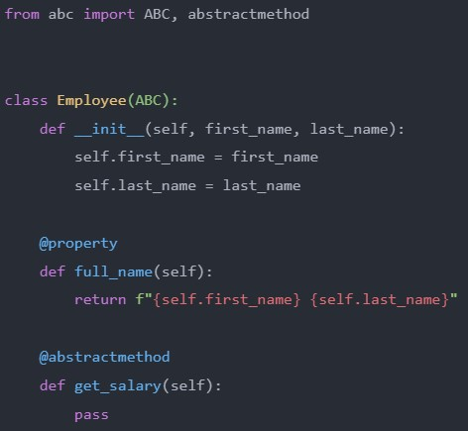
Abstract Class
Example:
The Employee class:

Slide 6
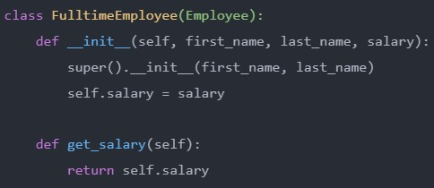
Abstract Class
Example:
The FulltimeEmployee class:

Slide 7
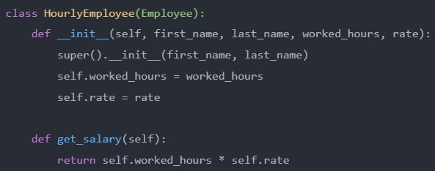
Abstract Class
Example:
The HourlyEmployee class:

Slide 8
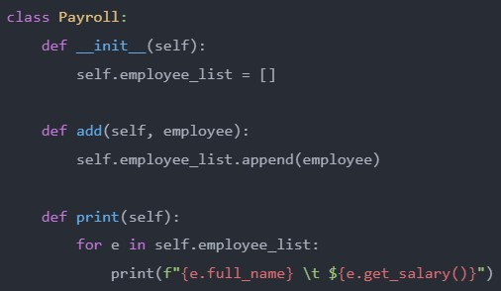
Abstract Class
Example:
The Payroll class:

Slide 9

Abstract Class
Example:
The Main program file:

Slide 10

Abstract Class
Output:

Slide 11
Thank You

