Slide 1
Interface

Slide 2
Interface
Interface:
The interface is a collection of method signatures that should be provided by the implementing class.
Implementing an interface is a way of writing an organized code and achieve abstraction.
The package Zope.interface provides an implementation of “Object interfaces” for python.
The package exports two objects, ‘Interface’ and ‘Attribute’ directly.

Slide 3
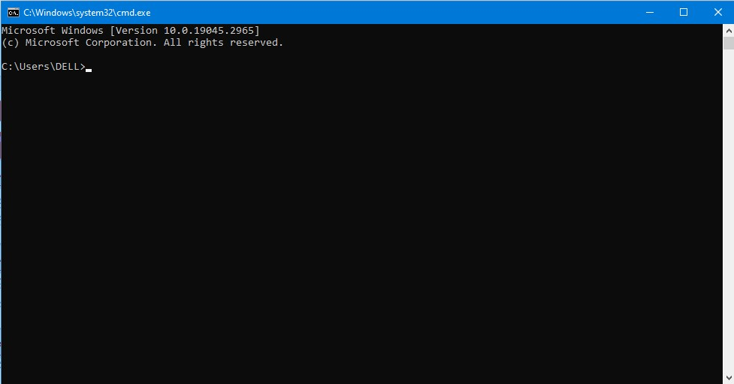

Interface
Steps to Install zope package:
Step1: Open command prompt.
Step2: Run the following command.

Slide 4
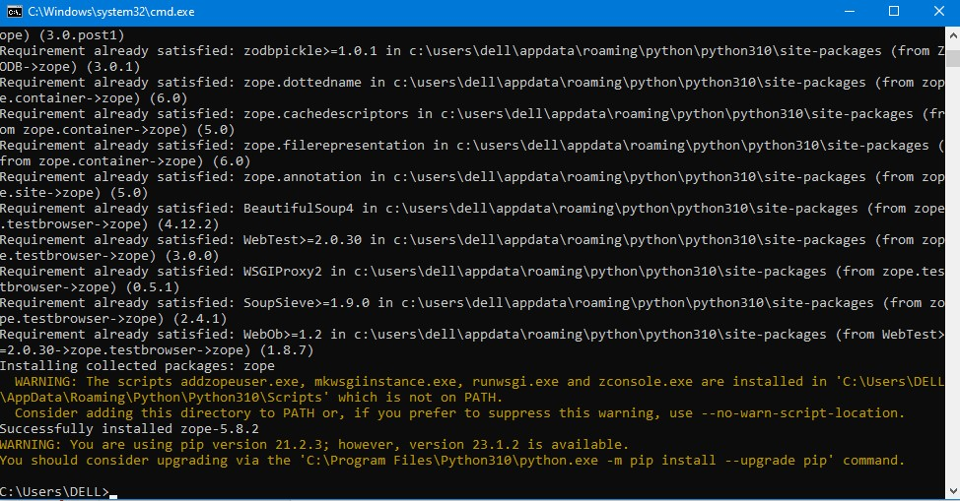
Interface
Steps to Install zope package:
Step3: After installation it shows successfully installed zope-5.8.2.

Slide 5

Interface
Declaring Interface:
In python, Interface is defined using python class statements and is a subclass of interface.interface which is the parent interface for all interfaces.
Syntax:

Slide 6
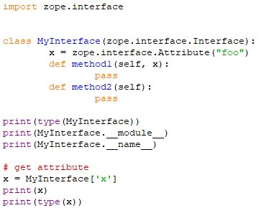
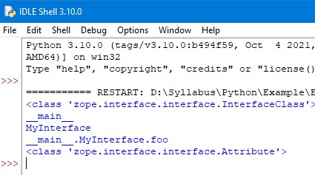
Interface
Example: Output:

Slide 7
Interface
Implementing Interface:
Interface acts as a blueprint for designing classes, so interfaces are implemented using implementer decorator on class.
If a class implements an interface, then the instances of the class provide the interface.
Objects can provide interfaces directly in addition to what their classes implement.

Slide 8

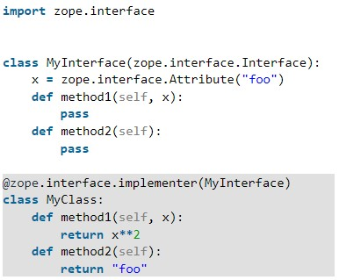
Interface
Syntax:
Example:

Slide 9
Interface
Implementation Methods:
implementedBy(class) – Returns a boolean value. True if class implements the interface else False.
providedBy(object) – Returns a boolean value, True if object provides the interface else False.
providedBy(class) – Returns False as class does not provide interface but implements it.
List(zope.interface.implementedBy(class)) – Returns the list of interfaces implemented by a class.

Slide 10
Interface
Implementation Methods:
List(zope.interface.providedBy(object)) – Returns the list of interfaces provided by an object.
List(zope.interface.providedBy(class)) – Returns empty list as class does not provide interface but implements it.

Slide 11
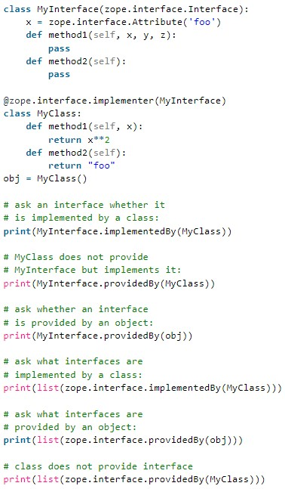
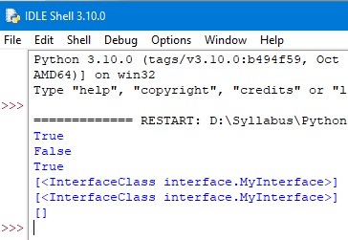
Interface
Example: Output:

Slide 12
Interface
Interface Inheritance:
Interfaces can extend other interfaces by listing the other interfaces as base interfaces.
Functions:
Extends(interface) – returns boolean value, whether one interface extends another.
isOrExtends(interface) – returns boolean value, whether interfaces are same or one extends another.
isEqualOrExtendedBy(interface) – Returns boolean value, whether interfaces are same or one is extended by another.

Slide 13
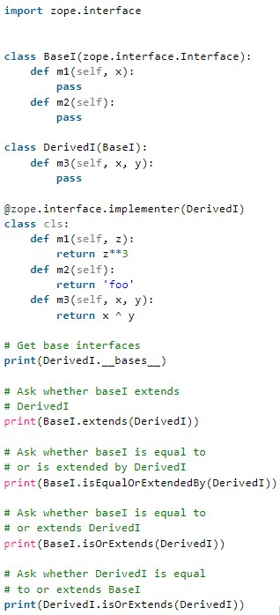
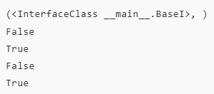
Interface
Example: Output:

Slide 14
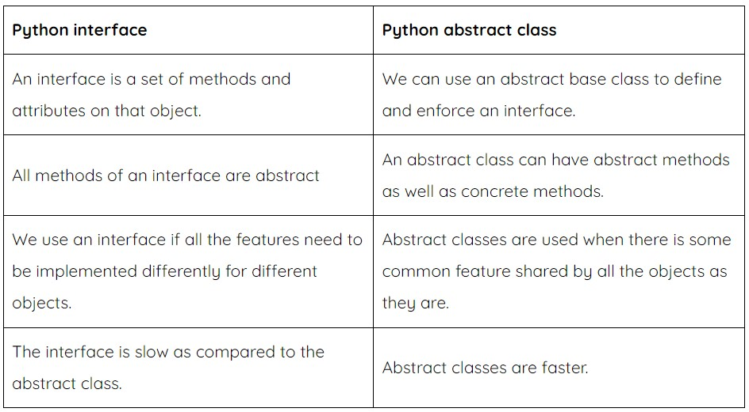
Interface
Interface VS Abstract class:

Slide 15
Thank You

