Slide 1
String Concatenation

Slide 2
String Concatenation
String Concatenation:
String Concatenation is the technique of combining two strings.
Strings are immutable, therefore, whenever it is concatenated, it is assigned to a new variable.
This can be done by using many ways, They are:
Using + Operator
Using join() Method
Using % Operator
Using format() function
Using comma(,).

Slide 3
String Concatenation
String Concatenation Using + Operator:
It’s very easy to use the + operator for string concatenation.
This operator can be used to add multiple strings together.

Slide 4
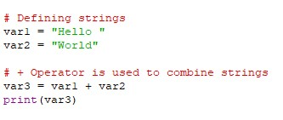
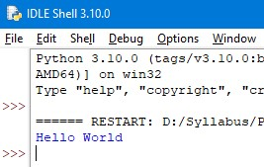
String Concatenation
Example:
Output:

Slide 5
String Concatenation
String Concatenation Using join() Method:
The Join() method is a string method and returns a string in which the elements of the sequence have been joined by str separator.
This method combines the string that is stored in the var1 and var2.
It accepts only the list as its argument and list size can be anything.

Slide 6
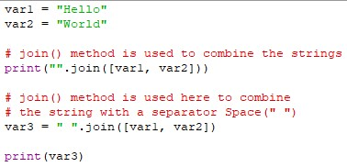
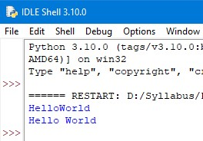
String Concatenation
Example:
Output:

Slide 7
String Concatenation
String Concatenation Using % Operator:
We can use the % operator for string formatting.
It’s useful when we want to concatenate strings and perform simple formatting.
The %s denotes string data type.

Slide 8

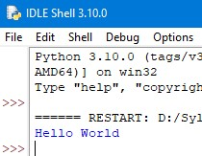
String Concatenation
Example:
Output:

Slide 9
Thank You

