Slide 1
Map() function

Slide 2
Map() Function
Map() function:
The map() function is used to apply a function to each element of the Iterable and returns a new Iterable with the outcomes.
The map() function takes two arguments: a function and an Iterable.
The function contention is the function that will be applied to every element of the Iterable.
The Iterable contention is the Iterable that the function will be applied to.

Slide 3
Map() Function
Syntax:
map(function, iterables)
Parameters:
Function: It is a function in which a map passes each item of the Iterable.
Iterable: It is a sequence, collection or an iterator object which is to be mapped.

Slide 4
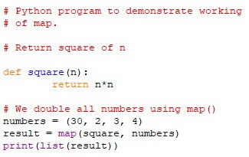
Map() Function
Example1:
Utilizing map() to square a list of numbers
Code: Output:

Slide 5
Map() Function
Example1:
Utilizing map() to square a list of numbers
Code: Output:

Slide 6
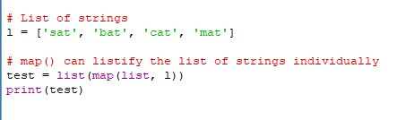
Map() Function
Example2:
Utilizing map() without using functions.
Code: Output:

Slide 7
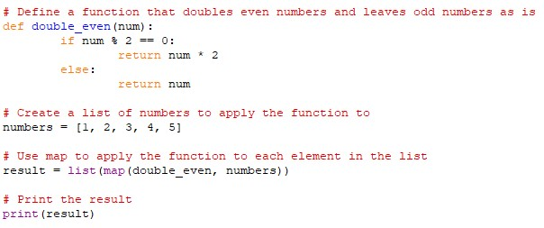
Map() Function
Example3:
Utilizing map() with if statement.
Code: Output:

Slide 8
Thank You

