Slide 1
List comprehension

Slide 2
List Comprehension
List comprehension:
List comprehension in python is an easy and compact syntax for creating a list from a string or another list.
It is very concise way to create a new list by performing an operation on each item in the existing list.
List comprehension is considerably faster than processing a list using the for loop.
Syntax:
newList=[expression(element) for element in oldList if condition]

Slide 3
List comprehension
Key points to remember:
List comprehension is an elegant way to define and create lists based on existing lists.
List comprehension is generally more compact and faster than normal functions and loops for creating list.
However, we should avoid writing very long list comprehension in one line to ensure that code is user – friendly.
Remember, every list comprehension can be rewritten in for loop, but every for loop can’t be rewritten in the form of list comprehension.

Slide 4
List Comprehension
Advantages of List comprehension:
More time- efficient and space-efficient than loops.
Require fewer lines of codes.
Transforms iterative statement into a formula.

Slide 5


List Comprehension
Example1:
Iteration with list comprehension.
Code: Output:

Slide 6


List Comprehension
Example2:
Even list using list comprehension.
Code: Output:

Slide 7
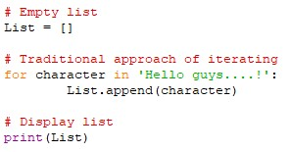

List Comprehension
List comprehension vs for loop:
For loop: List Comprehension:
Output:

Slide 8
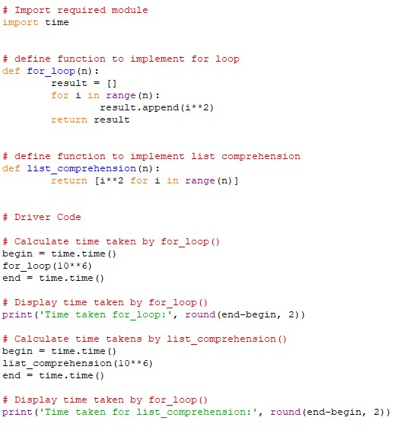

List Comprehension
Time analysis in list comprehension and for loop:
Example: Output:

Slide 9
Thank You

