Slide 1
About Python

Slide 2
About Python
Python Introduction:
Python is a widely used general-purpose, high level programming language.
It was designed with an emphasis on code readability.
It’s syntax allows programmers to express their concepts in fewer lines of code.
Python is maintained by Python Software Foundation a non-profit-membership organization and a community devoted to developing, improving, expanding and popularizing the python language and its environment.

Slide 3
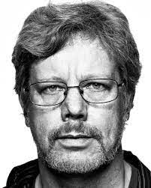

About Python
Python History:
Python was developed by Guido Van Rossum in February 20 1991.
Many think the name python is used after the large snake python.
Actually, The name of python programming language comes from an old BBC television comedy sketch series called “Monty Python’s Flying Circus”.
One of the amazing features of Python is the fact that is actually one person’s work.
If you read the python documentations, you will see many examples that are inspired by the Monty Python comedy series, we can see mention of spam, eggs, lumberjack etc..

Slide 4
About Python
Why Python?
It is easy to learn: The time needed to learn Python is shorter than for many other languages, This means that it is possible to start the actual programming faster.
It is easy to use for writing new software: It’s often possible to write code faster when using python.
It is easy to obtain, Install and deploy: Python is free, open and multiplatform.

Slide 5
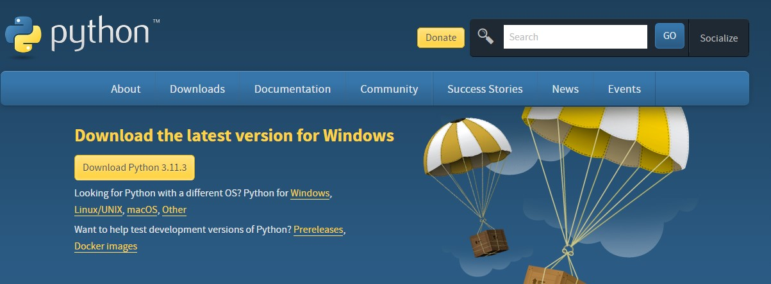
About Python
Install Python:
Download Python installer from official website.
Double click the Python Executable Installer.

Slide 6
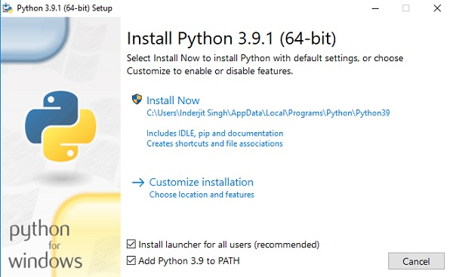
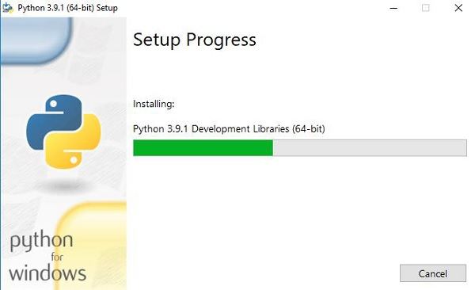
About Python
After opening the installer, Click Install Now.
Wait Until the installation is completed.

Slide 7
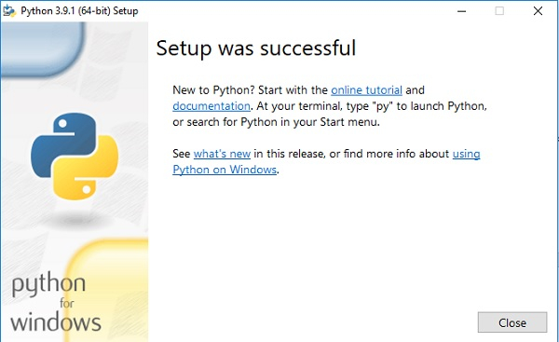
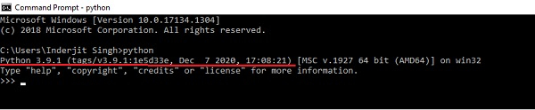
About Python
Once the installation is successful, The following screen is displayed.
To verify the python installation open command prompt and type “python”.

Slide 8

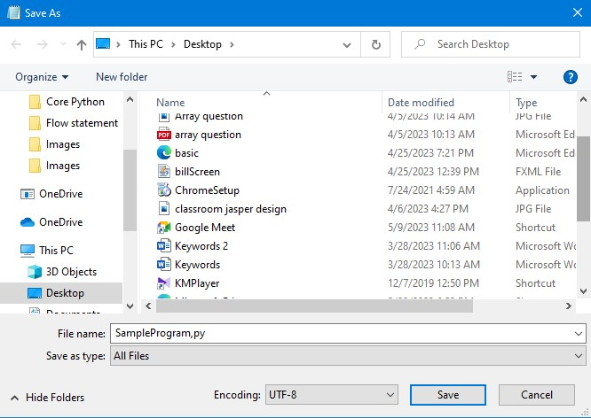
About Python
Writing a simple program using Notepad:
Open your Text editor and write following code.
Now, save your file with following extension(.py) and save as type as (all files).

Slide 9



About Python
An python file will be created on your destined location.
Open command prompt and redirect it to your file location.
Now type python and after an space type the filename with .py extension.
We have successfully executed our first python program.

Slide 10

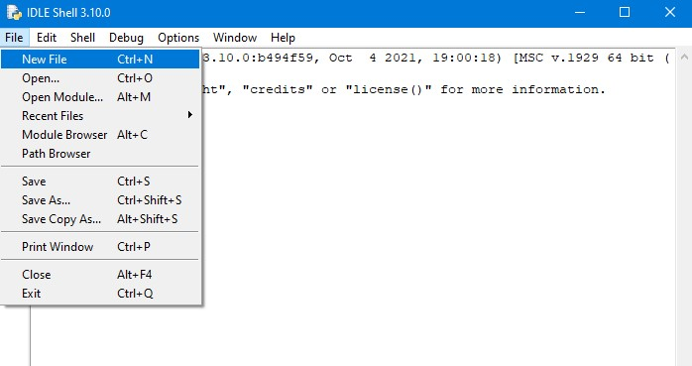
About Python
Writing a Simple Program using IDLE:
Open IDLE python application.
After opening the IDE select file and select new file.

Slide 11
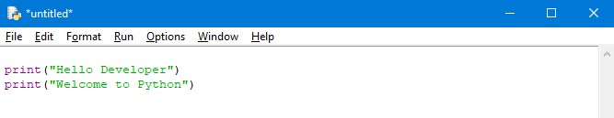
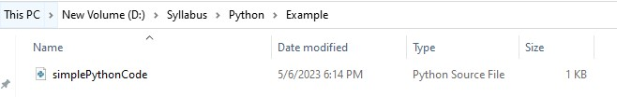
About Python
After opening new file write the following code.
Select save as from file menu and give your file a name.

Slide 12
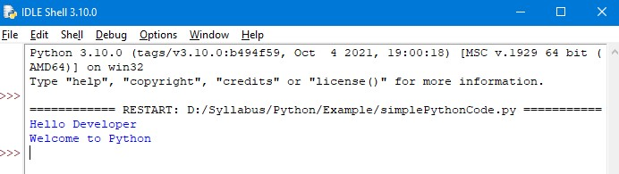
About Python
Run the python file by pressing F5.
Hurray! Our program has been executed successfully.

Slide 13
Thank You

