Slide 1
Generator

Slide 2
Generator
Generator:
A generator in python is a function that returns an iterator using the Yield keyword.
A generator function in python is defined like a normal function, but whenever it needs to generate a value, it does so with the yield keyword rather than return.
If the body of a def contains yield, the function automatically becomes a Python generator function.

Slide 3
Generator
Create a Generator:
We can create a generator function by simply using the def keyword and the yield keyword.
Syntax:
def function_name():
yield statement

Slide 4
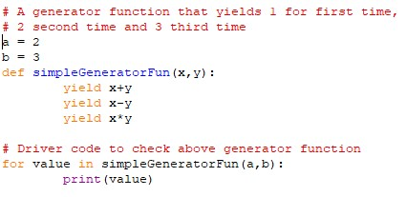

Generator
Example: Output:

Slide 5
Generator
Generator object:
Python Generator functions return a generator object that is Iterable.
Generator objects are used either by calling the next method of the generator object or using the generator object in a “for in ” loop.

Slide 6
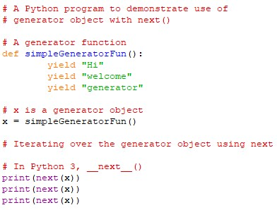

Generator
Example: Output:

Slide 7
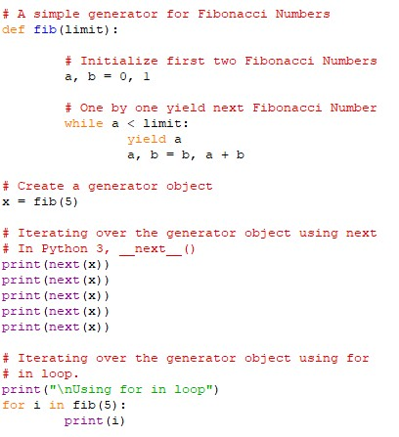
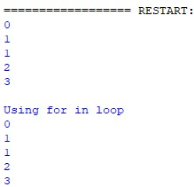
Generator
Example:
In this example we will create two generators for Fibonacci Numbers, first a simple generator and second generator using for loop.
Code: Output:

Slide 8
Generator
Generator Expression:
Generator Expression is another way of writing the generator function.
It uses the python list comprehension technique.
Instead of storing the elements in a list memory, It creates a generator objects.
Syntax:
(expression for item in iterable)

Slide 9


Generator
Example: Output:

Slide 10
Generator
Advantages:
Easier to built iterators using generators.
They are memory efficient since they produce one item at a time.
They can represent an infinite stream of data.

Slide 11
Generator
Disadvantages:
Every time you want to reuse the elements in a collection it must be regenerated.
Your code could be more trickier to read when performing lazy evaluation.

Slide 12
Thank You

