Slide 1
Lambda Function

Slide 2
Lambda Function
Lambda Function:
Python Lambda Functions are anonymous function means that the function is without a name.
As we already know that the def keyword is used to define a normal function in python.
Similarly, the lambda keyword is used to define an anonymous function in python.
Syntax:

Slide 3
Lambda Function
Points to remember:
This function can have any number of arguments but only one expression, which is evaluated and returned.
One is free to use lambda functions wherever function objects are required.
You need to keep in your knowledge that lambda functions are syntactically restricted to a single expression.
It has various uses in particular fields of programming besides other types of expression in functions.

Slide 4

Lambda Function
Example: Output:

Slide 5
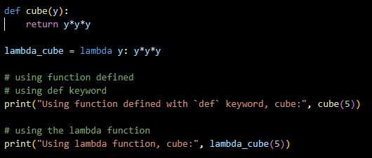

Lambda Function
Difference between lambda and normal function:
Example: Output:

Slide 6

Lambda Function
Condition checking using lambda function:
Example: Output:

Slide 7
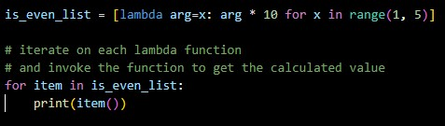

Lambda Function
Lambda function with list comprehension:
Example: Output:

Slide 8
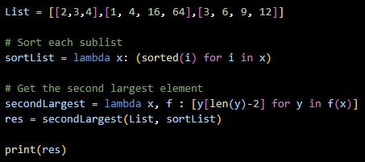
Lambda Function
Lambda function with Multiple statements:
Example: Output:

Slide 9

Lambda Function
Filter():
The filter() function in python takes in a function and a list as arguments.
This offers an elegant way to filter out all the elements of a sequence for which the function returns True.
Example: Output:

Slide 10
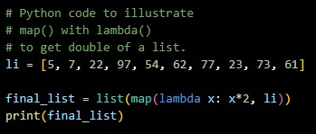
Lambda Function
Lambda function with map():
Example: Output:

Slide 11
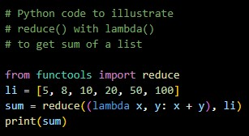
Lambda Function
Lambda function with map():
Example: Output:

Slide 12
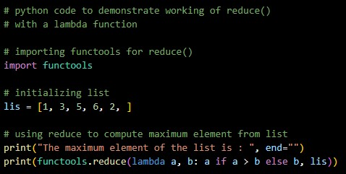
Lambda Function
Lambda function with map():
Example: Output:

Slide 13
Thank You

