Slide 1
Regular Expression

Slide 2
Regular Expression
Regular Expression:
A Regular Expressions(RegEx) is a special sequence of characters that uses a search pattern to find a string or set of strings.
It can detect the presence or absence of a text by matching it with a particular pattern and also can split a pattern into one or more sub patterns.
Python provides a re module that supports the use of regex in python.
Its primary function is to offer a search where it takes a regular expression and a string.

Slide 3
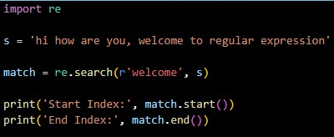

Regular Expression
Example: Output:

Slide 4
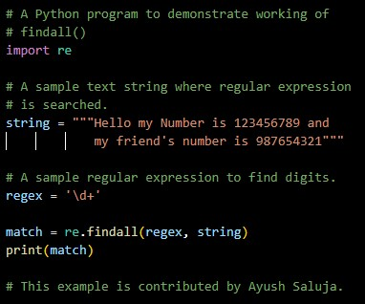
Regular Expression
re.findall():
Return all non-overlapping matches of pattern in string as a list of Strings.
The string is scanned left – to – right and matches are returned in the order found.
Example: Output:

Slide 5
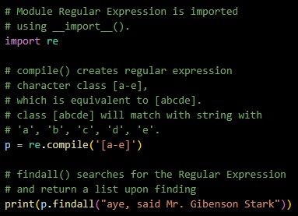
Regular Expression
re.compile():
Regular expressions are compiled into pattern objects.
Which have methods for various operations such as searching for pattern matches or performing string substitutions.
Example: Output:

Slide 6
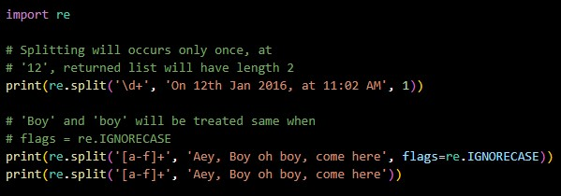

Regular Expression
re.split():
Split string by the occurrences of a character or a pattern, upon finding that pattern, the remaining characters from the string are returned as part of the resulting list.
Example: Output:

Slide 7
Regular Expression
re.sub():
The ‘sub’ in the function stands for SubString, a certain regular expression pattern is searched in the given string(3rd parameter) and upon finding the substring pattern is replaced by repl(2nd parameter).
Count checks and maintains the number of times this occurs.

Slide 8
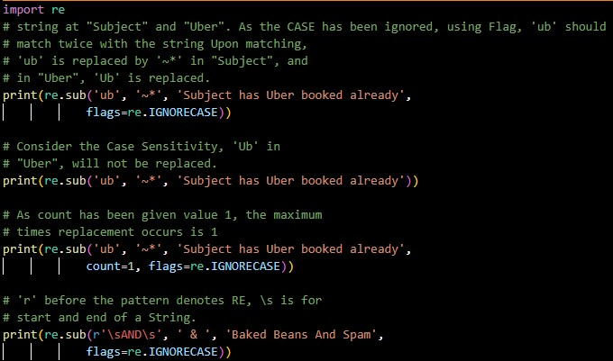

Regular Expression
Example: Output:

Slide 9
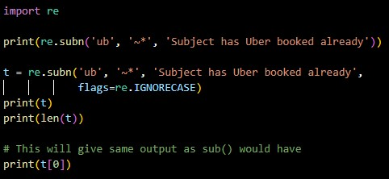

Regular Expression
re.subn():
Subn() is similar to sub() in all ways, except in its way of providing output.
It returns a tuple with a count of the total of replacement and the new string rather than just the string.
Example: Output:

Slide 10
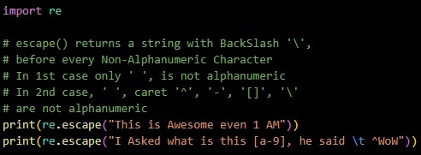
Regular Expression
re.escape():
Returns string with all non - alphanumerics backslashed, this is useful if you want match an arbitrary literal string that may have regular expression metacharacters in it.
Example: Output:

Slide 11
Regular Expression
re.search():
This method either returns none or a re.MatchObject contains information about the matching part of the string.
This method stops after the first match, so this is best suited for testing a regular expression more than extracting data.

Slide 12
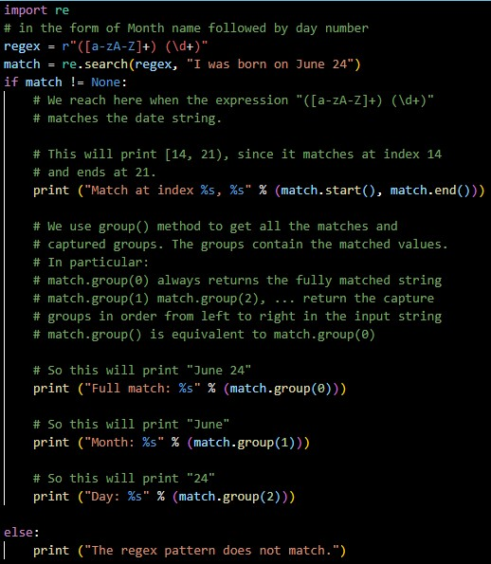

Regular Expression
Example: Output:

Slide 13
Thank You

