Slide 1
Threading

Slide 2
Threading
Thread:
A thread is an entity within a process that can be scheduled for execution. Also, it is the smallest unit of processing that can be performed in an OS(Operating System).
In simple words, a thread is a sequence of such instructions within a program that can be executed independently of other code.
For simplicity, you can assume that a thread is simply a subset of a process. A thread contains all this information in a TCB(Thread Control Block).

Slide 3
Threading
Thread Control Block:
Thread Identifier: Unique id(TID) is assigned to every new thread.
Stack pointer: Points to the thread’s stack in the process. The stage contains the local variables under the thread’s scope.
Program Counter: a register that stores the address of the instruction currently being executed by a thread.
Thread State: can be running, ready, waiting, starting or done.
Thread’s register set: registers assigned to thread for computations.
Parent process pointer: A pointer to the Process control block (PCB) of the process that the thread lives on.

Slide 4
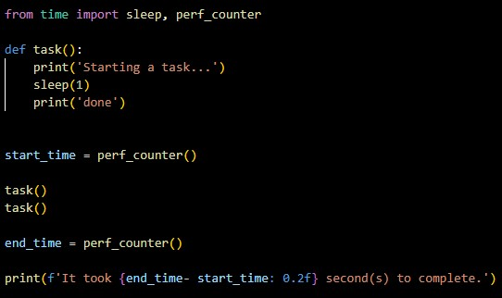

Threading
Basic function without using thread:
Example: Output:

Slide 5
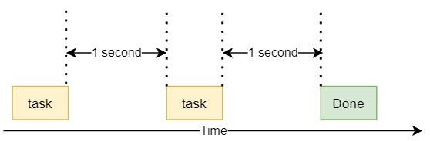
Threading
Flow diagram of previous Example:

Slide 6
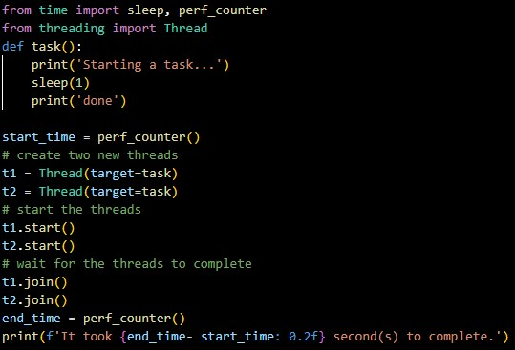

Threading
By using thread:
Example: Output:

Slide 7
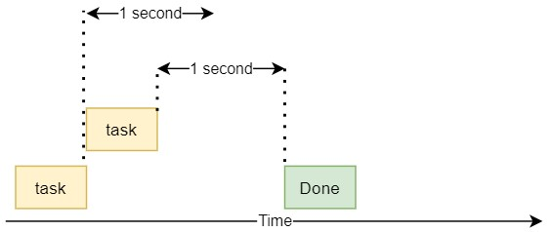
Threading
Flow diagram of previous Example:

Slide 8
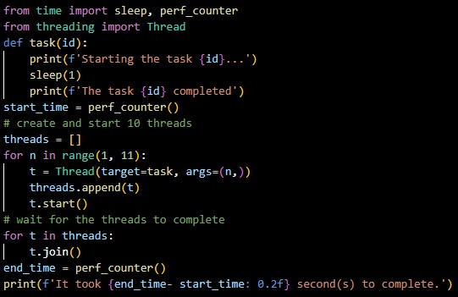
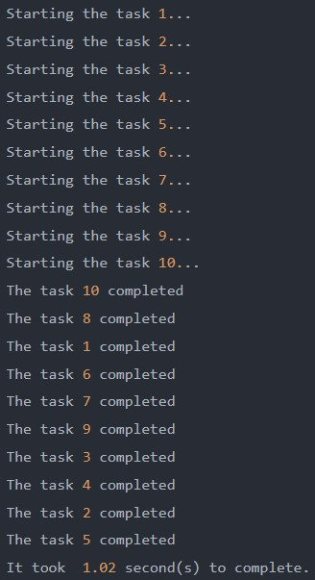
Threading
Passing Arguments to threads:
Example: Output:

Slide 9
Threading
When to use Python Threading:
I/O bound tasks: The I/O bound tasks spend more time doing I/O than doing computations. For Example: network requests, database connections and file reading/writing.
CPU-bound tasks: The CPU bound tasks use more time doing computation than generating I/O requests. For Example: finding prime numbers, video streaming.

Slide 10
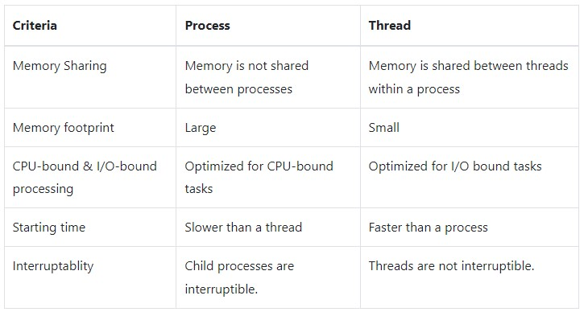
Threading
Difference between processes and threads:

Slide 11
Thank you

