Slide 1
Operators

Slide 2
Operators
What is an Operator?
An Operator is a character that represents a specific mathematical or logical action or process.
The values that an operator acts on are called operands.
Some important operators programmers use :
Arithmetic operator
Assignment operator
Logical operator

Slide 3
Operators
Types Of Operators:
Arithmetic Operator
Assignment Operator
Comparison Operator
Logical Operator
Identity Operator
Membership Operator

Slide 4
Operators
Arithmetic operator:
Arithmetic operators are used with numeric values to perform common mathematical operations.

Slide 5
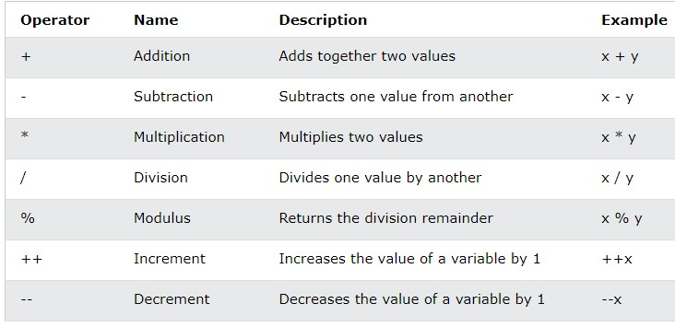
Operators
Arithmetic operator:

Slide 6
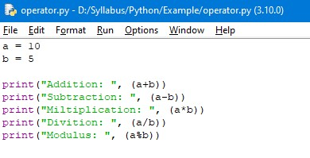
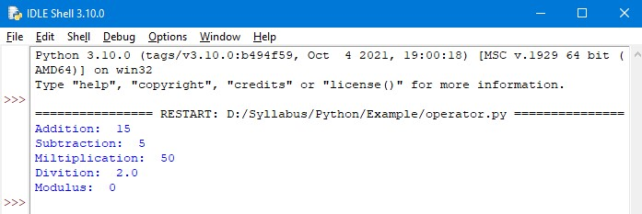
Operators
Example: Output:

Slide 7
Operators
Assignment operator:
Assignment operator is used to assign the value, variable and function to another variable.

Slide 8
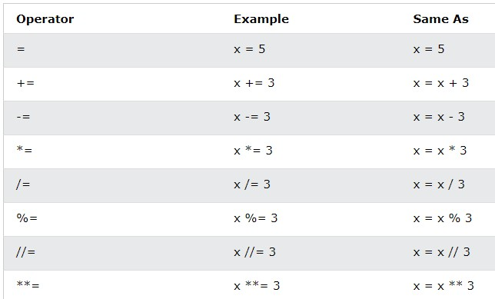
Operators
Assignment operator:

Slide 9
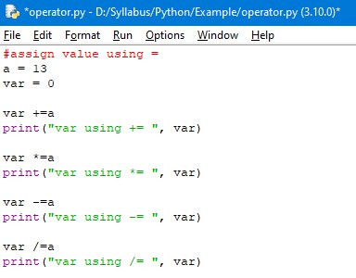
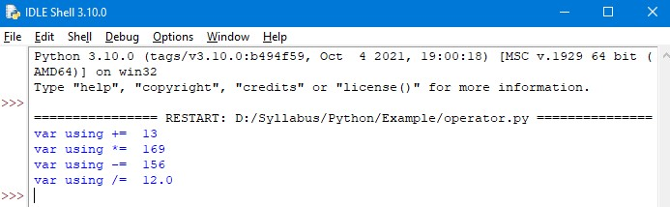
Operators
Example: Output:

Slide 10
Operators
Comparison operator:
Comparison operators are used to Compare two values.
If the condition is true it returns true. Else, it returns false.

Slide 11
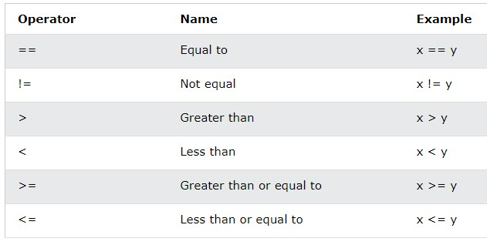
Operators
Comparison operator:

Slide 12
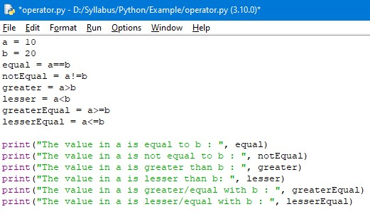
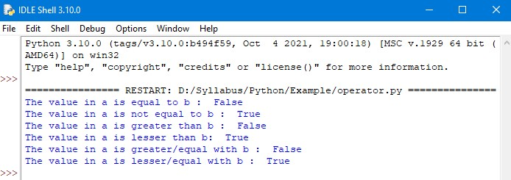
Operators
Example: Output:

Slide 13
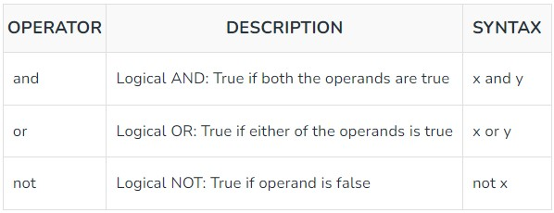
Operators
Logical operator:
Logical operators are used on conditional statements.

Slide 14
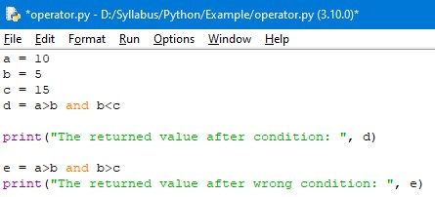
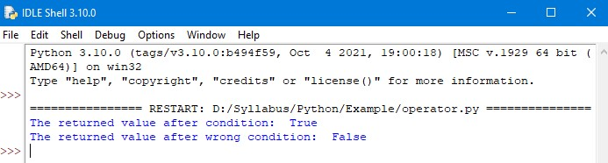
Operators
Logical AND operator:
Logical and operator returns True if both the operands are True else it returns False.
Example: Output:

Slide 15
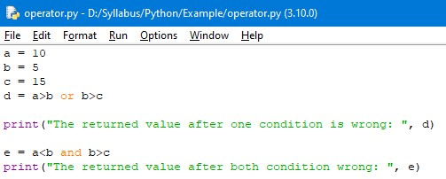
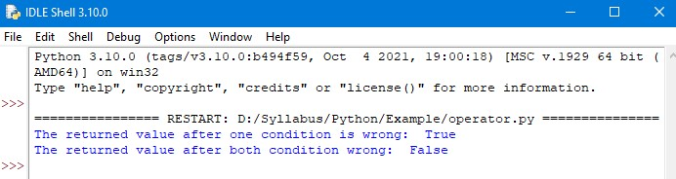
Operators
Logical OR operator:
Logical or operator returns True if either of the operands are True, else it returns False.
Example: Output:

Slide 16
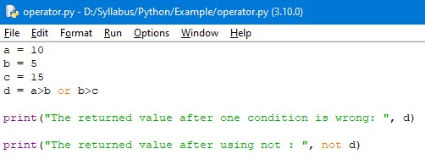
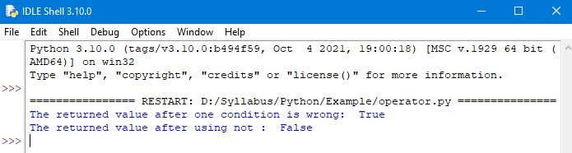
Operators
Logical NOT operator:
Logical not operator works with single boolean value.
If the boolean value is True it returns False and vice-versa.
Example: Output:

Slide 17
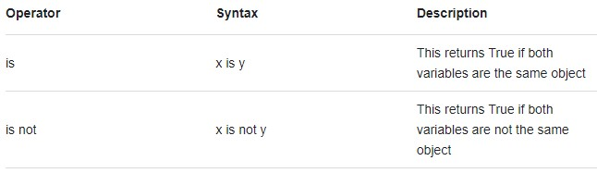
Operators
Identity operator:
Identity operators are used to compare two object whether the objects are same and share same memory location.

Slide 18
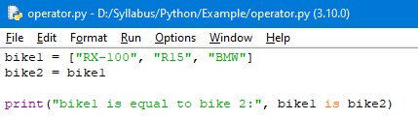
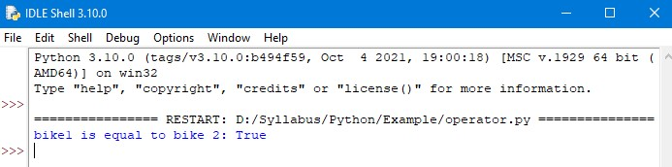
Operators
Identity is operator:
Identity is operator evaluates to True if the variables on either side of the operator point is the same objects. else, false.
Example: Output:

Slide 19
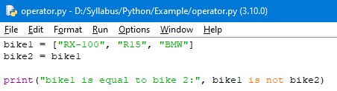
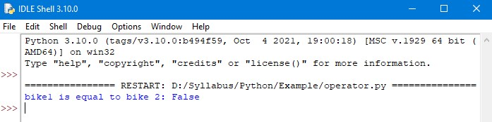
Operators
Identity is not operator:
Identity is not operator evaluates to True if both variables are not same the same objects. Else, False.
Example: Output:

Slide 20
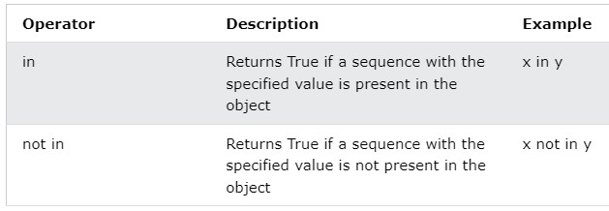
Operators
Membership operator:
Membership operators are used to test if a sequence is presented in an object.

Slide 21
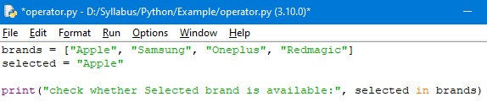
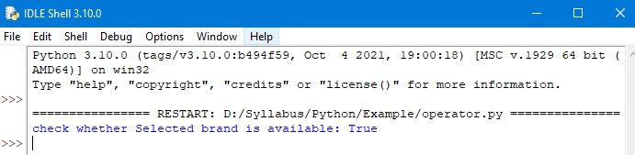
Operators
Membership in operator:
The in operator is used to check is a character exists in a sequence or not.
Example: Output:

Slide 22
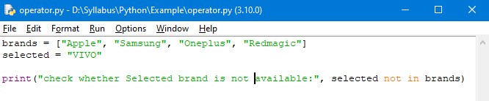
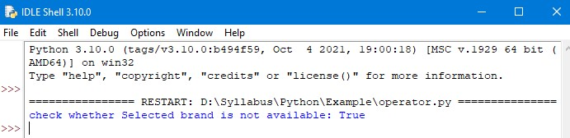
Operators
Membership not in operator:
The not in operator evaluates to true if it does not find a variable in the specified sequence and false otherwise.
Example: Output:

Slide 23
Thank You

