Slide 1
Flow Statement

Slide 2
Flow Statement
Flow Statement:
Control flow is the order in which the program’s code executes.
The control flow of a python program is regulated by conditional statements, loops and function calls.
Three types of control structures:
Sequential statement
Conditional statement
Looping statement

Slide 3
Flow Statement
Sequential statement:
Sequential statements are a set of statements whose execution process happens in a sequence.
The problem with sequential statements is that if the logic has broken in any one of the lines, then the complete source code execution will break.
It is the default mode of execution.

Slide 4
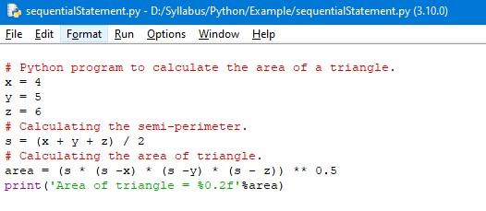
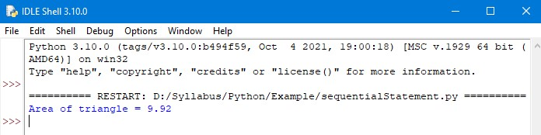
Flow Statement
Example: Output:

Slide 5
Flow Statement
Conditional Statement:
A conditional statement is also known as selection control statement and decision control statement.
It is based on the condition or decision.
If the condition is true, then the block of statement will be executed.
If the condition is false, then the block of statements will not execute.
Three conditional statement:
If statement
If – else statement
If – elif – ladder statement
Nested if statement

Slide 6
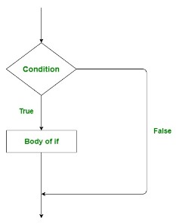
Flow Statement
If statement:
If statement is used to run a set of codes only when the given condition is true.
If statement work flow:

Slide 7
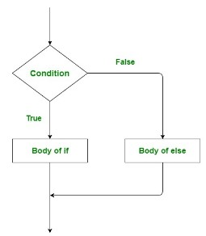
Flow Statement
If – else statement:
If…else statement executes a block of codes if an condition is True, if the condition is false another block of codes will be executed.
If – else statement work flow:

Slide 8
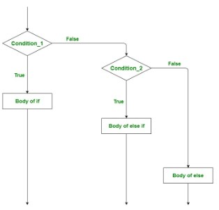
Flow Statement
If – elif – else ladder:
If…elif…else statement helps us to make choices more than two alternatives.
If – elif – else ladder:

Slide 9
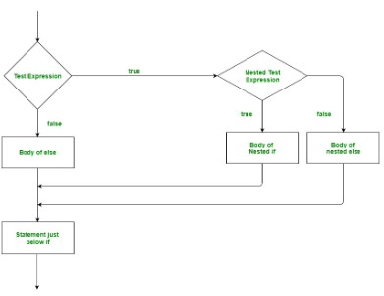
Flow Statement
Nested if statement:
The Nested If Statements are the nesting of an if statement inside another if statement inside another if statement with or without an else statement.
Nested if statement work flow:

Slide 10
Flow statement
Looping Statement:
A loop control statement allows us to execute or repeat a statement or a group of code multiple times.
As long as the test condition is true, a block of code is repeated again and again.
Types of Loop control statement:
For loop
While loop

Slide 11
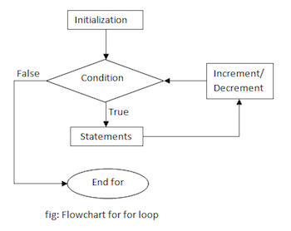
Flow Statement
For loop:
For loop is a counting loop that repeats a block of statements a certain number of times.
For loop work flow:

Slide 12
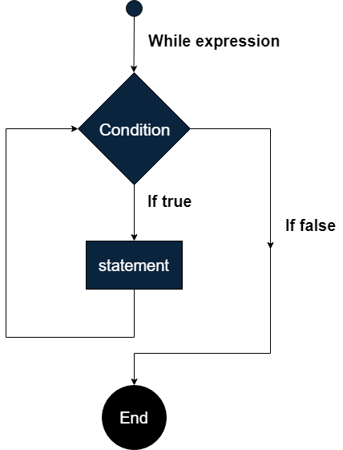
Flow Diagram
While Loop:
While loop is a conditional loop that keeps repeating a set of statements as long as some test condition is true.
While Loop work flow:

Slide 13
Thank You

