Slide 1
Array

Slide 2
Arrays
What is an array?
Array is a container which can hold a fix number of items and these items should be of the same type.
Terms used in array:
Element: Each item stored in an array is called an element.
Index: Each location of an element in an array has a numerical index, which is used to identify the element.

Slide 3

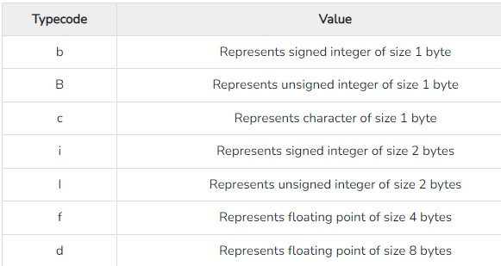
Arrays
Syntax:
In above example type code are the codes that are used to define the type of value the array will hold.

Slide 4
Array
Array Operations:
Traverse Operation
Insertion Operation
Deletion Operation
Search Operation
Update Operation

Slide 5
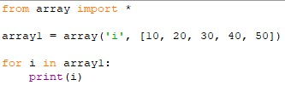
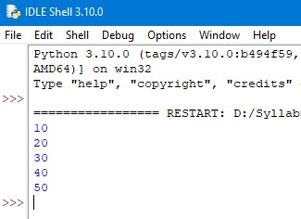
Arrays
Array Operations:
Traverse operation:
This operation is used to print all the array elements one by one.
Example: Output:

Slide 6
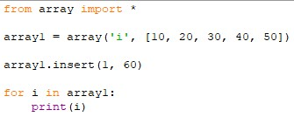
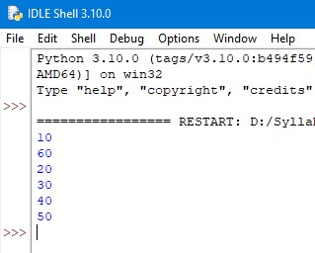
Arrays
Array Operations:
Insertion operation:
Insertion operation is used to insert one or more data elements into an array.
Example: Output:

Slide 7
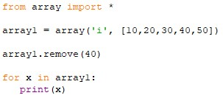
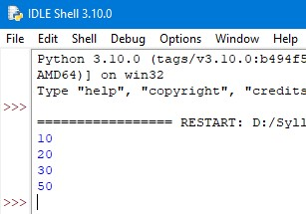
Arrays
Array Operations:
Deletion operation:
Deletion refers to removing an existing element from the array and re-organizing all elements of an array.
Example: Output:

Slide 8

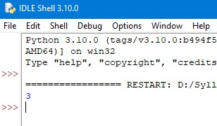
Arrays
Array Operations:
Search operation:
This operation searches an element using the given index or by the value.
Example: Output:

Slide 9
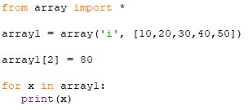
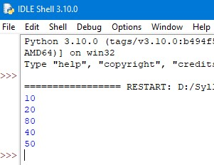
Arrays
Array Operations:
Update operation:
Update operation refers to updating an existing element from the array.
Example: Output:

Slide 10
Thank You

