Slide 1
Type Casting

Slide 2
Type casting
What is Type casting?
Type casting is a method or process that converts a datatype into another datatype in both ways manually and automatically.
The automatic conversion is done by the compiler and manual conversion is done by the programmer.
Types of type casting:
Implicit Type Casting
Explicit Type Casting

Slide 3
Type Casting
Implicit Type Casting:
This method converts the datatype into another datatype automatically.
In this process, users don’t have to change the types.

Slide 4
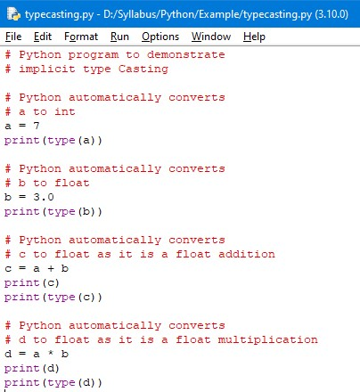
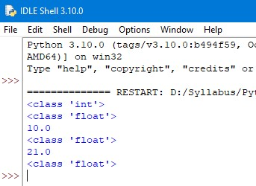
Type Casting
Example: Output:

Slide 5
Type Casting
Explicit Type Casting:
This method needs user involvement to convert the variable data type into a certain datatype in order to the operation required.
Type casting can be done with the following datatype functions.
Int(): python int() function take float or string as an argument and returns int type object.
Float(): Python float() function take int or string as an argument and return float type object.
Str(): Python str() function takes float or int as an argument and returns string type object.

Slide 6
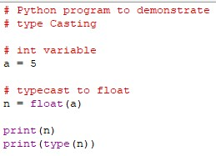
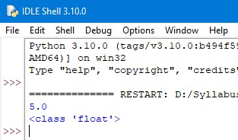
Type Casting
Python int to float:
Example: Output:

Slide 7
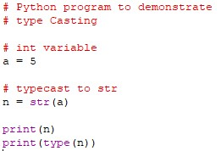
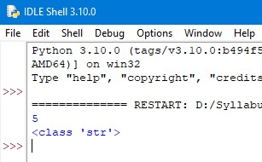
Type Casting
Python int to string:
Example: Output:

Slide 8
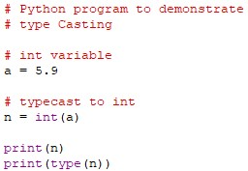
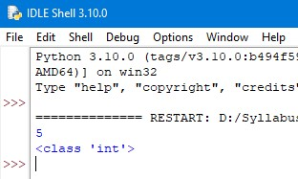
Type Casting
Python float to int:
Example: Output:

Slide 9
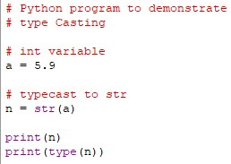
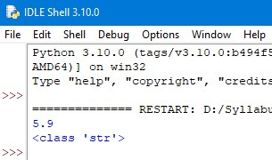
Type Casting
Python float to string:
Example: Output:

Slide 10
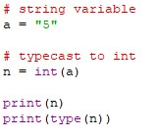
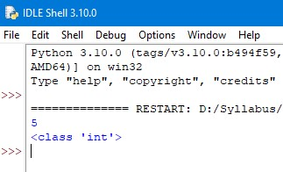
Type Casting
Python string to int:
Example: Output:

Slide 11
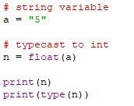
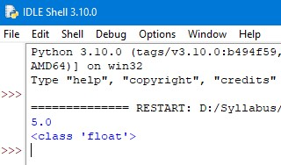
Type Casting
Python string to float:
Example: Output:

Slide 12
Thank You

