Slide 1
Constructor

Slide 2
Constructor:
What is Constructor?
Constructors are generally used for instantiating an object.
The task of constructors is to initialize(assign value) to the data members of the class when an object of the class is created.
In python the __init__() method is called the constructor and is always called when an object is created.
Types of Constructors:
Non-parameterized Constructor
Parameterized Constructor

Slide 3
Constructor
__init__() method:
The __init__method is similar to constructor in c++ and Java.
Constructors are used to initializing the object’s state.
Like methods, a constructor also contains a collection of statements that are executed at the time of Object creation.
It runs as soon as an object of a class is instantiated.
Syntax:
def __init__(self):
#body of the costructor

Slide 4
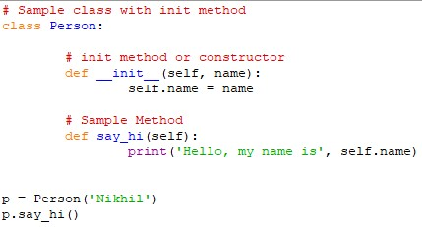
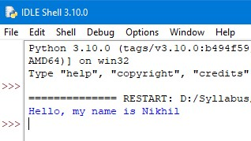
Constructor
Example: Output:

Slide 5
Constructor
Non parameterized Constructor:
The non-parameterized constructor is a simple constructor which doesn’t accept any arguments.
Its definition has only one argument which is a reference to the instance being constructed.

Slide 6
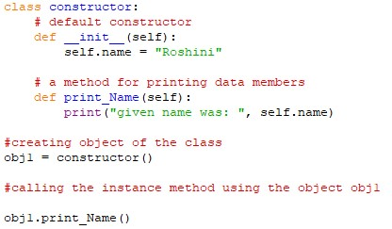
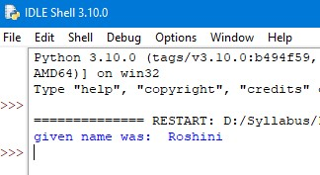
Constructor
Example: Output:

Slide 7
Constructor
Parameterized Constructor:
Constructor with parameters is known as parameterized constructor.
The parameterized constructor takes its first argument as a reference to the instance being constructed known as self and the rest of the arguments are provided by the programmer.

Slide 8
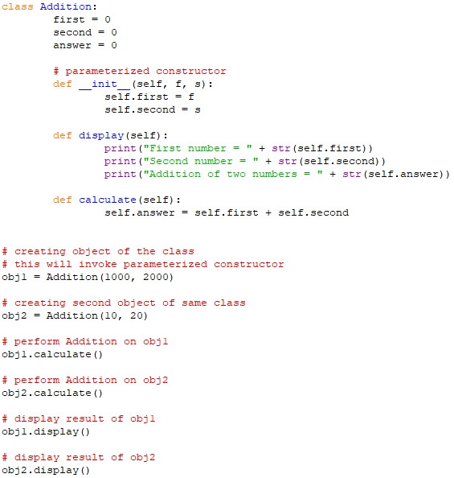
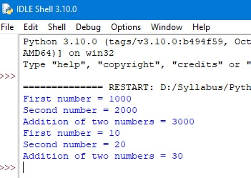
Constructor
Example: Output:

Slide 9
Thank You

