Slide 1
Packages

Slide 2
Packages
What is a Package?
A package is a container that contains various functions to perform specific tasks.
While working on big projects, we have to deal with a large amount of code and writing everything together in the same file will make our code look messy.
Instead we can separate our code into multiple files by keeping the related code together in packages.
We can use package whenever we need it in our projects. This way we can also reuse our code.

Slide 3
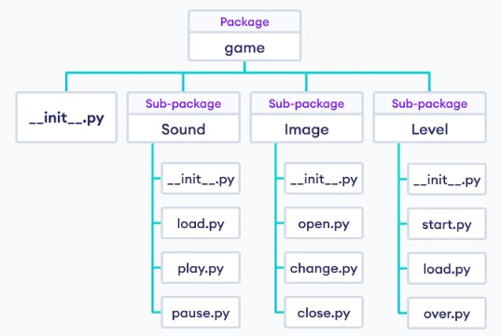
Packages
Package Model Structure:

Slide 4
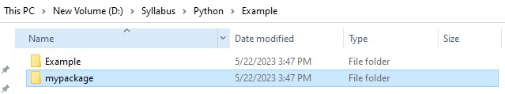
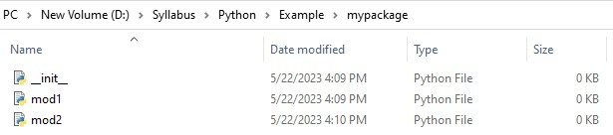
Packages
Creating package:
Create a folder named mypackage.
Inside the folder create an empty Python file named __init__.py.
Then create two files named mod1 and mod2.

Slide 5


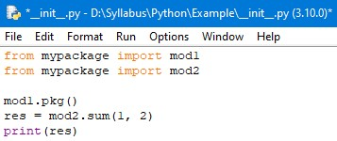
Packages
Write the following code in mod1.py.
Write the following code in mod2.py.
Write the following code in __init__.py.

Slide 6
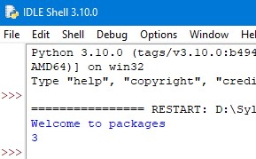
Packages
Now, Run the __init__.py file.
We have executed __init__.py only and mod1.py, mod2.py has been executed.

Slide 7
Packages
Understanding __init__.py:
__init__.py helps the python interpreter recognize the folder as a package.
It also specifies the resource to be imported from the modules.
If the __init__.py is empty this means that all the functions of the modules will be imported.
We can also specify the functions from each module to be made available.

Slide 8
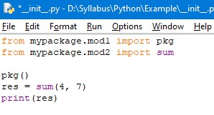
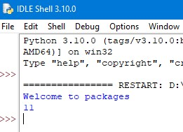
Packages
We can also import the specific function from the module:
Example: Output:

Slide 9
Packages
Advantages:
Packages are useful to arrange all the classes & interface performing the same task.
Packages hide the classes & interfaces in a separate subdirectory, so that accidental deletion of classes & interfaces will not take place.
The classes & interfaces of a packages are isolated from the classes & interfaces of another packages.
Reusability nature of packages makes programming easy.

Slide 10
Thank You

