Slide 1
Access Modifier

Slide 2
Access Modifier
Access Modifiers:
Access Modifiers are used to restrict the access of the class member variable and methods from outside the class.
Python uses ‘_’ symbol to determine the access control for a specific data members or a member function of a class.
Access modifiers in Python have an important role to play in securing data from unauthorized access and in preventing it from being exploited.
Types of Access Modifiers:
Public Access Modifiers
Protected Access Modifiers
Private Access Modifiers

Slide 3
Access Modifier
Public Access Modifier:
By default the member variables and methods are public which means they can be accessed from anywhere outside or inside the class.
No public keyword is required to make the class or methods and properties public.

Slide 4
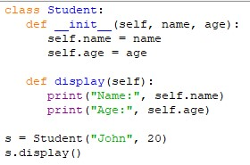
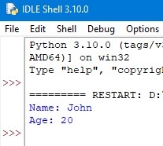
Access Modifier
Example: Output:

Slide 5
Access Modifier
Private Access Modifier:
Class properties and methods with private access modifier can only be accessed within the class where they are defined and cannot be accessed outside the class.
In python private properties and methods are declared by adding a prefix with two underscores(‘__’)before their declaration.

Slide 6
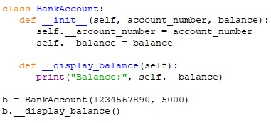
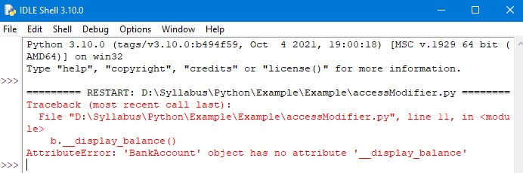
Access Modifier
Example: Output:

Slide 7
Access Modifier
Protected Access Modifier:
Class properties and methods with protected access modifier can be accessed within the class and from the class that inherits the protected class.
In python, protected members and methods are declared using single underscore(‘_’) as prefix before their names.

Slide 8
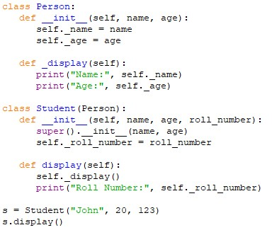
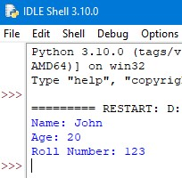
Access Modifiers
Example: Output:

Slide 9
Thank You

