Slide 1
Polymorphism

Slide 2
Polymorphism
What is polymorphism?
Polymorphism means “Many Forms”.
That is, The same entity can perform different operations in different scenarios.
It occurs when we have classes that are related to each other by inheritance.

Slide 3
Polymorphism
Method Overloading :
Method Overloading is the class having methods that are have the same name with different arguments.
Arguments will be will be differed from number of arguments and type of argument.
It is used in a single class.

Slide 4
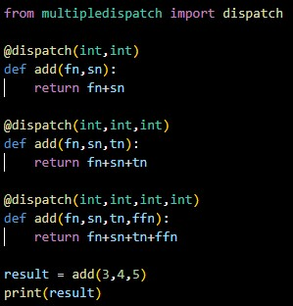
Polymorphism
Example: Output:

Slide 5
Polymorphism
Method Overriding :
Method Overriding in python is when you have two methods with the same name that each perform different tasks.
This is an important feature of inheritance in python.
In method overring the child class can change its functions that are defined by its ancestral classes.

Slide 6



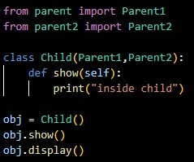
Polymorphism
Example: Output:

Slide 7
Thank You

