Slide 1
Inheritance

Slide 2
Inheritance
What is Inheritance?
Inheritance is the ability to ‘inherit’ features or attributes from already written classes into newer classes we make.
These features and attributes are defined data structures and the functions we can perform with them.
The new class copies all the older class’s functions and attributes without rewriting the syntax in the new classes.
The old class is called as base class.
The new class is called as derived classes.
Syntax:
class DerivedClass(BaseClass):
# class definition

Slide 3
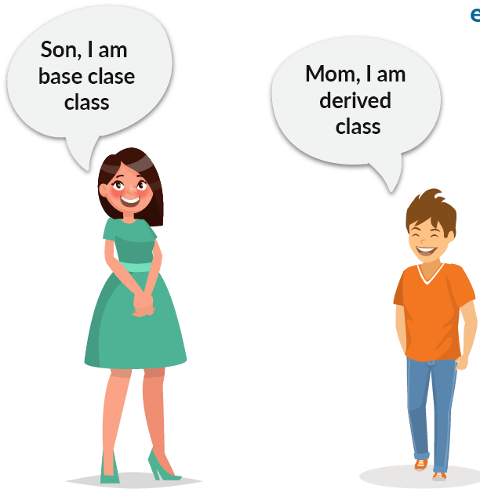
Inheritance
Types of Inheritance:
There are five types of inheritance, They are:
Single Inheritance
Multiple Inheritance
Multilevel Inheritance
Hierarchical Inheritance
Hybrid Inheritance

Slide 4
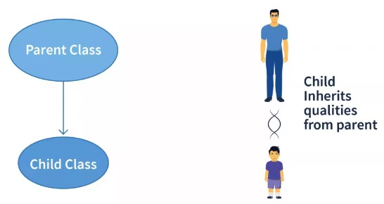
Inheritance
Single Inheritance:
Single inheritance is the simplest form of inheritance where a single child class is derived from a single parent class.
It is also known as Simple Inheritance.

Slide 5
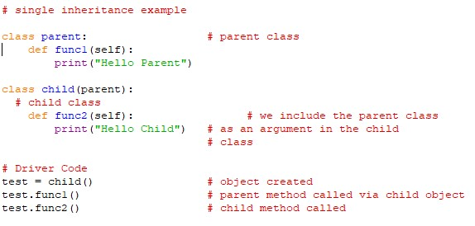
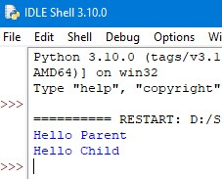
Inheritance
Example: Output:

Slide 6

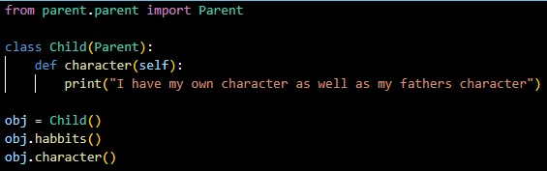
Single Inheritance
Inheriting from new file:
Create a file named parent inside a folder named parent and write the following codes in it.
Now create a file named child outside the parent folder and write the following codes.

Slide 7

Inheritance
Inheriting from new file:
Run the child file.

Slide 8
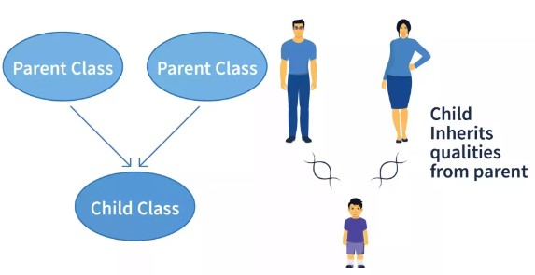
Inheritance
Multiple Inheritance:
In multiple Inheritance, a single child class is inherited from two or more parent classes.
It means the child class has access to all the parent classes methods and attributes.
If two parents have the same “named” methods, the child class performs the method of the first parent in order or reference.

Slide 9
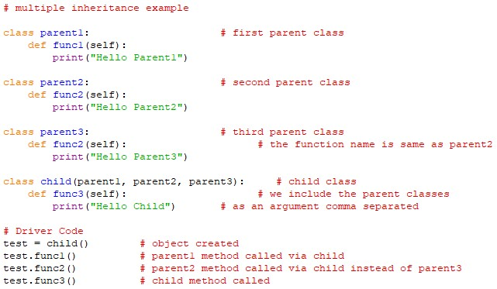
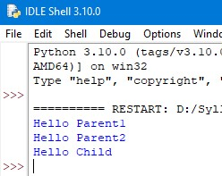
Inheritance
Example: Output:

Slide 10


Inheritance
Example:
Parent1.py:
Parent2.py:

Slide 11


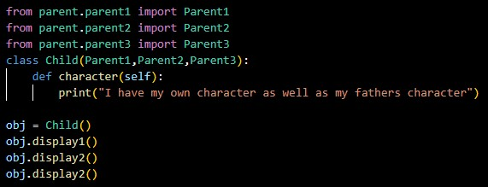
Inheritance
Example: Output:
Parent3.py:
child.py:

Slide 12
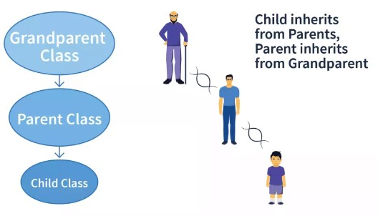
Inheritance
Multilevel Inheritance:
In multilevel inheritance, we go beyond just a parent – child relation.
Here we can have multiple levels where the parent class itself is derived from another class.

Slide 13
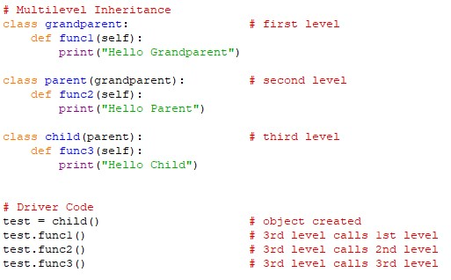
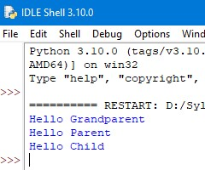
Inheritance
Example: Output:

Slide 14

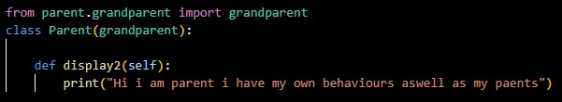
Inheritance
Example:
Grandparent.py:
Parent.py:

Slide 15
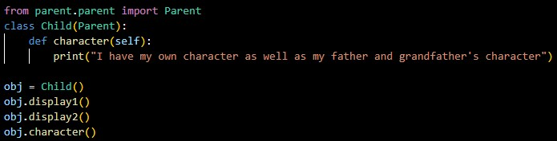

Inheritance
Example:
child.py:
Output:

Slide 16
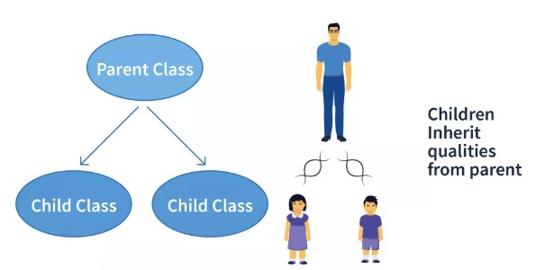
Inheritance
Hierarchical Inheritance:
Hierarchical Inheritance is the right opposite of multiple Inheritance.
It means that there are multiple derived child classes from a single parent class.

Slide 17
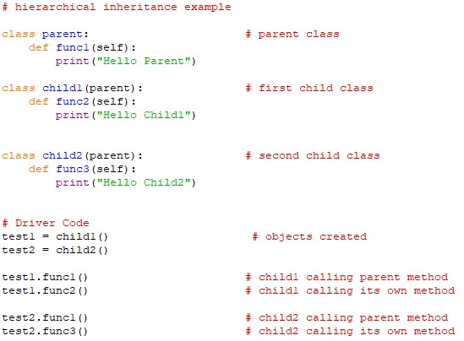
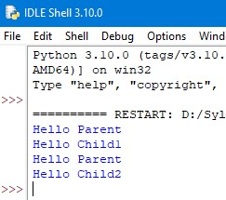
Inheritance
Example: Output:

Slide 18

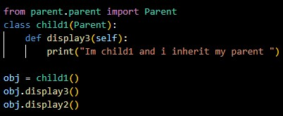
Inheritance
Example:
Parent.py:
Child1.py: Output:

Slide 19
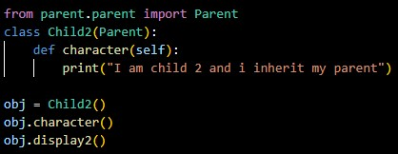

Inheritance
Example:
Parent.py:
Child2.py: Output:

Slide 20
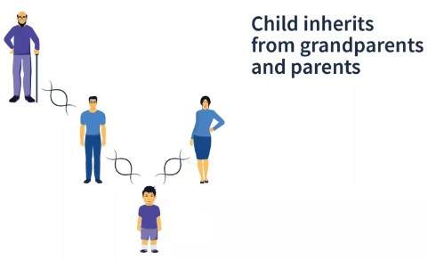
Inheritance
Hybrid Inheritance:
Hybrid Inheritance is the mixture of two or more different types of inheritance.
Here we can have many relationships between parent and child classes with multiple levels.

Slide 21
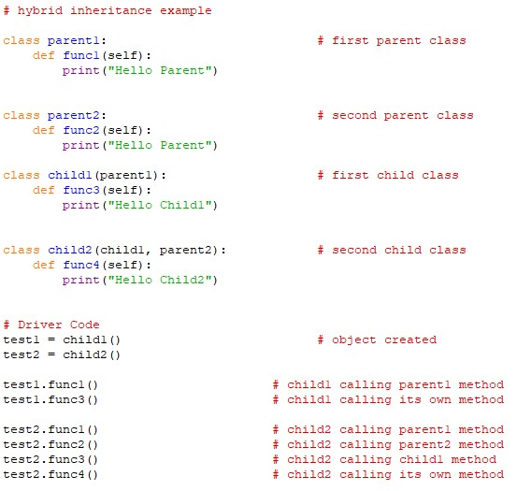
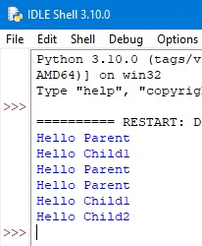
Inheritance
Example: Output:

Slide 22

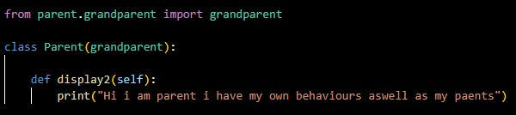
Inheritance
Example:
Grandparent.py:
Parent.py:

Slide 23
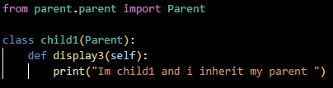

Inheritance
Example:
child1.py:
Parent3.py:

Slide 24
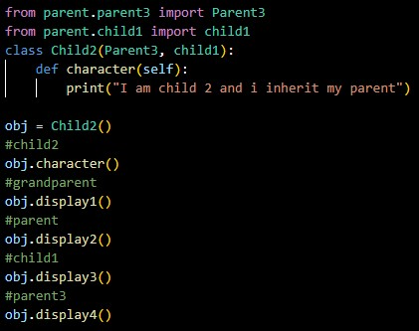

Inheritance
Example:
child2.py:
Output:

Slide 25
Inheritance
Special Functions in Inheritance:
Super() Function:
Method overriding is an ability of any object – oriented programming language that allows a subclass or child class to provide a specific implementation of a method already provided by one of its super-classes or parent classes.
In python method overriding is done by using super() function.

Slide 26


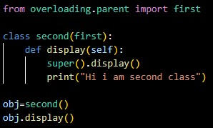
Inheritance
Example: Output:

Slide 27
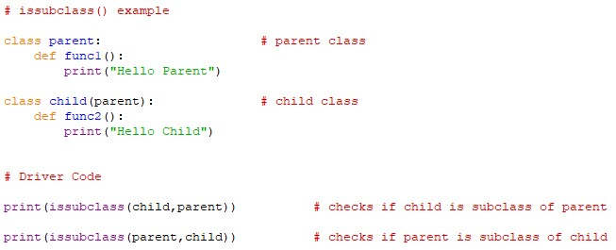
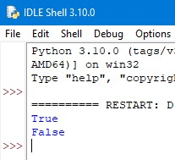
Inheritance
Issubclass():
The issubclass() function is a convenient way to check whether a class is the child of the parent class.
It checks if the first class is derived from the second class.
Example: Output:

Slide 28
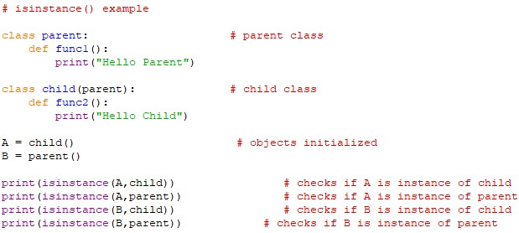
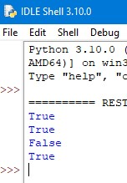
Inheritance
Isinstance():
Isinstance() is another inbuilt function of python that allows us to check whether an object is an instance of a particular class or any of the classes it has been derived from.
It takes two parameters the object and the class we need to check it against.
Example: Output:

Slide 29
Thank You

