Slide 1
Abstraction

Slide 2
Abstraction
What is Abstraction?
Data abstraction is the process of hiding implementational details and showing only functionality to the user.
It shows only the essential things to the user and hides the internal details.
Abstraction is done by using Abstract keyword.

Slide 3
Abstraction
Algorithm To Implement Abstraction:
Determine the classes or interfaces that will be part of the abstraction.
Create an abstract class or interface that defines the common behaviors and properties of these classes.
Define abstract methods within the abstract class or interface that do not have any implementations details.
Implement concrete classes that extend the abstract class or implement the interface.
Override the abstract methods in the concrete classes to provide their specific implementations.
Use the concrete classes to implement the program logic.

Slide 4
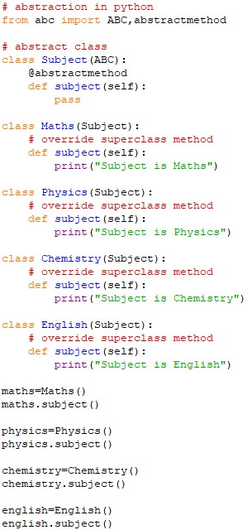
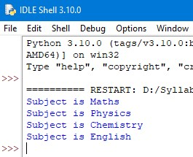
Abstraction Using Abstract Class
Example: Output:

Slide 5
Thank You

