Slide 1
Iterator

Slide 2
Iterator
Iterator:
Iterators are methods that iterate collections like list, tuple etc.
Using an iterator method, we can loop through an object and return its elements.
A python iterator object must implement two special methods __iter__() and __next__(), collectively called the iterator protocol.

Slide 3
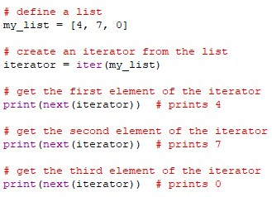

Iterator
Iterating Through Iterator:
In python, we can use the next() function to return the next item in the sequence.
Example: Output:

Slide 4
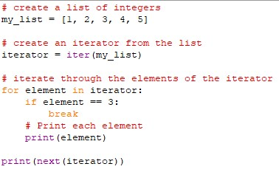

Iterator
Working of for loops for iterators:
Example: Output:

Slide 5
Iterator
Building custom iterators:
Building an iterator from scratch is easy in python. We just have to implement the __iter__() and the __next__() methods.
__iter__() returns the iterator object itself. If required, some initialization can be performed.
__next__() must return the next item in the sequence. On reaching the end, and in subsequent calls, it must raise Stopiteration.

Slide 6
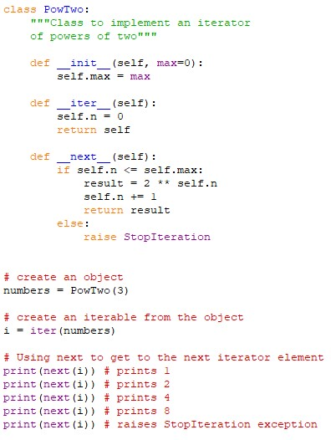
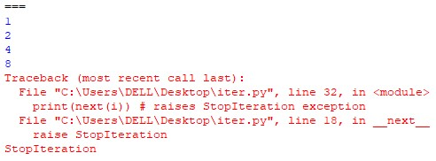
Iterator
Example: Output:

Slide 7
Thank You

