Slide 1
Itertools

Slide 2
Itertools
Itertools:
Itertools is a module in python, it is used to iterate over data structures that can be stopped over using a for-loop.
Such data structures are also known as iterables.
This modules works as a fast, memory-efficient tool that is used either by themselves or in combination to form iterator algebra.
Types of Iterators:
Infinite Iterators
Combinatoric iterators
Terminating iterators

Slide 3
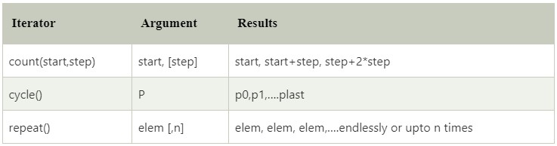
Itertools
Infinite Iterator:
In python, any object that can implement for loop is called iterators.
Iterator can also be infinite and this type of iterator is called infinite iterator.

Slide 4
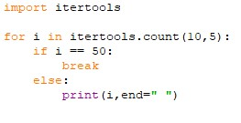

Itertools
count(start, step):
It prints from the start value to infinite.
The step argument is optional, if the value is provided to the step the number of steps will be skipped.
Example: Output:

Slide 5
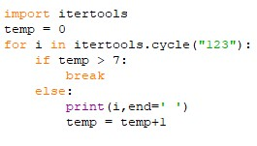

Itertools
cycle(Iterable):
This iterator prints all the value in sequence from the passed argument.
It prints values In a cycle manner.
Example: Output:

Slide 6

Itertools
repeat(value, num):
As the name suggests, it repeatedly prints the passed value for infinite time.
The num argument is used to define the repetation time.
Example: Output:

Slide 7
Itertools
Combinatoric Iterators:
The complex combinatorial constructs are simplified by the recursive generators.
The permutations, combinations and Cartesian products are the example of the combinatoric construct.
Types:
Product()
Permutations()
Combinations()
Combination_with_replacement()

Slide 8
Itertools
Product():
It is used to calculate the cartesian product of input Iterable.
In this function, we use the optional repeat keyword argument for computation of the product of an Iterable with itself.
The repeat keyword represents the number of repetitions.
It returns output in the form of sorted tuples.

Slide 9
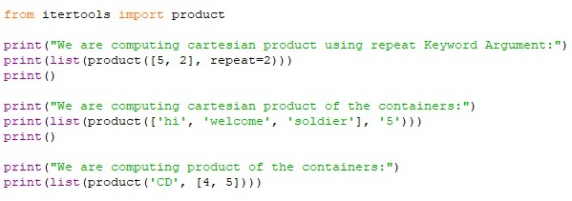
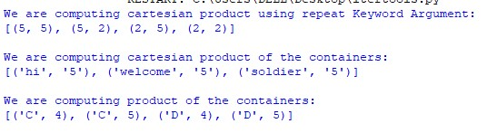
Itertools
Example: Output:

Slide 10
Itertools
Permutations():
It is used to generate all possible permutation of an Iterable.
The uniqueness of each element depends upon their position instead of values.
It accepts two arguments Iterable and group size.
If the value of group size is none or not specified then group size turns into length of the Iterable.

Slide 11

Itertools
Example: Output:

Slide 12

Itertools
Combinations():
It is used to print all the possible combinations(without replacement) of the container which is passed as argument in the specified group size in sorted order.
Example: Output:

Slide 13

Itertools
Combination_with_replacement():
It accepts two arguments, first argument is a r-length tuple and the second argument is repetition.
It returns a subsequence of length n from the elements of the Iterable and repeat the same process. Separate elements may repeat itself in Combination_with_replacement().
Example: Output:

Slide 14
Itertools
Terminating Iterator:
Terminating iterators are generally used to work on the small input sequence and generate the output based on the functionality of the method used in iterator.
Types:
Accumulate()
Chain()
Islice()
Starmap()

Slide 15
Itertools
Accumulate(iter,func):
It takes two arguments, first argument is Iterable and the second is a function which would be followed at each iteration of value in iterable.
If the function is not defined in accumulate() iterator, addition takes place by default.
The output iterable depends on the input iterable.
If input iterable contains no value then the output iterable will also be empty.

Slide 16
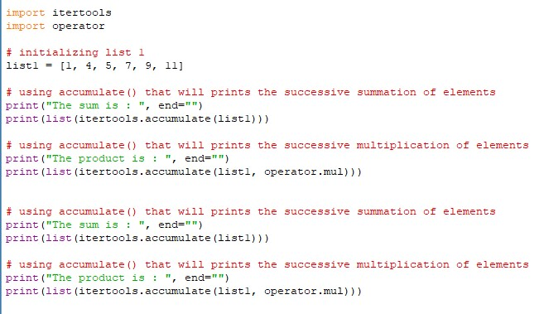

Itertools
Example: Output:

Slide 17
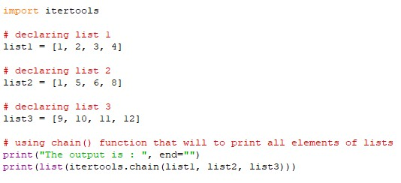
Itertools
Chain(iter1,iter2):
It is used to print all the values in iterable passed in the form of chain and declared in arguments.
Example: Output:

Slide 18
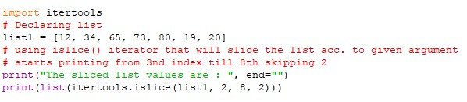

Itertools
islice(iterable,start,stop,step):
It slices the given iterable according to given position.
It accepts four arguments respectively and these are iterable, container, starting position, ending position and step.
Example: Output:

Slide 19
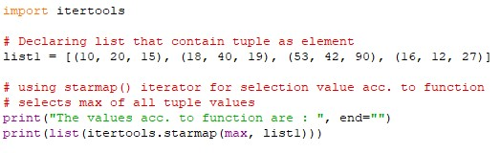
Itertools
starmap(func, tuple list):
It takes two arguments, first argument is function and second argument is list which consists element in the form of tuple.
Example: Output:

Slide 20


Itertools
Zip_longest(iterable1, iterable2, fillval):
It prints the values of iterable alternatively In sequence.
If one of the iterable prints all values, remaining values are filled by the values assigned to fill value.
Example: Output:

Slide 21
Thank You

