Slide 1
Exception Handling

Slide 2
Exception Handling
Exception Handling:
An exception In python is an incident that happens while executing a program that causes the regular course of the program’s commands to be disrupted.
When a python code comes across a condition it can’t handle, it raises an exception.
An object in python that describes an error is called an exception.

Slide 3
Exception Handling
Different types of Exceptions:
SyntaxError:
This exception is raised when the interpreter encounters a syntax error in the code such as misspelled keyword, a missing colon or an unbalanced parenthesis.
TypeError:
This exception is raised when an operation or function is applied to an object of the wrong type such as adding a string to an integer.

Slide 4
Exception Handling
Different types of Exceptions:
NameError:
This exception is raised when a variable or function name is not found in the current scope.
IndexError:
This exception is raised when an index is out of range for a list, tuple or other sequence types.
KeyError:
This exception is raised when a key is not found in a dictionary.

Slide 5
Exception Handling
Different types of Exceptions:
ValueError:
This exception is raised when a function or method is called with an invalid argument or input.
Such as trying to convert a string to an integer when the string does not represent a valid integer.
AttributeError:
This exception is raised when an attribute or method is not found on an object. Such as trying to access a non-existent attribute of a class instance.

Slide 6
Exception Handling
Different types of Exceptions:
IOError:
This exception is raised when an I/O operation such as reading or writing a file, fails due to an input/output error.
ZeroDivisionError:
This exception is raised when an attempt is made to divide a number by zero.
ImportError:
This exception is raised when an import statement fails to find or load a module.

Slide 7
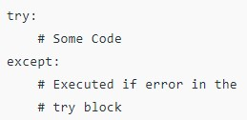
Exception Handling
Try and Except Statement:
Try and Except statement is used to handle these errors within our code in python.
The try block is used to check some code for errors i.e. the code inside the try block will execute when there is no error in the program.
Where as the code inside the except block will execute whenever the program encounters some error in the preceding try block.
Syntax:

Slide 8
Exception Handling
How try() works?
First, the try clause is executed i.e. the code between try.
If there is no exception, then only the try clause will run, except clause is skipped.
If any exception occurs, the try clause will be skipped and except clause will run.
If any exceptions occurs, but the except clause within the code doesn’t handle it. It is passed on to the outer try statements. If the exception is left unhandled, then the execution stops.
A try statement can have more than one except clause.

Slide 9
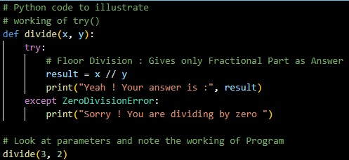
Exception Handling
Example1: Output:

Slide 10
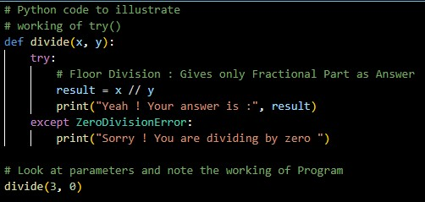
Exception Handling
Example2: Output:

Slide 11
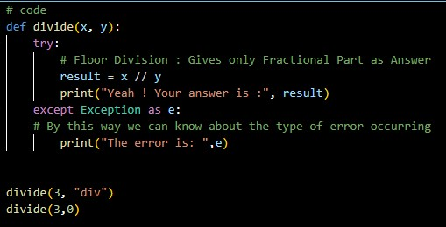
Exception Handling
Example3: Output:

Slide 12
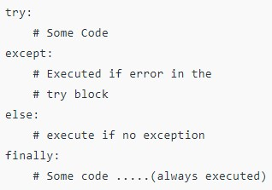
Exception Handling
Finally Keyword:
Python provides a keyword finally, which is always executed after the try and except blocks.
The final block always executes after the normal termination of the try block or after the try block terminates due to some exceptions.
Syntax:

Slide 13
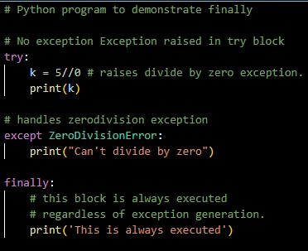

Exception Handling
Example: Output:

Slide 14
Thank You

