Slide 1
Magic Method

Slide 2
Magic Method
Magic Method:
To add “magic” to the class we create, we can define special methods called “magic methods”.
For example: The magic methods __init__ and __str__ are always wrapped by double underscores from both sides.
By granting us accessibility to python’s built-in syntax tools, magic methods can improve the structure of our classes.

Slide 3
Magic Method
__new__()method:
The magic method __new__() is called implicitly by the __init__() method.
The new instance returned by the __new__() method is initialised.
To modify the creation of objects in a user-defined class, we mush supply a modified implementation of the __new__() magic method.
We need to provide the first argument as the reference to the class whose object is to be created for this static function.

Slide 4
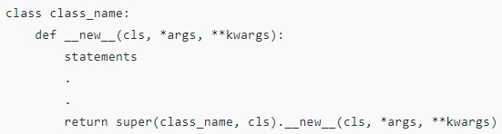
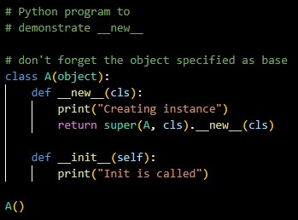

Magic Method
Syntax:
Example: Output:

Slide 5
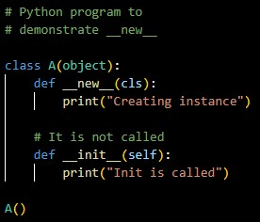
Magic Method
Example: Output:

Slide 6
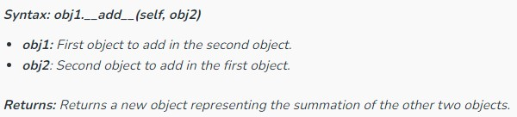
Magic Method
__add__() method:
Python __add__() function is one of the magic methods in python that returns a new object(third) i.e. the addition of the other two objects.
It implements the addition operator “+” in python.
Syntax:

Slide 7
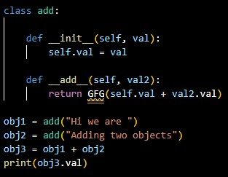
Magic Method
Example: Output:

Slide 8
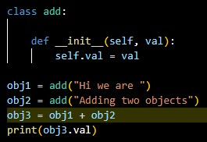
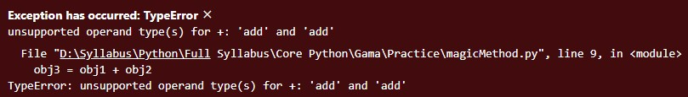
Magic Method
Example: Output:

Slide 9
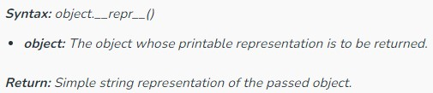
Magic Method
__repr__() Method:
Python __repr__() is one of the magic methods that returns a printable representation of an object in python that can be customized or predefined.
i.e. we can also create the string representation of the object according to our needs.
Syntax:

Slide 10
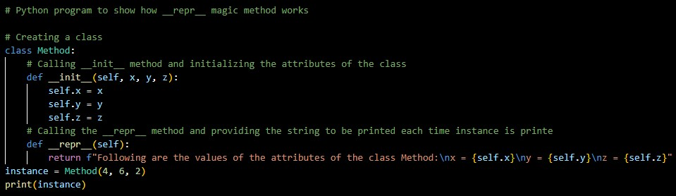

Magic Method
Example:
Output:

Slide 11
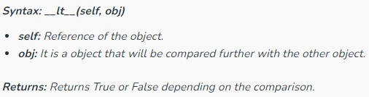
Magic Method
__it__() method:
Python __it__() method is one magic method that is used to define or implement the functionality of the less than operator”<”.
It returns a boolean value according to the condition. i.e. It returns true if a<b where a and b are the objects of the class.
Syntax:

Slide 12
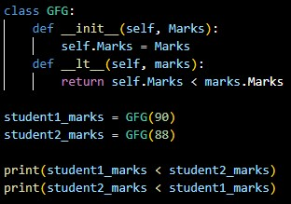

Magic Method
Example: Output:

Slide 13
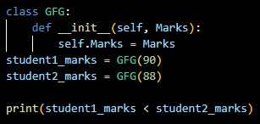
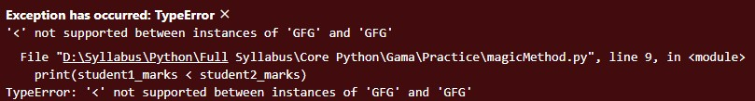
Magic Method
Example: Output:

Slide 14
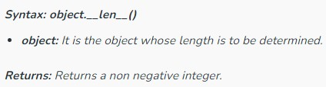
Magic Method
__len__() method:
Python __len__() is one of the various magic methods in python programming language.
It is basically used to implement the len() function in python because whenever we call the len() function then internally __len__ magic method is called.
It finally returns an integer value that is greater than or equal to zero as it represents the length of the object for which it is called.
Syntax:

Slide 15
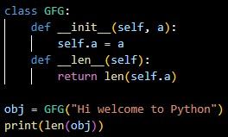
Magic Method
Example: Output:

Slide 16
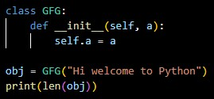
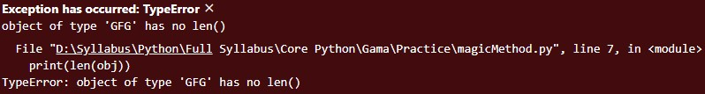
Magic Method
Example: Output:

Slide 17
Thank You

