Slide 1
Collections

Slide 2
Collections
Collection:
The collection module in python provides different types of containers.
A Container is an object that is used to store different objects and provide a way to access the contained objects and iterate over them.
Some of the built-in containers are tuple, list, Dictionary etc.

Slide 3
Collections
Types of collections:
Counters
OrderedDict
DefaultDict
ChainSet
NamedTuple
DeQue
UserDict
UserList
UserString

Slide 4
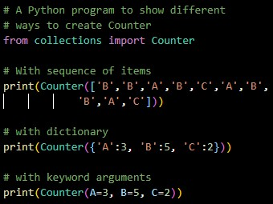

Collections
Counters:
A Counter is a sub-class of the dictionary.
It is used to keep the count of the element in an iterable in the form of an unordered dictionary where the key represents the element in the iterable and value represents the count of that element in the iterable.
Example: Output:

Slide 5
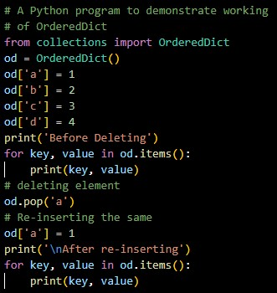
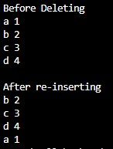
Collections
OrderedDict:
An OrderedDict is also a sub-class of dictionary but unlike dictionary, it remembers the order in which the keys were inserted.
Example: Output:

Slide 6
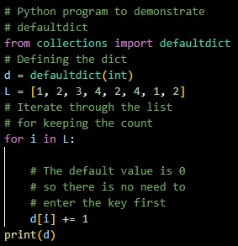
Collections
DefaultDict:
A DefaultDict is also a sub-class to dictionary.
It is used to provide some default values for the key that does not exist and never raises a KeyError.
Example: Output:

Slide 7
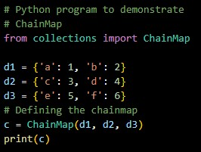
Collections
ChainMap:
A ChainMap encapsulates many dictionaries into a single unit and returns a list of dictionaries.
Example: Output:

Slide 8
Collections
NamedTuple:
A NamedTuple returns a tuple object with names for each position which the ordinary tuples lack.
For Example: consider a tuple named student where the first element represents fname, second name represents lname and the third element represents the DOB.
Suppose for calling fname instead of remembering the index position you can actually call the element by using the fname argument.
Syntax:

Slide 9
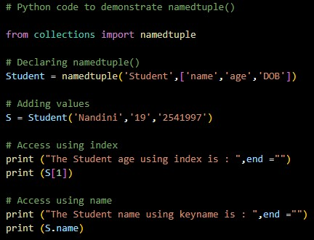

Collections
Example: Output:

Slide 10
Collections
NamedTuple:
Conversion Operations:
_make(): This function is used to return a namedtuple() from the iterable passed as argument.
_asdict(): This function returns the OrderedDict() as constructed from the mapped values of namedtuple().

Slide 11
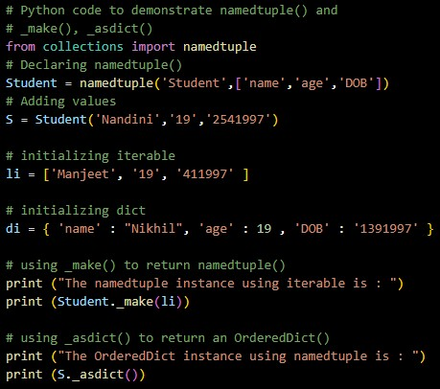

Collections
Example: Output:

Slide 12
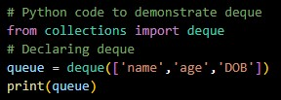
Collections
Deque:
Deque(Doubly Ended Queue) is the optimized list for quicker append and pop operations from both sides of the container.
It provides O(1) time complexity for append and pop operations as compared to list with O(n) time complexity.
Example: Output:

Slide 13
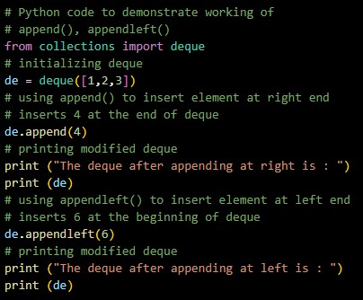

Collections
Inserting elements in Deque:
Elements in deque can be inserted from both ends.
To insert element from right append() method is used and to insert the elements from the left appendLeft() method is used.
Example: Output:

Slide 14
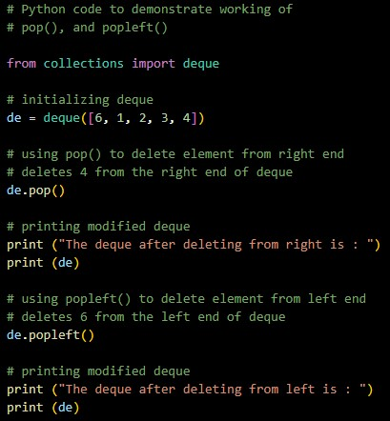

Collections
Removing elements in Deque:
Elements can also be removed from the deque from both the ends.
To remove elements from right use pop() method and to remove elements from the left use popleft() method.
Example: Output:

Slide 15

Collections
UserDict:
UserDict is a dictionary-like container that acts as a wrapper around the dictionary objects.
This container is used when someone wants to create their own dictionary with some modified or new functionality.
Syntax:

Slide 16
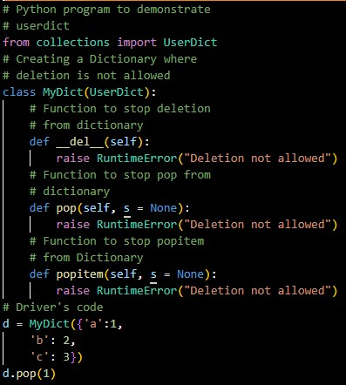
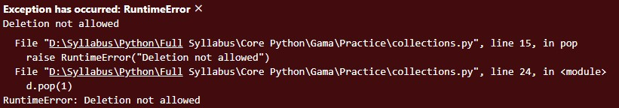
Collections
Example: Output:

Slide 17
Collections
UserList:
UserList is a list like container that acts as a wrapper around the list objects.
This is useful when someone wants to create their own list with some modified or additional functionality.
Syntax:

Slide 18
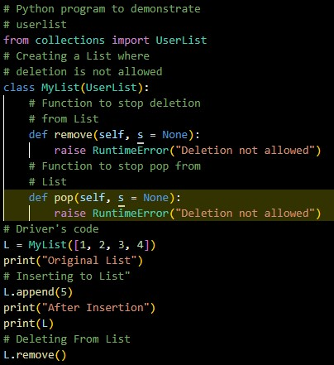

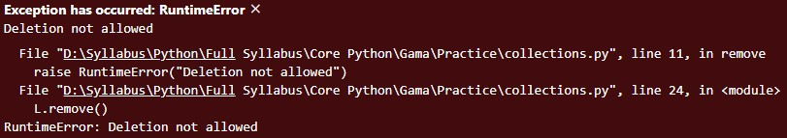
Collections
Example: Output:

Slide 19
Collections
UserString:
UserString is a string like container that acts as a wrapper around the string objects.
It is used when someone wants to create their own strings with some modified or additional functionality.
Syntax:

Slide 20
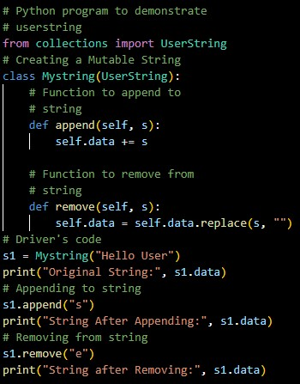

Collections
Example: Output:

Slide 21
Thank You

