Slide 1
Variable & Datatype

Slide 2
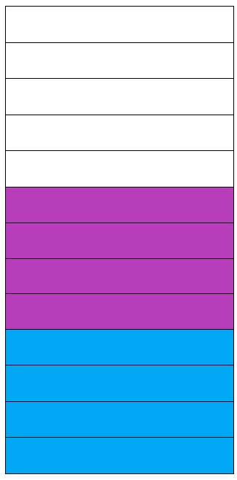
Variables
Variables:
A Variable is a container which holds the value while the program is being executed.
Variable is a name of Memory Location.
There are three types of Variables they are: Local, Instance and Static.
Unallocated Memory
expectedSalary = 180000
Age = 22

Slide 3
Variable
Syntax:
Declaring a variable:
variable name= value
Getting value from a variable:
print(variable_name)
Example:
Declaring a variable:
age = 21
Getting value from a variable:
print(age)

Slide 4
Datatypes
Datatypes:
Datatypes specifies the different sizes and values that can stored in an variable.
Inbuilt datatypes in python:
Numeric types: int, float, complex.
Text type: string.
Sequence types: list, tuple, range, set, dict.
Boolean type: Bool.

Slide 5
Datatypes
Numeric Datatypes:
Int :
The int datatype represents integer numbers.
Example: a=20
Float :
The float datatype represents floating point numbers.
Example: a= 20.35
Complex:
The complex number is a number that’s been written with arithmetic functions.
Example: a= 3+5j

Slide 6
Datatypes
Text type:
String:
A String is represented by group of characters, Strings are enclosed with Single quotes(‘’) & double quotes(“”).
Example:
a= “ hello world”

Slide 7
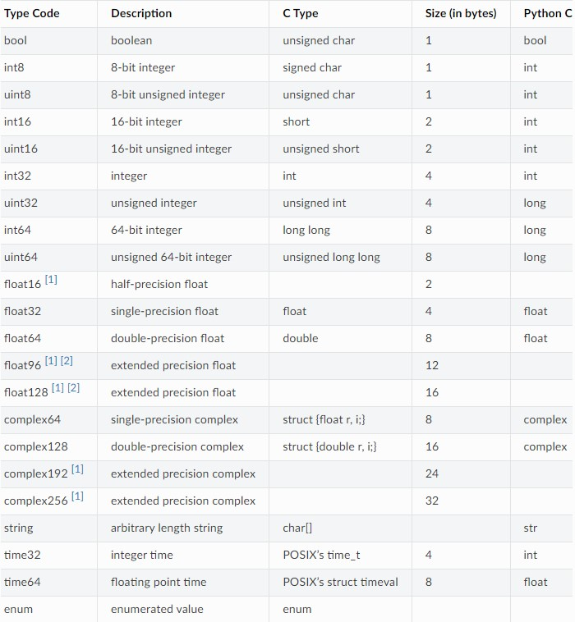
Datatypes
Datatype Memory Size:

Slide 8
Datatypes
Sequence Datatypes:
List :
A List represents a group of elements written inside of square bracket([]). List can store different types of elements.
Example:
a=[10,20.45,”Hello world”]
The above example will create an List with different types of elements for variable a.

Slide 9
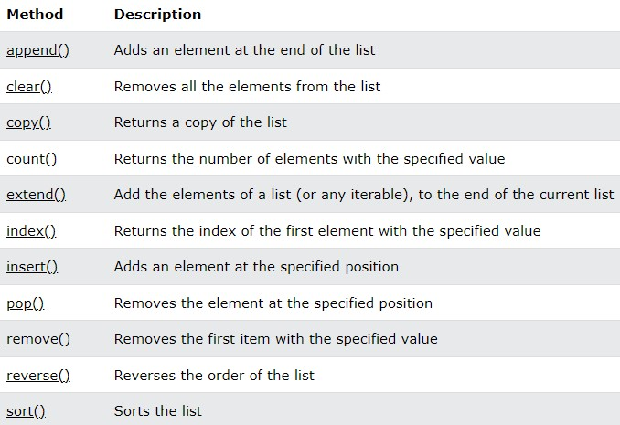
Sequence Datatype methods
List Methods:

Slide 10
Datatypes
Sequence Datatypes:
Tuple:
A tuple is similar to list but the elements in tuple cannot be modified.
Example:
a=(10,20.45,”Hello world”)
The above example will create an Tuple with different types of elements for variable a.

Slide 11
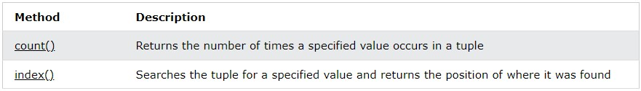
Sequence Datatype methods
Tuple Methods:

Slide 12
Datatypes
Sequence Datatypes:
Set:
A set is an unordered collection of elements, it means the elements may not appear in the same order as they are entered into the set. A set does not accept duplicate elements.
Example:
a={10,20,30,40,30}
Output:
(30,20,40,10)
In above example the output is printed in unordered format and duplicate values has been removed, hence it is an set.

Slide 13
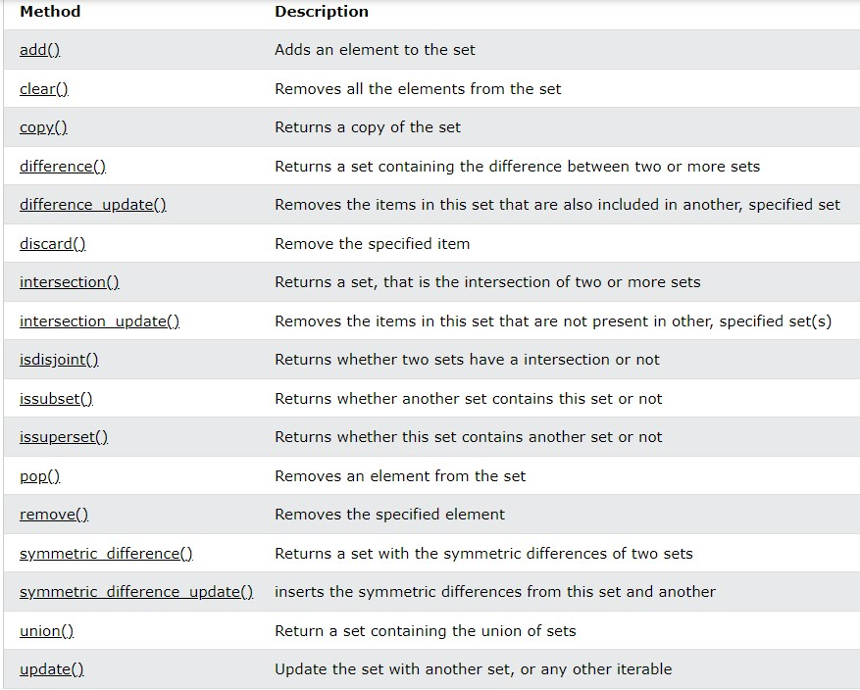
Sequence Datatype methods
Set Methods:

Slide 14
Datatypes
Sequence Datatypes:
Dictionary:
Dictionaries are used to store the data in key: value pairs, an dictionary does not allow duplicate value.
Example:
dict={ “model”: “Mustang”,
“year”:”1986”,
“brand”:”Ford”}
In above example an variable has been declared with curly braces with keys and values, hence it is known as Dictionary.

Slide 15
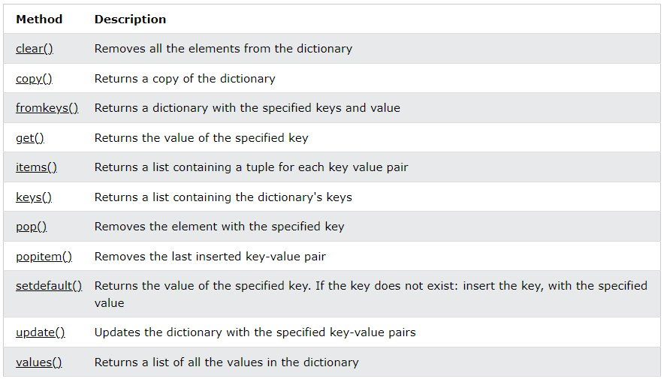
Sequence Datatype methods
Dictionary Methods:

Slide 16
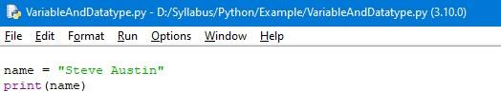
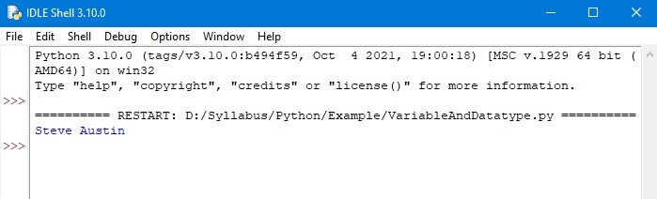
Example 1
Code:
Output:

Slide 17
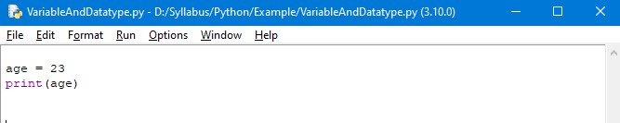
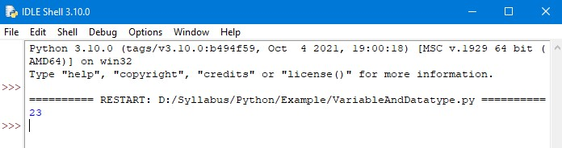
Example 2
Code:
Output:

Slide 18
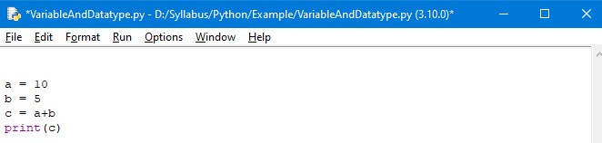
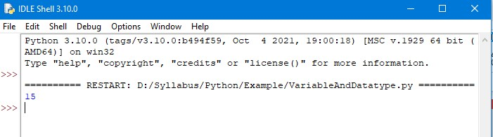
Example 3
Code:
Output:

Slide 19
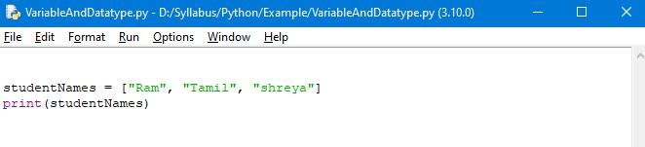
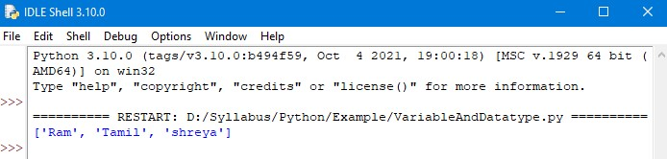
Example 4
Code:
Output:

Slide 20
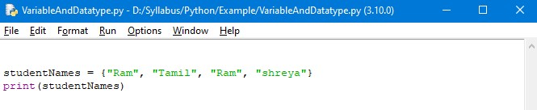
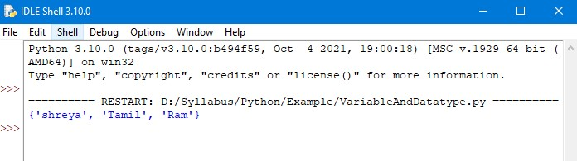
Example 5
Code:
Output:

Slide 21
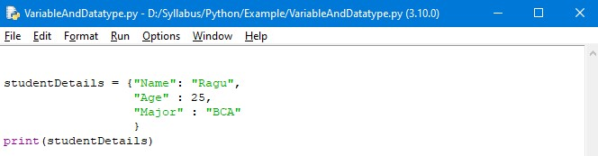
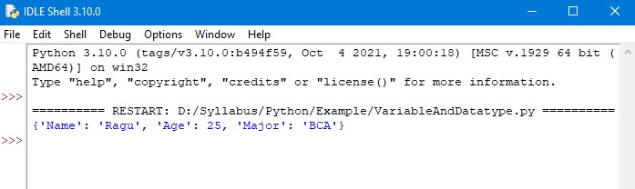
Example 6
Code:
Output:

Slide 22
Thank You

