Slide 1
Loops in Python

Slide 2
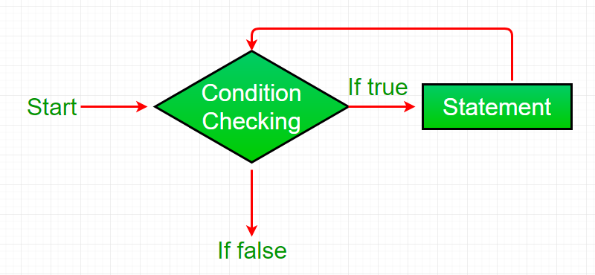
Loop
What is a loop ?
Loop is a feature used to execute a particular part of a program repeatedly if a given condition evaluates to be True.
Types of Loop: Loop work flow:
For Loop
While Loop
Do – While Loop

Slide 3
Loop
For Loop:
The for loop is used to iterate a given set of statements multiple times.
The for loop functions by running a section of code repeatedly until a certain condition has been satisfied.
Syntax of For loop:
for iterator_variable in sequence:
statements

Slide 4
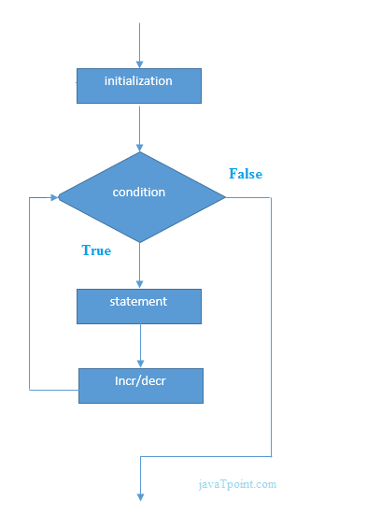
Loop
Flow chart:

Slide 5

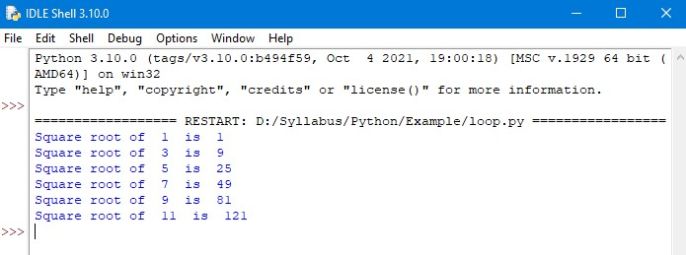
Loop
Example: Output:

Slide 6
Loop
range() function:
The range() function returns a sequence of numbers, starting from 0 by default and increments by 1 by default and stops before a specified number.
Syntax:
range(start, stop, step)
Parameter values:
Start: Optional. An integer number specifying at which position to start. Default is 0.
Stop: Required. An integer number specifying at which position to stop.
Step: Optional. An integer number specifying the incrementations. Default is 1.

Slide 7
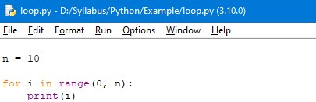
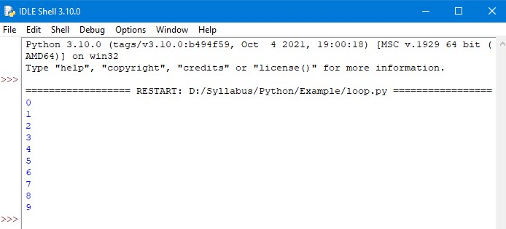
Loop
Example: Output:

Slide 8
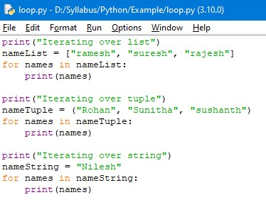
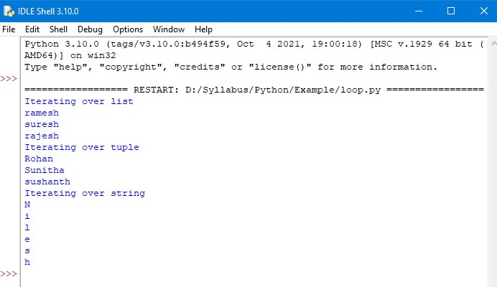
Loop
Sequence datatypes in for loop:
Example: Output:

Slide 9
Loop
Else statement with for loop in python:
We can also combine else statement with for loop.
As there is no condition in for loop based on which the execution will terminate so the else block will be executed immediately after for block finishes execution.
Syntax:
for iterator_variable in sequence:
statements
else:
statements

Slide 10
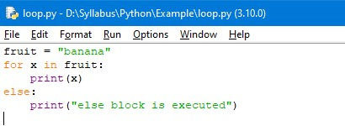
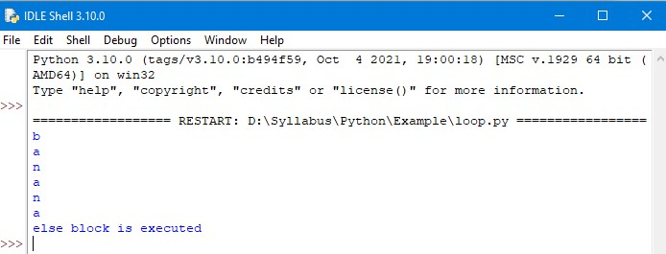
Loop
Example: Output:

Slide 11
Loop
Nested for loop:
Python programming language allows to use one for loop inside another for loop.
Syntax:
for iterator_var in sequence:
for iterator_var in sequence:
statements
statements

Slide 12
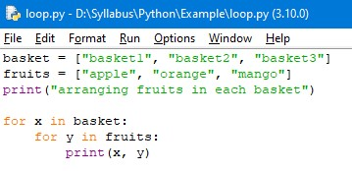
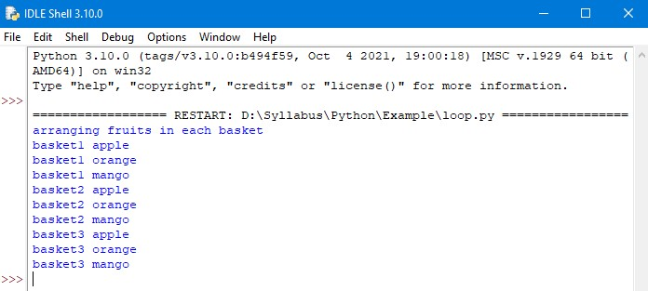
Loop
Example: output:

Slide 13
Loop
While Loop:
The While loop is used to iterate a part of a program repeatedly until the specified Boolean Condition is True. As soon as the Boolean condition turns False , The loop automatically stops.
The while loop is considered as a repeating if statement.
If the number of iterations is not fixed, it is recommended to use while loop.
Syntax:
while condition:
statement
increment/decrement

Slide 14
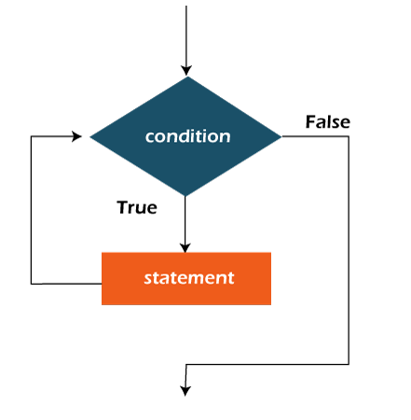
Loop
Flow chart:

Slide 15
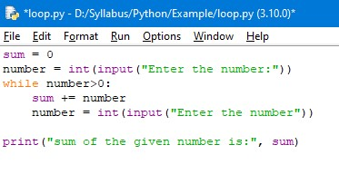
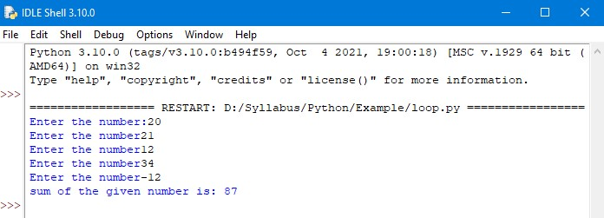
Loop
Example: Output:

Slide 16
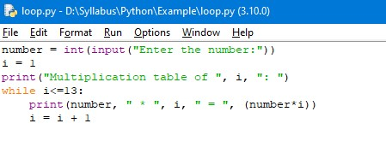
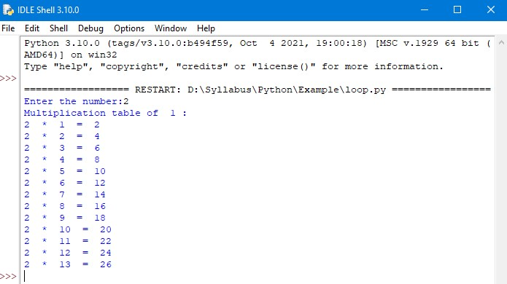
Loop
Example: Output:

Slide 17
Loop
Else statement in while loop:
The else clause is only executed when your while condition becomes false.
If you break out of the loop or if an exception is raised, it won’t be executed.
Syntax:
while condition:
statements
else:
statements

Slide 18
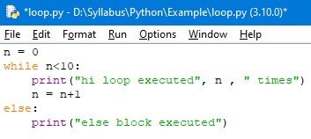
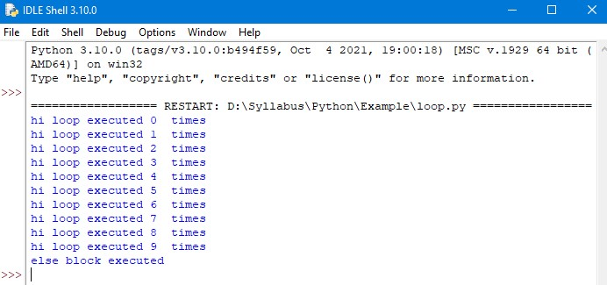
Loop
Example: Output:

Slide 19
Loop
Nested while loop:
Python programming language allows to use one while loop inside another while loop.
Syntax:
while expression:
while expression:
statement(s)
statement(s)

Slide 20
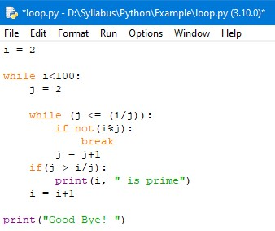
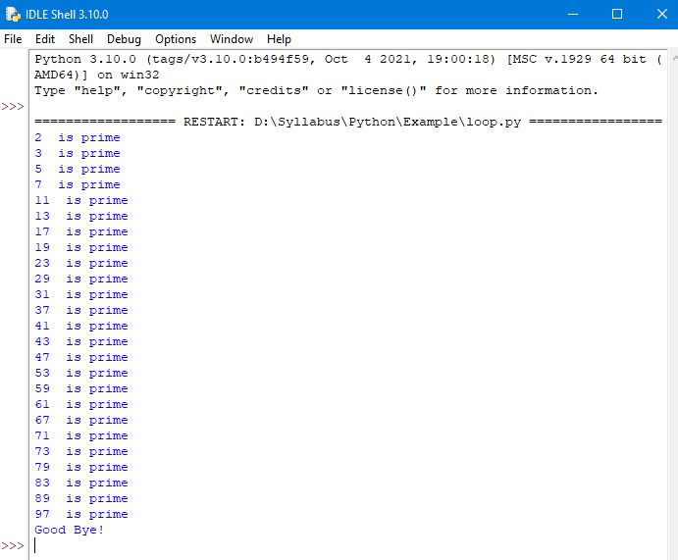
Loop
Example: Output:

Slide 21
Loop
Loop control statements:
Loop control statements change execution from their normal sequence.
When execution leaves a scope, all automatic objects that were created in that scope are destroyed.
Three control statements:
Continue statement
Break statement
Pass statement

Slide 22
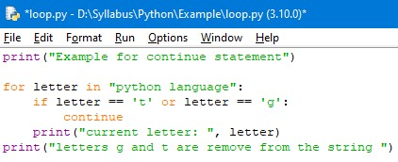
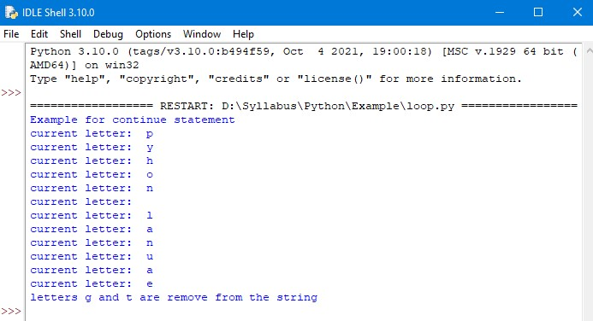
Loop
Continue Statement:
The continue statement in python returns the control to the beginning of the loop.
Example: Output:

Slide 23
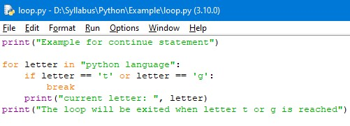
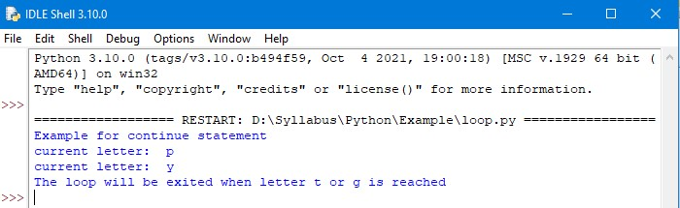
Loop
break Statement:
The break statement in python brings the control out of the loop.
Example: Output:

Slide 24
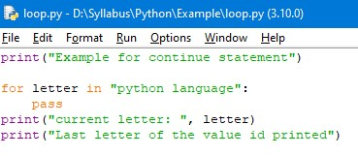
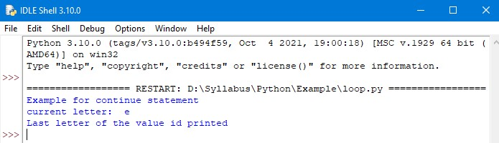
Loop
pass Statement:
We use pass statement in python to write empty loops.
pass is also used for empty control statements, functions and classes.
Example: Output:

Slide 25
Thank You

