Slide 1
Scopes In Python

Slide 2
Scope
What is a Scope?
A variable is only available from inside the region it is created. This is known as scope.
Types of scopes:
Local Scope
Global Scope
Naming Variables
Global keyword

Slide 3
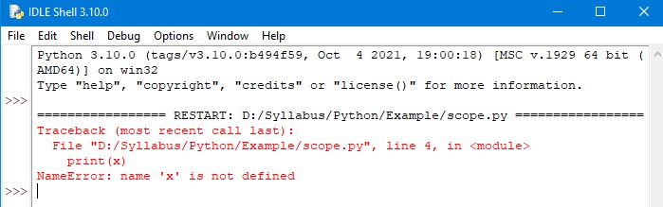

Scope
Local Scope:
A variable created inside a function belongs to the local scope of that function.
It can be only used inside that function.
Example: Output:

Slide 4
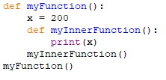
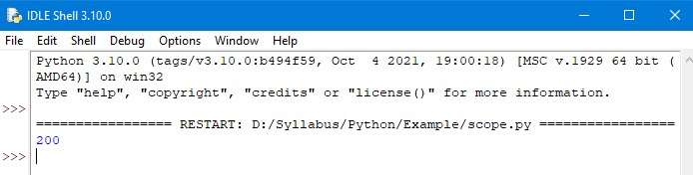
Scope
Function Inside Function:
As explained before the variable inside a function is not available outside the function.
But it is available for any function inside the function.
Example: Output:

Slide 5

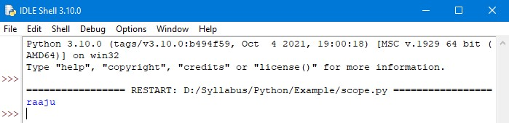
Scope
Global Scope:
A variable created in the main body of the python code is a global variable and belongs to the global scope.
Global variables are available from within any scope, global and local.
Example: Output:

Slide 6
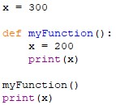
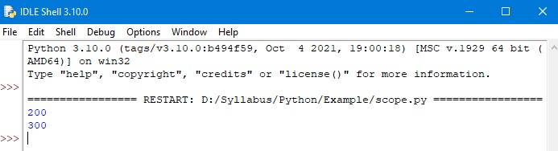
Scope
Naming Variables:
If you operate with the same variable name inside and outside of a function.
Python will treat them as two separate variables.
One available in the global scope and one available in the local scope.
Example: Output:

Slide 7
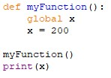
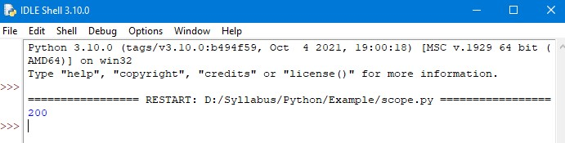
Scope
Global Keyword:
If you need to create a global variable, but are stuck in the local scope.
You can use the global keyword.
The global keyword makes the variable global.
Example: Output:

Slide 8
Thank You

