Slide 1
Cart2Insights: Decoding E-Commerce Performance
Olist Brazilian e-commerce, January 2017 to August 2018
GUVI x HCL Capstone | github.com/sathish-p-0406/cart2insights
Submitted By – Sathish P
R$15.69M
revenue
97,910
orders
4.12 / 5
average review
Notes:
Introduce the project: an end-to-end analysis of the Olist Brazilian e-commerce dataset (9 CSVs, Jan 2017 to Aug 2018). The three numbers are the headline: R$15.69M revenue, 97,910 orders, 4.12 average review. The story of the talk: what happened, why, and what to do about it.

Slide 2
From 9 raw CSVs to a decision-ready database
1
2
3
4
5
Clean
Query
Engineer
Explore
Deliver
Removed duplicates and orphan rows, filled missing categories
SQLAlchemy on SQLite: KPIs, CTEs, subqueries, window functions
Order, customer, seller and item feature tables
Six EDA chart groups and three hypothesis tests
Interactive Streamlit dashboard with six sections
9
base tables with primary and foreign keys
4
feature tables for analysis
20
months of orders analysed
Notes:
Walk through the pipeline in five steps. Cleaning fixed duplicate reviews and geolocation rows and filled 610 missing product categories. SQL used SQLAlchemy on SQLite (the same code works on MySQL). The ER diagram is in docs/er_diagram.png in the repo.

Slide 3
R$15.69M in revenue from 97,910 orders
R$15.69M
Total revenue
97,910
Orders
94,707
Customers
3,029
Sellers
R$160.22
Average order value
4.12
Average review score (out of 5)
January 2017 to August 2018, excluding canceled and unavailable orders
Notes:
Business overview KPIs from the dashboard. Average order value is R$160.22 on this basis; the order_features table mean is R$161.00 because it includes all orders. Average review is 4.12 out of 5.

Slide 4
SP, RJ and MG lead sales; November 2017 was the peak
OBSERVATION
São Paulo leads with ~R$5.77M from 40,500 delivered orders, ahead of RJ and MG. Monthly revenue peaked in November 2017.
TOP STATE BY REVENUE
~R$5.77M
São Paulo (SP), 40,500 delivered orders
INTERPRETATION
Demand is led by the Southeast and spikes around Black Friday.
PEAK MONTH
Nov 2017
BUSINESS IMPACT
Prioritise stock and delivery capacity in these states, and plan inventory and campaigns ahead of November.
Black Friday drove the highest monthly revenue
Notes:
Revenue is concentrated in a few large southeastern states: SP is far ahead (about R$5.77M, 40,500 orders on delivered-order revenue), followed by RJ and MG. Monthly revenue peaked in November 2017, which lines up with Black Friday.

Slide 5
Only 3.1% of customers come back
OBSERVATION
93,099 customers bought once; only 2,997 (about 3.1%) ordered again.
INTERPRETATION
Acquisition works, but loyalty is low: most buyers treat the marketplace as a one-off purchase.
BUSINESS IMPACT
A small lift in repeat rate adds revenue with no new acquisition cost. Target one-time buyers with retention campaigns.
Notes:
About 97% of customers purchased only once (93,099 one-time vs 2,997 repeat). This is the biggest growth lever that does not require buying new customers.

Slide 6
Late delivery drops reviews from 4.30 to 2.55
OBSERVATION
88,710 orders arrived on time, 7,766 late and 2,965 were never delivered. Average review: 4.30, 2.55 and 1.74.
INTERPRETATION
Delivery time matters more than price: review score correlates −0.33 with delivery days but only −0.04 with order value.
BUSINESS IMPACT
Late and missing deliveries are the biggest satisfaction risk. Fix slow lanes and set realistic delivery estimates.
Notes:
Delivery status drives satisfaction. On-time orders average 4.30 stars, delayed 2.55, never delivered 1.74. The 2,965 not-delivered orders match the 2,965 missing delivery dates in the raw orders table. Correlations with review score: delivery days −0.33, delivery delay days −0.27, order value −0.04.

Slide 7
Statistics confirm delivery delay has the largest effect
Welch t-test
One-way ANOVA
Chi-square test
Do delayed orders get lower review scores than on-time ones?
Does order value differ across 51 product categories?
Is payment method linked to order status?
d = 1.22
η² = 0.098
V = 0.028
Cohen's d; t = −89.77, p < 0.001
F = 208.07, p < 0.001
Cramér's V; χ² = 154.48, df = 6, p < 0.001
Large effect: delayed orders are rated far lower
Category explains ~10% of order-value variation
Significant, but the effect is negligible
Robustness: Mann-Whitney and Kruskal-Wallis tests agree with the parametric results. Limitation: Levene's test shows unequal variances across categories.
Notes:
Three hypotheses, all significant, with very different effect sizes. Delivery delay vs review score: t = −89.77, Cohen's d = 1.22 (large). Order value across 51 categories (95,945 orders): F = 208.07, eta squared 0.098. Payment method vs order status: chi2 = 154.48, p = 8.7e-31, but Cramér's V is only 0.028, so practically negligible. Non-parametric tests confirm the first two; Levene shows unequal variances for ANOVA, which is a stated limitation.

Slide 8
Order value ranges from R$81 to R$1,287 by category
OBSERVATION
Average order value spans R$81 (electronics) to R$1,287 (computers). Voucher orders fail 3.62% of the time vs ~1.2% for other payment types.
INTERPRETATION
Category drives basket size (about 10% of variation). The voucher gap is statistically real but small overall (V = 0.028).
BUSINESS IMPACT
Promote high-value categories and bundle low-value ones. Audit the voucher checkout and fulfilment flow.
3.62%
voucher orders canceled or unavailable
~1.2%
other payment types
Notes:
Order value differs a lot by category: computers average R$1,287, electronics R$81, against an overall average of R$160.22. Voucher orders are canceled or unavailable 3.62% of the time versus about 1.2% for other payment types. The effect is small overall (Cramér's V 0.028) but worth investigating.

Slide 9
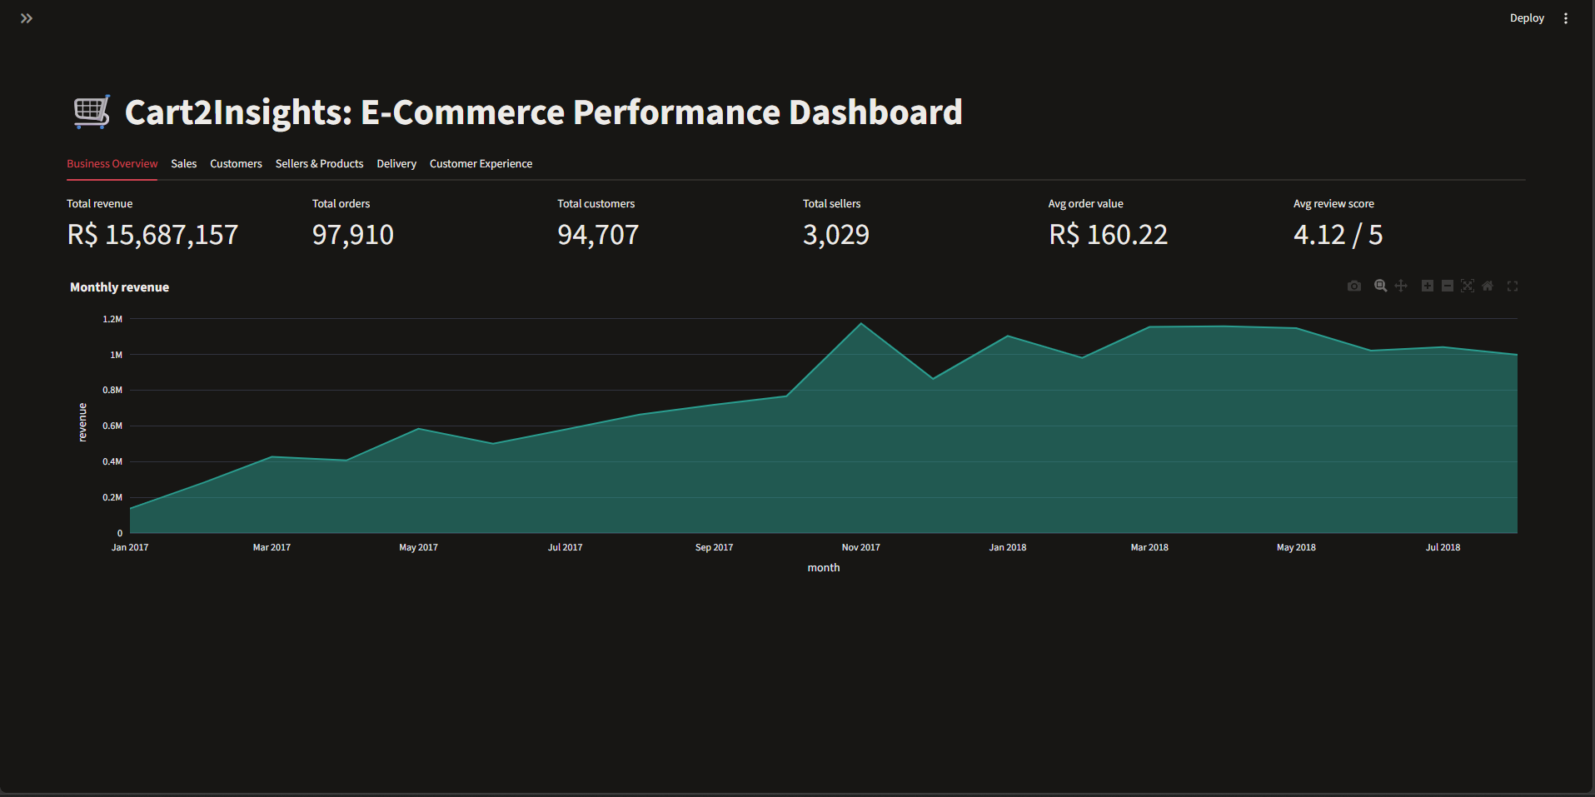
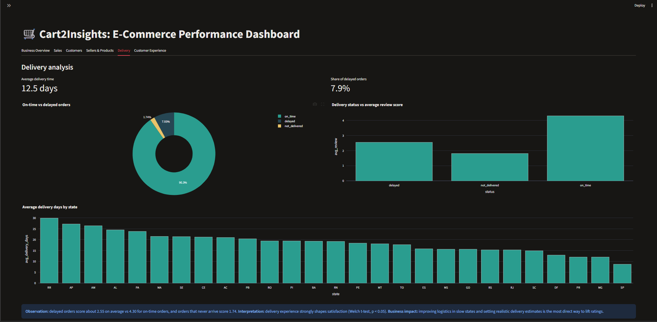
A six-section interactive Streamlit dashboard
Business Overview
Sales
Customers
Sellers & Products
Delivery
Customer Experience
Built with Streamlit and SQLAlchemy; code and README are on GitHub
Notes:
Before presenting: replace the two dashed frames with your own screenshots (Insert > Pictures, then delete the dashed frame and its text). Suggested tabs: Business Overview and Delivery. Run the dashboard with: .\venv\Scripts\python.exe -m streamlit run streamlit\app.py. All six tabs were checked with no errors.

Slide 10
Four actions to grow revenue and satisfaction
1
Improve logistics in slow states and set realistic delivery estimates
2
Run retention campaigns for the ~97% one-time buyers
Delayed orders average 2.55 stars vs 4.30 on time
Only 3.1% of customers (2,997) ordered again
3
Promote high-value categories and bundle in low-value ones
4
Investigate the voucher checkout and fulfilment flow
Average order value: computers R$1,287 vs electronics R$81
Voucher orders: 3.62% canceled or unavailable vs ~1.2% for other payments
Code, notebooks and README: github.com/sathish-p-0406/cart2insights
Notes:
Close with the four recommendations, each tied to evidence: (1) logistics and realistic delivery estimates, (2) retention for one-time buyers, (3) category promotion and bundling, (4) investigate the voucher flow. Then invite questions.

