Slide 1
IST719 Sync Session 1

Slide 2
Agenda
Student Profiles - Posts
Course Overview
LMS – 2U Platform
Async Lecture / Synch Lecture
Lab
Collaboration Mechanics – Wall, Google Doc’s, Breakout Sessions
More Collaboration: slack.com, rstudio.cloud
Syllabus Summary – posted in Files area
Typical Sync Session
Lab oriented – review code/visuals germane to weekly subject material
Comments/reflection on Lecture Material
Discussion Topic Germaine to Weekly Subject Material
In class exercise – individual or group
More breakout sessions throughout the semester
Presentations – Advanced Topic, Final Poster
General / Specific Q&A
Note: Final Project Samples posted (on 2U not BB)

Slide 3
Some Consistent Themes/Observations/To-do’s
Async Lectures, Labs, HW’s – Structure/Methodology
Data preparation as a precursor to visualization(s)
Data generation
Data Acquisition, Cleansing, Transformation
Plot/Visualization code
Quizes
2 – 4 questions requiring text and/or code response
Majority of questions are multiple choice
Questions sourced from asynch material, texts, collateral pdf content,,, your answers should be drawn from these sources vs. your heuristic knowledge base. Questions are framed within the context of this course ie Visualization
Not timed
You can refer to source content

Slide 4
Some Consistent Themes/Observations/To-do’s
Check out your access to the iLab, specifically Adobe Acrobat
[remotelab.ischool.syr.edu] RemoteLab has had a good run, but we’re transitioning to a new platform for ‘remote lab’ access. The new platform ([rlab.ischool.syr.edu]RLab) currently has a 144 seat capacity (we’ll add more if needed) and access from off campus will no longer require the SU VPN!
Documentation for RLab can be found here: https://answers.syr.edu/x/ygabBQ

Slide 5
How to Reach Me
How to Reach Me / Pseudo Office Hours
gekrudys@syr.edu
Follow up Communication Options
Email
Mutually agreeable phone call
Recognize our schedules will vary due to work, family, other commitments
Best days to connect: Monday through Friday
Saturdays are somewhat flexible
Worst day to connect: Sunday
Open to other synchronous communication options ie.
Schedule Zoom outside of regular Tuesday time

Slide 6
Today / This Evening
Why Visualization
Communication
Exploration
Anscombe Quartet – https://medium.com/datadriveninvestor/anscombes-quartet-12649db7eac0
Reference to Week 1 lab code
Some additional lab code to share
Advanced Topic sign up – google doc in files area
Visualization “Nuggets”
Places to Find Data

Slide 7
Asynch Lab Recap
Visualization Functions
pie
plot
barplot
hist

Slide 8
Visualization Features/Options
labels
col
pch
cex
lwd
type
lty
bty
lend
names.arg
main
border
xlab
ylab
horiz
density
angle
bg

Slide 9
Other Course Nuances, FYI’s, Take-Aways
Week 3/4 asynch and lab submission
Adobe Illustrator – asynch version of Illustrator is an earlier version of what is available today via the rLab
Some of the navigation is slightly different using the current version.
Spend some extra time to get familiar with current version
Illustrator Cross Walk – async version vs Lab version,, posted in files area
Week 7 asynch and lab submission – package issues
rnaturalearth
geocode
See alternative code posted in Files area
“Week 7 code for rnaturalearth and geocode”
Week 9 asynch and lab submission – animation
Asynch lecture is not clear on what to submit
Sample submission posted in Files area
“week 9 sample output” - plot
associated r script

Slide 10
Other Course Nuances, FYI’s, Take-Aways
Week 10 asynch and lab submission - Shiny
Asynch lecture is not clear on what to submit
Context of Lab Assignment
Iterative build of a Shiny app ie adding incremental functionality
Here are the submission requirements
R script that contains the final application build
Pdf showing the output of the final built application
Advanced Topic Presentation
Topics to be selected from posted google doc in files area
Other topics can be considered if/when discussed with me
Final Project
“proprietary” data not acceptable

Slide 11
Other Course Nuances, FYI’s, Take-Aways
Assignment submissions
Single pdf containing all plots/visuals
R script
Assignments missing the pdf or script will not be “re-opened” via 2U for a subsequent submission
Grading Turn-around
Typically 1 week, sometimes 2 week turnaround
Assignment submissions are due on the posted due date. Late assignments per the syllabus get “half points” taken off. No assignments, except the final poster are accepted and graded after our week 10 class..

Slide 12
Other Course Nuances, FYI’s, Take-Aways
Quizes
Primarily multiple choice
And 3/4 non multiple choice questions
Non Mult Choice questions – examples
In the readings, Fry notes that the seven steps for visualization are acquire, parse, filter, mine, represent, refine, and interact. What are the most common linkages between the steps? Make up a simple example using two or three sentences that shows what it means to iterate through these steps
Note: there are 2 questions here. Both must be answered
When opening a .csv or .tsv file, we can include the parameter stringsAsFactor. What does the parameter do? In this class, do we typically set this value to true or false? Why would we set it the way we do?
Note: there are 3 questions here. All must be answered

Slide 13
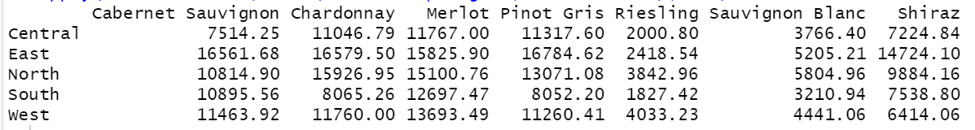
Other Course Nuances, FYI’s, Take-Aways
Non Mult Choice questions – examples
Write the code necessary to find out which wine is responsible for the highest receipts in 2012 for each region? (sales.csv)
Notes
Reference to receipts – data set has “Income”
I will run your code
If your answer is in a “displayed” data frame I do not want to scan the data frame looking for your answer
This does not answer the question

Slide 14
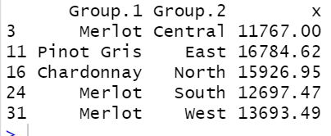
Other Course Nuances, FYI’s, Take-Aways
Non Mult Choice questions – examples
Write the code necessary to find out which wine is responsible for the highest receipts in 2012 for each region? (sales.csv)
This does not answer the question
This answers the question

