Slide 1


IST769 - Week 6 Agenda
Housekeeping
Course planning – lab assignments and final
Course Content
Breakout
Week 6 lab review
Week 7 lab preview
Recommended reading
Taylor, R. C. (2010). An overview of the Hadoop/MapReduce/HBase framework and its current applications in bioinformatics. BMC bioinformatics, 11(12), 1-6.
Wrap-up

Slide 2








Hadoop Data Transformation (example)
Web Server
Storm
HDFS (Parquet)
Analytics
Kafka
Hive
Storm
Mongo

Slide 3
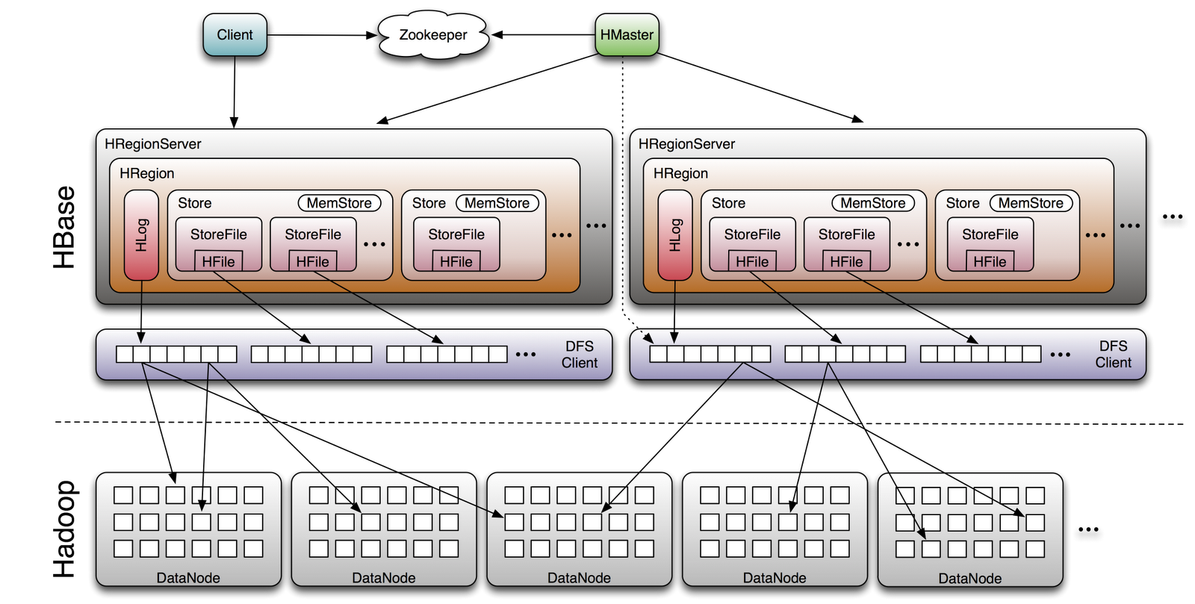
HBase Architecture
Source: http://www.larsgeorge.com/2009/10/hbase-architecture-101-storage.html

Slide 4
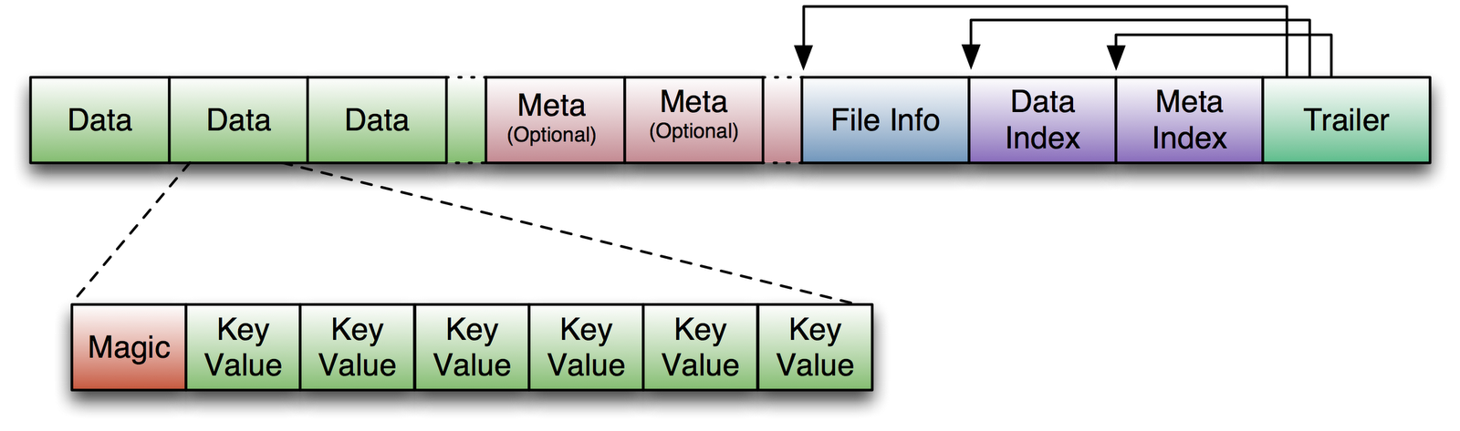
HBase Table Structure
Source: http://www.larsgeorge.com/2009/10/hbase-architecture-101-storage.html

