Slide 1

IST769 - Week 5 Agenda
Housekeeping
Course planning
Course Content
Week 5 lab review
Week 6 lab preview
Recommended reading
Wrap-up
Pavithradevi, K., Naveen, A., & Pavithra, P. BIG DATA WITH HADOOP-MAPREDUCE.
Breakout

Slide 2
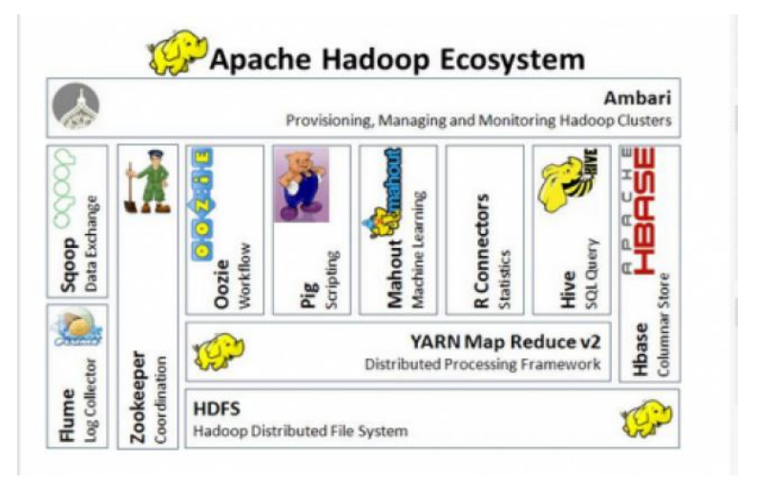
Hadoop Apache Architecture
Source: BIG DATA WITH HADOOP-MAPREDUCE

Slide 3
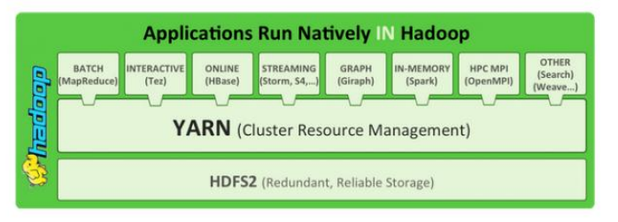
Hadoop Native Services
Source: BIG DATA WITH HADOOP-MAPREDUCE

Slide 4
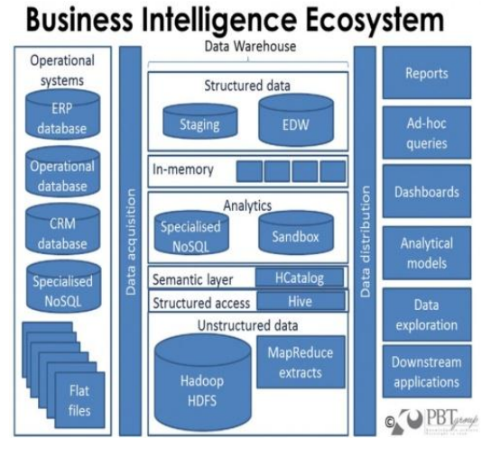
Business Intelligence Ecosystem
Source: BIG DATA WITH HADOOP-MAPREDUCE

