Slide 1


IST769 - Week 7 Agenda
Housekeeping
Course planning – lab assignments and final
Course Content - Hadoop, Hbase, Impala
Breakout
Week7 lab review
Week 8 lab preview
Recommended reading
Gupta, A., Tyagi, S., Panwar, N., Sachdeva, S., & Saxena, U. (2017, October). NoSQL databases: Critical analysis and comparison. In 2017 International Conference on Computing and Communication Technologies for Smart Nation (IC3TSN) (pp. 293-299). IEEE.
Wrap-up

Slide 2
What is "NoSQL"
"Not only" SQL
Really means "not only relational" rather than "not only structured query language"
Includes:
Key-value pairs (e.g. dictionaries)
Column families
Graphs
documents

Slide 3
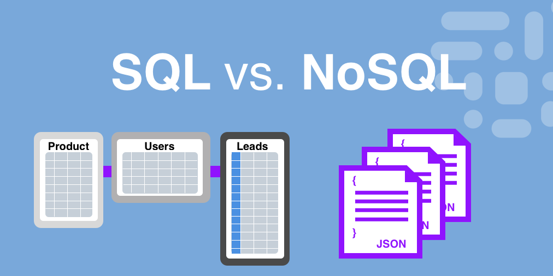
Document model
Source: https://medium.com/analytics-vidhya/relational-model-vs-document-model-a71cddd6782d

Slide 4
Documents are...
Nested
Multiple levels
Self-contained
Schema not predefined
Schema stored with data
Usually in JSON or XML format

Slide 5
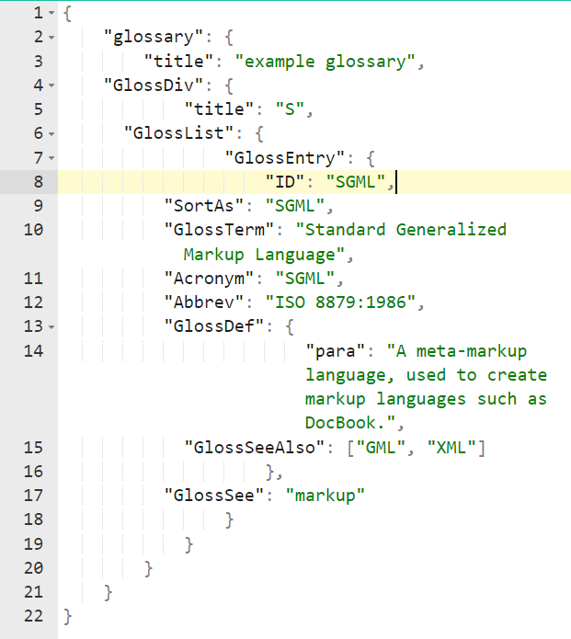
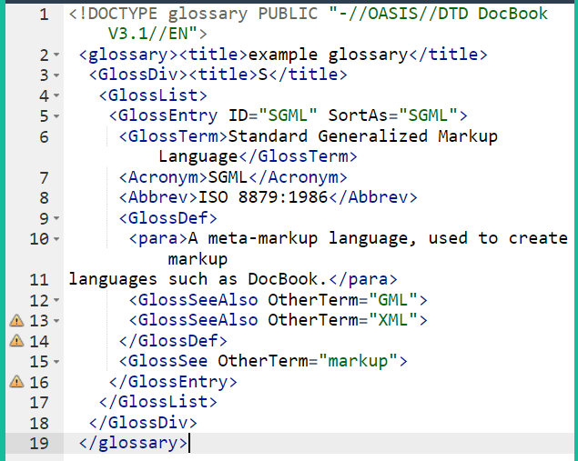
JSON and XML examples
http://www.json.org/example.html

Slide 6
Key-value pair
Behaves like a dictionary – the key is the lookup term and the value is the "definition"
Better performance than relational databases
Some systems enforce a key "namespace"
The value can be a complex object, such as a document
The value is also schema-less

Slide 7
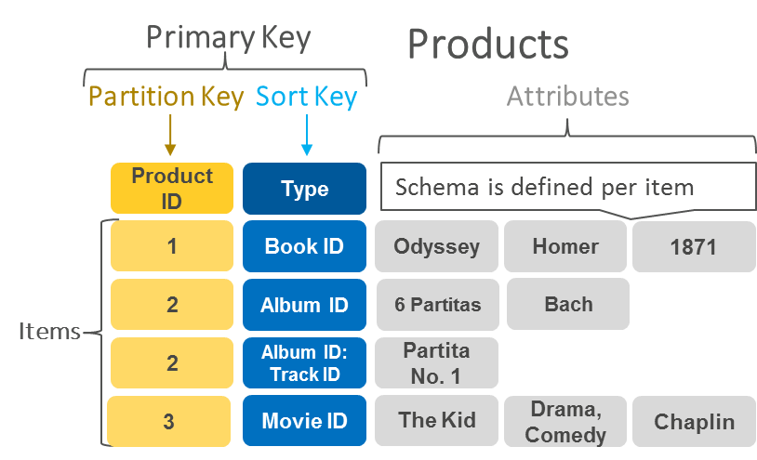
Key-value database example
Source: https://aws.amazon.com/nosql/key-value/

