Slide 1


IST769 - Week 8 Agenda
Start Recording!!
Housekeeping
Course planning – lab assignments and final
"Distractions"
Breakout
Course Content
Week 9 lab review
Subject
CAP Theorem
ACID versus BASE
Week 10 lab preview
Recommended reading
Wrap-up

Slide 2
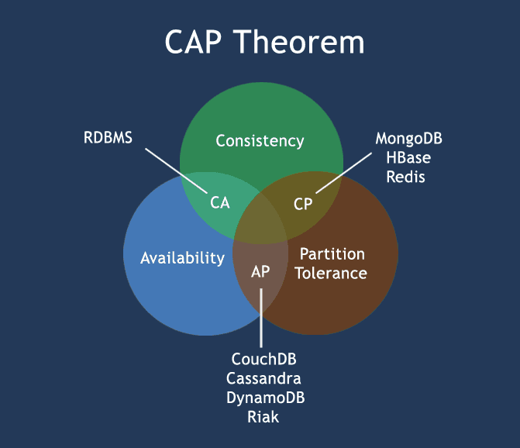
CAP Theorem
Consistency: Every read receives the most recent write or an error
Availability: Every request receives a (non-error) response, without the guarantee that it contains the most recent write
Partition tolerance: The system continues to operate despite an arbitrary number of messages being dropped (or delayed) by the network between nodes
Source: https://www.w3resource.com/mongodb/nosql.php, https://en.wikipedia.org/wiki/CAP_theorem

Slide 3
ACID versus BASE -- ACID
Atomic – Each transaction is either properly carried out or the process halts and the database reverts back to the state before the transaction started. This ensures that all data in the database is valid.
Consistent – A processed transaction will never endanger the structural integrity of the database.
Isolated – Transactions cannot compromise the integrity of other transactions by interacting with them while they are still in progress.
Durable – The data related to the completed transaction will persist even in the cases of network or power outages. If a transaction fails, it will not impact the manipulated data.

Slide 4
ACID versus BASE -- BASE
Basically Available – Rather than enforcing immediate consistency, BASE-modelled NoSQL databases will ensure availability of data by spreading and replicating it across the nodes of the database cluster.
Soft State – Due to the lack of immediate consistency, data values may change over time. The BASE model breaks off with the concept of a database which enforces its own consistency, delegating that responsibility to developers.
Eventually Consistent – The fact that BASE does not enforce immediate consistency does not mean that it never achieves it. However, until it does, data reads are still possible (even though they might not reflect the reality).

