Slide 1


IST769 - Week 9 Agenda
Housekeeping
Course planning – lab assignments and final
Course Content
Week 9 review
Cassandra keys and data distribution
Week 10 lab preview
"Stream versus batch"
Breakout
Recommended reading: Lakshman, A., & Malik, P. (2010). Cassandra: a decentralized structured storage system. ACM SIGOPS Operating Systems Review, 44(2), 35-40.
Wrap-up

Slide 2
Cassandra review
Primary key – uniquely identifies each record in a table
Composite primary key – when the primary key has multiple columns
Cluster key – defines how records are sorted within a partition
Partition key – defines how records distributed across partitions and nodes. Like data should be stored in the same partition
For tables with single-column primary keys, the primary key is the partition key
For tables with composite primary keys, by default the partition key is the first column of the primary key

Slide 3
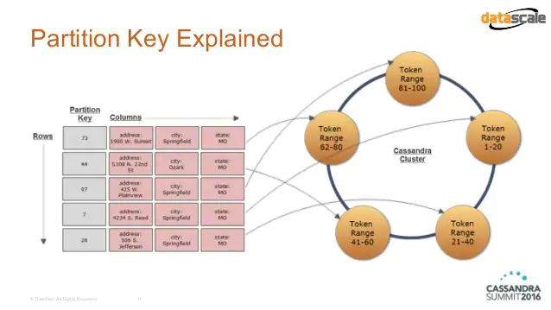
Cassandra review -partitioning
Source: datascale

Slide 4
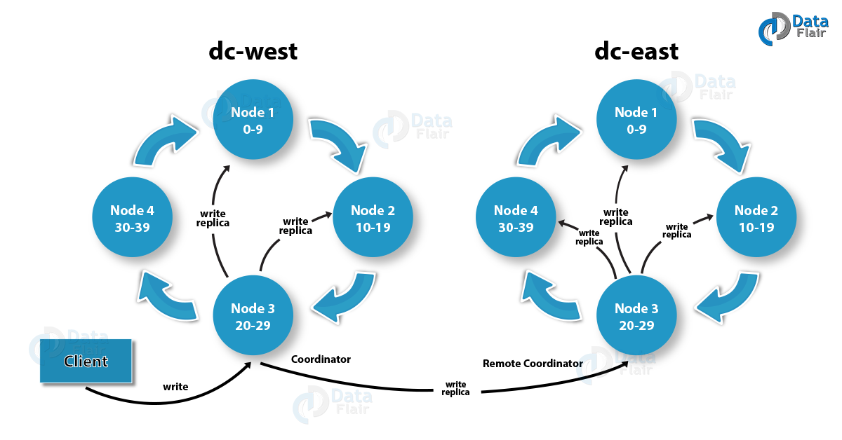
Cassandra review – part 2
Source: Data Flair

Slide 5
Kafka preview - stream versus batch
Stream | Batch
"Perpetual" query | Repetitive query (usually in a loop)
No fixed record size | Application-controlled record size
"Exactly-once" semantics | Application must determine how to fetch records so there are no gaps or repetitions
Application must support streams (e.g. Spark) | Applications must support batches (as most do)

Slide 6
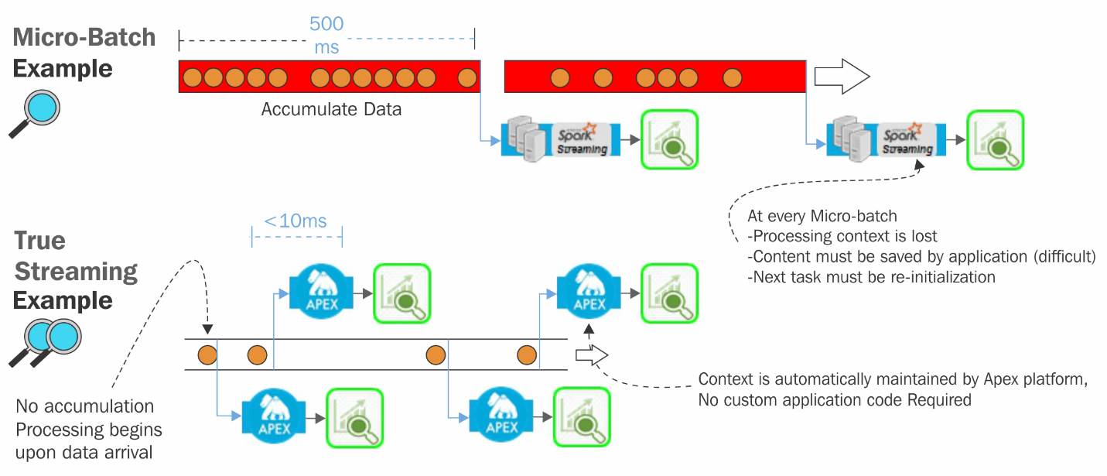
Kafka preview - stream versus batch
Source: O'Reilly

