Slide 1

Homework2
Team:
Prasad Kulkarni
Sathish Rajendiran
Kenny Wu
MAR 653 - Marketing Analytics
Date: 1 March 2021

Slide 2
Logistic Regression on Relay Data
Model 1: Independent Variable - esent, eclickrate, avgorder, ordfreq, paperless, refill, doorstep
Model 2: Independent Variable - avgorder, ordfreq, paperless, refill, doorstep
Model 3: Independent Variable - esent
Model 4: Independent Variable - esent, eclickrate, avgorder, ordfreq, paperless, refill, doorstep and weekend
Why esent is a strong predictor?
Does sign of the coefficients for avgorder, ordfreq, and weekend make sense ?
Recommendations for improving their customer retention

Slide 3
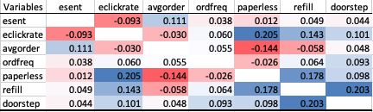
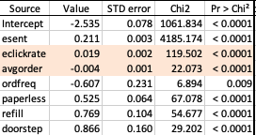

Model 1
Correlation Matrix
Strong Positive correlation
eClickrate and paperless
Refill and doorstep
Strong Negative correlation
Avgorder and paperless
Co-efficient
Independent Variable - esent, eclickrate, avgorder, ordfreq, paperless, refill, doorstep
Both eclickrate and avgorder has insignificant / small co-efficients
p-value is small
Hit Rate: 94 %
Model predicted positive outcome (1) at relatively much higher accuracy compared to negative outcome (0)

Slide 4

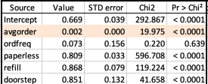

Model 2
Correlation Matrix
Strong Positive correlation
Refill and doorstep
Strong Negative correlation
Avgorder and paperless
Co-efficient
Independent Variable - avgorder, ordfreq, paperless, refill, doorstep
avgorder has insignificant / small co-efficients
p-value is small
Hit Rate: 79%
Model failed to predict any negative outcome.

Slide 5


Model 3
Correlation Matrix
Since only esent is used for this model, there is no correlation matrix
None – Only one variable
Co-efficient
Independent Variable - esent
Esent has a high level of significance to the model.
Hit Rate: 92%
The variable esent has a high level of accuracy in predicting retention by itself

Slide 6
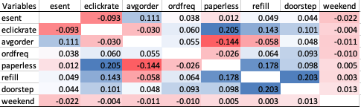
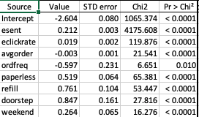

Model 4
Correlation Matrix
The highest correlation was between elclickrate and paperless, as well as, doorstep and refill.
The added weekend value was uncorrelated to any other variable.
Co-efficient
Independent Variable - esent, eclickrate, avgorder, ordfreq, paperless, refill, doorstep and weekend
Avgorder and eclickrate have very small coefficients
All p-values show the variables have a high level of significance
Hit Rate: 94%
The model did a slightly better job of predicting retained customers. However the accuracy slipped on the unretained customers

Slide 7
Question 5
Esent is a strong predictor of retention because it counts the amount of times a customer is exposed to the company. The higher the frequency of e-mails the more a customer is reminded of the company.
Esent would appear to predict that the more e-mails you send a customer the more you will retain a customer. However, at a certain point of e-mails, there could be an adverse effect to retention.
Because higher values of Esent will weigh more favorably on the outcome, it would be a good idea to scale Esent using the log of it.
Why is esent a strong predictor of retention? Do you see any issues with using esent as a predictor for retention? Recommend transformations of esent that can overcome issues of using esent as a predictor.

Slide 8
Question 6
The coefficient of:
Avgorder is negative
OrderFreq is negative
Weekend is positive
Avgorder fluctuates between positive and negative but very close to zero. It almost has no significance. The sign on this variable is not intuitive.
OrderFreq is intuitive. A larger orderfreq might mean that a customer purchased one time and has a short tenure with the company. Thus a larger number would be negative for retaining since the relationship with the customer is short.
Weekend is intuitive. Most people would want to be home to receive deliveries. Since the majority of working adults are home on weekends, this would make the weekend delivery favorable for retention.
Does the sign of the coefficients for avgorder, ordfreq, and weekend make sense? What consumer behavior explanation can you provide for the sign of these coefficients.

Slide 9
Question 7
Recommendation for improving customer retention
Focus on customers who has, as they are repeat customers
enrolled for paperless communication,
subscribed for automatic refill
Subscribed for doorstep delivery
Improve the delivery time for doorstep delivery particularly over the week to have an improved customer experience
Ensure logic and rules are in place for determining the appropriate number of emails so customers are not fatigued with too many emails
Identify reasons for customers buying large orders and not coming back, develop product recommendation model and setup a targeted marketing campaign to retain such customers.
What are your recommendations to Relay Foods Management for improving their customer retention?

Slide 10

Thank you

