Slide 1
Vodka Study
-Marketing Analytics-
Stephanie Machado Reggeti
Gary A. Neumann
Juan M. Rodriguez Vega

Slide 2
Strategic challenges
How does the vodka industry function?
On an individual level, what levers should the biggest players use in order to increase sales?

Slide 3
Questions for Model
What drives sales for the biggest players? & Why?
What drives sales for a big brand? & Why?
Which brands compete with each other?
Are there differences between commercialization channels?
How does the economy influence all this?

Slide 4


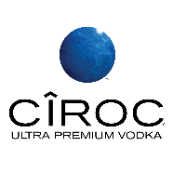
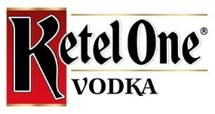

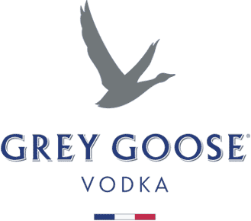
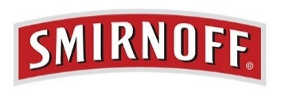

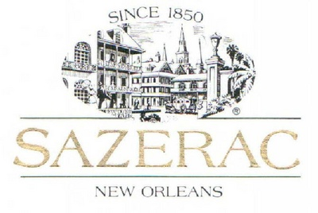

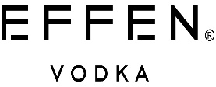
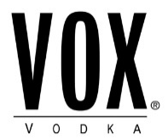
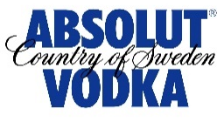
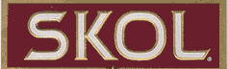
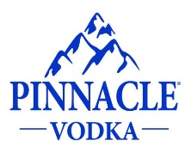
Big picture of a consolidated vodka industry
25%
6%
9%
8%
6%

Slide 5
Analysis revealed additional tiers for the market
Ultra Premium
(Tier 1)
Belvedere
Chopin
Grey Goose
Premium
(Tier 2)
Absolut
Finlandia
Fris
Level
Pravda
Sky
Stolichnaya
Tanqueray
Ketel one
Standard
(Tier 3)
Smirnoff
Three Olives
Economy
(Tier 4)
Aristocrat
Barton
Burnett
Crystal Palace
Fleischmann’s
Gilbey’s
Gordon’s
Kamchatka
McCormick
Polar Ice
Popov
Seagram’s
Skol

Slide 6
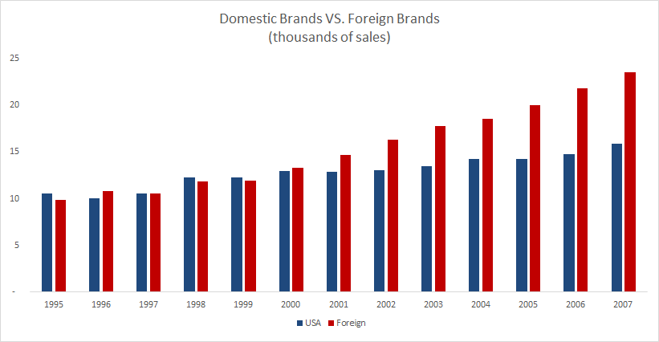
US consumers prefer foreign vodka brands
Source: Euromonitor Passport
51% of the studied brands were imported

Slide 7
Market Trends
Source | Value | STD Err | t | Pr > |t|
Intercept | 1.134 | 0.366 | 3.096 | 0.002
LnPrice | -0.195 | 0.066 | -2.968 | 0.003
LnMag | 0.015 | 0.007 | 2.058 | 0.041
LnNews | 0.013 | 0.006 | 2.327 | 0.021
LnOut | -0.014 | 0.006 | -2.432 | 0.016
LnBroad | 0.002 | 0.006 | 0.323 | 0.747
LnPrint | -0.005 | 0.008 | -0.702 | 0.483
New Tier | -0.106 | 0.036 | -2.957 | 0.003
Firstintro | 0.489 | 0.081 | 6.066 | < 0.0001
Foreign | 0.048 | 0.043 | 1.125 | 0.262
House | 0.005 | 0.003 | 1.693 | 0.092
Tier Mkt Share | -0.167 | 0.128 | -1.303 | 0.194
The difference in sales for the overall vodka market is determined by:
Product price
Competition within tier
New introduction into segment
Marketing spend in Magazines, News and Outdoors
Nevertheless, we decided to dig deeper to better understand the two biggest players in the market.
R² 0.296

Slide 8
Market Trends
Market leader, but lacks an Ultra Premium brand.
Would benefit from increasing price on one second tier brand since it already has recognition
Source | Value | STD Err | t | Pr > |t|
LnPrice | 0.680 | 0.324 | 2.097 | 0.041
LnMag | 0.682 | 0.423 | 1.612 | 0.114
LnNews | -0.378 | 0.336 | -1.126 | 0.266
LnOut | 0.032 | 0.226 | 0.140 | 0.889
LnBroad | 0.036 | 0.188 | 0.193 | 0.848
LnPrint | -0.070 | 0.276 | -0.252 | 0.802
New Tier | 0.011 | 0.550 | 0.020 | 0.984
Foreign | -0.188 | 0.489 | -0.384 | 0.703
R² 0.413

Slide 9
Market Trends
Competes in tier 2 and 4, but contrary to Diageo, would overall suffer from price increases for most of its brands
Would benefit from increasing broadcast and print marketing expenditure because they have still not aligned all of their recent acquisitions and do not have a well defined portfolio
Source | Value | STD Err | t | Pr > |t|
Intercept | 1.767 | 1.400 | 1.262 | 0.221
LnPrice | -0.360 | 0.262 | -1.377 | 0.184
LnMag | -0.005 | 0.019 | -0.264 | 0.795
LnNews | 0.013 | 0.016 | 0.802 | 0.432
LnOut | -0.013 | 0.026 | -0.518 | 0.610
LnBroad | 0.035 | 0.025 | 1.416 | 0.172
LnPrint | 0.041 | 0.021 | 1.934 | 0.067
New Tier | -0.023 | 0.092 | -0.246 | 0.808
Tier Mkt Shar | -0.948 | 0.409 | -2.319 | 0.031
R² 0.308

Slide 10
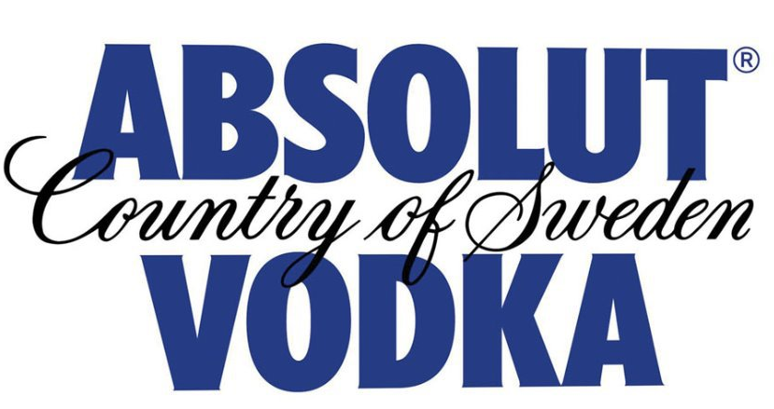
Brand Power
Its the only Pernod Ricard brand that would benefit from increasing price and repositioning itself as a ultra premium brand in the portfolio
Source | Value | STD Err | t | Pr > |t|
Intercept | 1.661 | 1.697 | 0.979 | 0.365
LnPrice | 1.097 | 0.253 | 4.332 | 0.005
LnMag | 0.089 | 0.062 | 1.438 | 0.200
LnNews | 0.013 | 0.012 | 1.132 | 0.301
LnOut | -0.122 | 0.106 | -1.152 | 0.293
LnBroad | 0.033 | 0.023 | 1.413 | 0.207
LnPrint | 0.110 | 0.081 | 1.366 | 0.221
R² 0.933

Slide 11
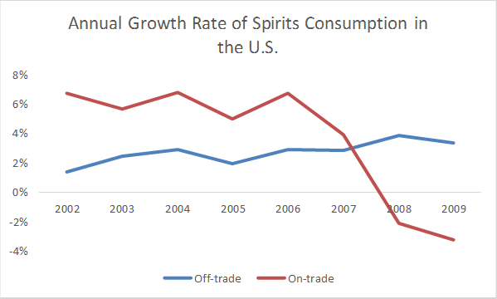
Commercialization channels
Consumers are increasingly switching their preference from purchasing from the on-trade to the off-trade channel
Source: Euromonitor Passport

Slide 12
Macroeconomic factors lack significance for vodka sales
Source | Value | STD Err | t | Pr > |t|
Intercept | 0.037 | 0.164 | 0.222 | 0.824
GDP growth | -0.004 | 0.011 | -0.325 | 0.745
GDP per capita | 0.000 | 0.000 | 1.040 | 0.299
Inflation % | -0.025 | 0.027 | -0.927 | 0.355
Unemployment | -0.006 | 0.019 | -0.309 | 0.757
The studied time period corresponds to mostly prosperous economic times, in this context GDP, Inflation, Imports and unemployment had no influence on overall change in sales
Consumers are very brand loyal and will not change their brand preference due to slight economic changes. They are more likely to switch channels
R² 0.007

Slide 13
Insights
There are more than 2 tiers for the vodka brands
Tier 3 had a big opportunity for another entrant, which explains Svedka’s success in joining the market
Imported vodka brands are not only more expensive, but also have higher demand
Diageo would benefit from having an ultra-premium vodka
Absolut should increase its price point
Consumers are trending towards off-trade consumption
Macroeconomic factors do not have any influence on vodka sales in the studied time period

