Slide 1

Perceptually Mapping Hybrid Cars

Slide 2
Executive Summary
Project was focused to best understand how hybrid vehicles are perceived in the market
Conducted a survey to 33 respondents where they rated 8 attributes of the hybrid vehicles based on an 7 point Likert Scale.
⅓ of our respondents were female and ⅔ were male
Our audience was reactively split between age demographics of 18-24 and 24-40
Utilized Position Mapping to analyze the data
Describes Market space as perceived by customers in the target segment
Each line representing where customer perceives specific attribute, with brands closes to these lines matching with those perceived values
Similar perceived offerings are mapped close together
Length of line indicates variance in that attribute explained by perceptual map – longer the line, greater the importance
Tesla Model 3
Made a huge impact perceptually on almost all attributes, but the Model 3 is considered to be too expensive
There could potentially be a skew in the perception due to users confusing the Model 3 with the Model S
Toyota Prius
Perceived to be the most fuel efficient in the market
Received the lowest ratings on Attractiveness and Design/Style
Future outlook for hybrids.
76% identified themselves as a potential buyer of a hybrid
24% identified themselves as not a potential buyer of a hybrid

Slide 3
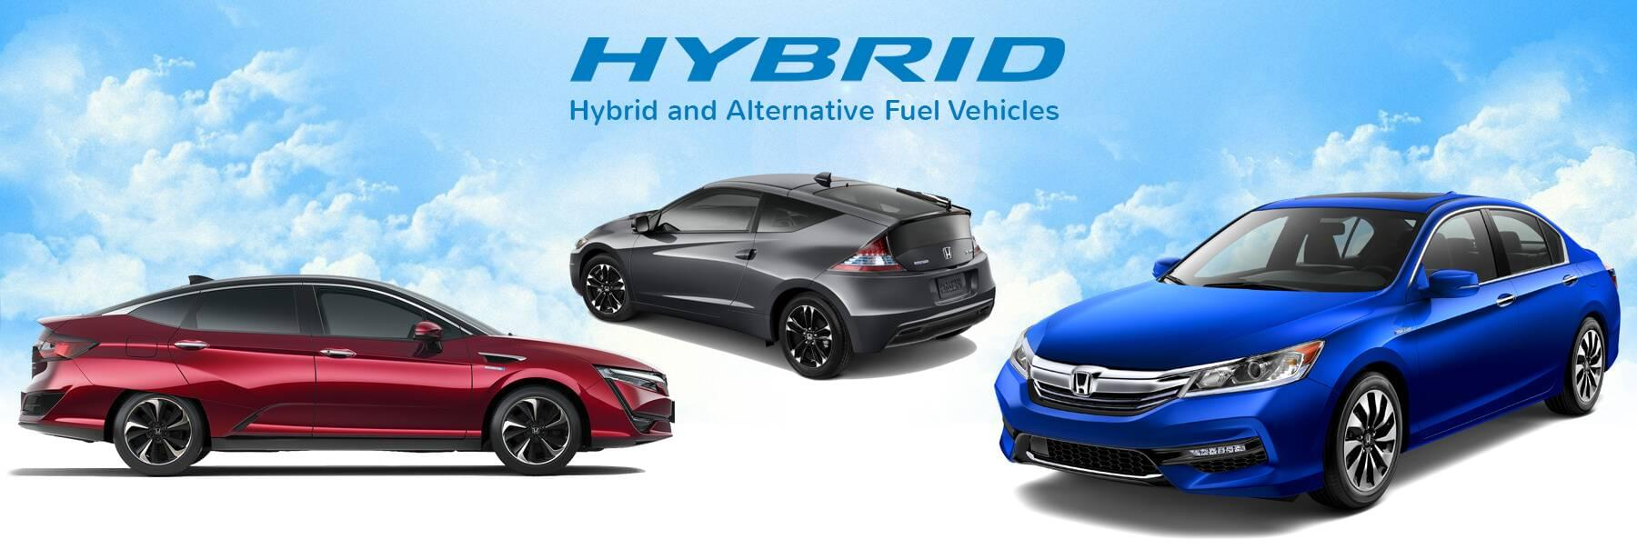
Goals of the Project:
How Hybrid cars are perceived in the market?
How does a Toyota Prius compare to other hybrid cars in the market?
Who is the ideal purchaser of a Hybrid car?
What impact has Tesla Motors had on the market?
Future outlook for hybrids.

Slide 4
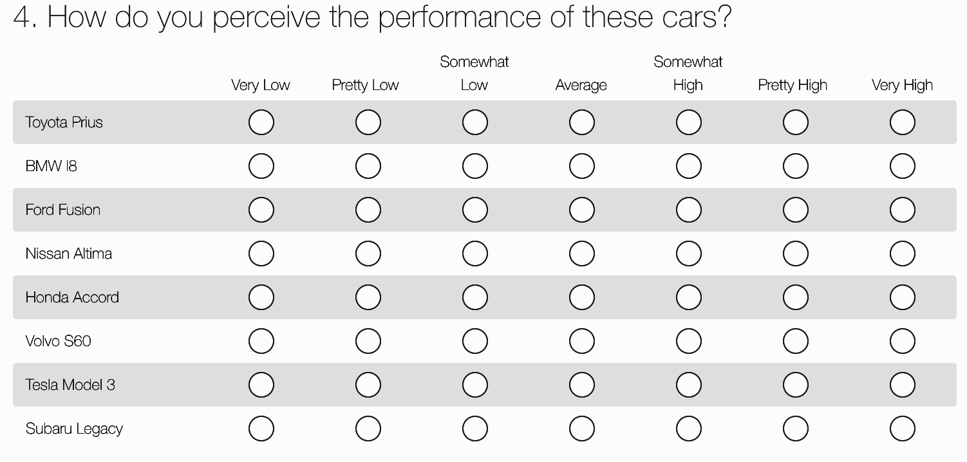
Data Collection through Survey
Survey Monkey
14 Questions
Likert - 7 point scale
Perception questions of each car
Focused on 8 characteristics
Performance
Fuel Economy
Attractiveness
Price
Safety
Technology/Innovation
Design Style
Quality

Slide 5
Perceptual Data from Our Survey
Brands / Attributes | Toyota Prius | BMW i8 | Ford Fusion | Nissan Altima | Honda Accord | Volvo S60 | Tesla Model 3 | Subaru Legacy
Performance | 3.79 | 4.97 | 4.21 | 3.88 | 4.76 | 4.64 | 5.79 | 4.58
Fuel Economy | 6.33 | 4.7 | 4.64 | 4.21 | 4.7 | 3.94 | 5.91 | 4.39
Attractiveness | 2.45 | 5.09 | 3.94 | 3.94 | 4.39 | 4.67 | 5.73 | 4.06
Price | 4.39 | 5.88 | 4.03 | 3.94 | 4.03 | 5 | 6.06 | 4.18
Safety | 4.33 | 4.45 | 4.45 | 4.21 | 4.91 | 5.18 | 4.64 | 5
Technology / Innovativeness | 5.27 | 5.52 | 4.12 | 3.88 | 4.15 | 4.61 | 6.42 | 4.24
Design / Style | 2.97 | 5 | 3.91 | 3.79 | 4.33 | 4.55 | 5.61 | 4.18
Quality | 5.03 | 5.03 | 4.18 | 4.12 | 4.97 | 4.67 | 5.45 | 4.85

Slide 6
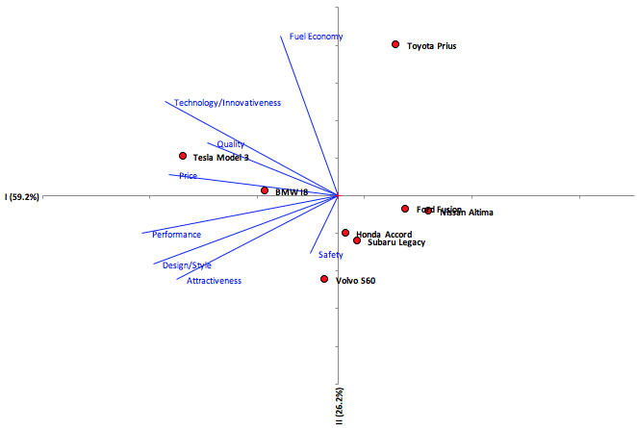
Positioning Map

Slide 7
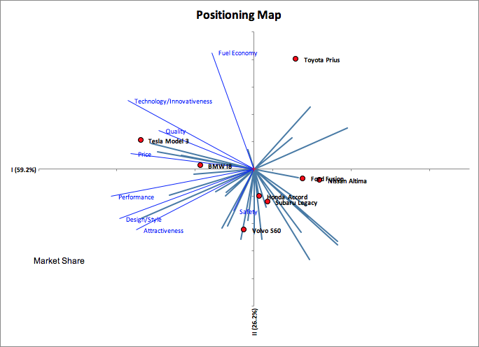
Positioning Map Cont’d

Slide 8
Perception Analysis from the Maps
Vehicle Similarity
Honda Accord & Subaru Legacy
Ford Fusion & Nissan Altima
Tesla Model 3 & BMW i8
Toyota Prius: Own class
Fuel Economy
Toyota Prius
Innovativeness, Quality & Price
Tesla Model 3
BMW i8
Safety (likely to be the most important preference when purchasing*)
Volvo
Honda Accord
Subaru Legacy
Top 3 Attributes (based on length of line)
Fuel Economy
Technology / Innovativeness
Design / Style
*clustering of data lines on the Perception Map with Preferences.

Slide 9
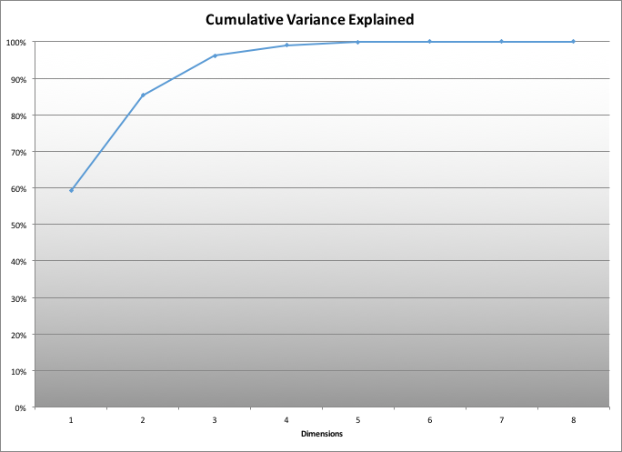
Variance Map: Perceptual Map with Preference
Perceptual Maps only viewed on two dimensions: only captured 85.4% of the variance
Utilizing a third dimension would have brought this up to capturing 96.2% of the variance

Slide 10
Surveyed Vehicles MSRP Variation
Car | Starting MSRP | Price Perception
Ford Fusion | $ 22,120 | 4.03
Subaru Legacy | $22,195 | 4.18
Nissan Altima | $23,140 | 3.94
Toyota Prius | $ 23,475 | 4.39
Honda Accord | $23,570 | 4.03
Volvo S60 | $34,100 | 5
Tesla Model 3 | $35,000 | 6.06
BMW i8 | $ 143,400 | 5.88
Notes:
We also looked at the perception on the vehicle prices and found an interesting thing to note.
Before I go into the survey data, please note that the table on this slide lists starting MSRP prices were collected directly from the car makers website for the 2018 base models.
In this table, we listed the cars in the order of the starting MSRP prices and included the results of their perceived values. From what can be gathered, the perception of the car values relative to one another seems to somewhat align to the MSRP values of the cars with the exception of the Tesla Model 3.
The price range of the cars starts from $22,120 to $143,400 with perception values ranging 3.94 to 6.06. The lower range represents low perceived value and the higher range represents higher perceived value. What’s interesting about data is that Tesla Model 3 had a way higher perceived value even though its actual MSRP value is almost ¼ of the BMW I8.
Maybe, this is because the name TESLA carries a consumer perception of a high end car and not enough people know about the more economically priced TESLA models, that is, economically priced relative to the higher end priced TESLAs.

Slide 11

Recommendations from the Data
Hybrid vehicle perception
75% of our surveyors would consider buying a hybrid in the future.
Hybrids are becoming more attractive in the market.
“If you build it and they will come.” - Field of Dreams
Hybrid perceptions were much better for the more generic model (i.e. Honda Accord)
Give customers the choice to purchase their desired car model in a hybrid version.
Toyota Prius perception
Attractiveness and design/style were the lowest rated averages for the entire survey.
Implement more attractive designs and aggressively advertise.
Being “different” will not attract all buyers, some want a more traditional look and feel
Performance was the third lowest rated average for the Prius.
Bite the bullet on performance and double down on fuel economy, (money maker).
Tesla Model 3 perception
All vehicles made by Tesla Motors are considered to be very expensive
Tesla needs to improve their perception when targeting the economy sedan segment.
Tesla already has an exception perception in all other attributes except safety.
Lead with ads on safety like Volvo and other highly rated safety vehicles.

