Slide 1

Automotive Dealership A Marketing Analysis
A study on the influence of different marketing channels on new and used vehicle sales
Syracuse University - Marketing Analytics (MAR653) #MakeItHappen Group 1:
Kirby Hood Neal Hamilton
Luis Pliego
Nathan Buckner
Pedro Bonnin

Slide 2
Executive summary
Monthly sales were evaluated and marketing expenditure from Dealership A in order to try and predict profits for the dealership through marketing channel optimization.
Log transformations were applied on the independent variables chosen for the creation of two separate linear models to show what the drivers were for new and used vehicle sales and determine the elasticities of each. In order to find the right mix of independent variables several linear models were tested using features ranging from dollars spent on each broadcaster to usage statistics for the dealership’s website.
Both models’ results were validated through the use of seemingly unrelated regression, increasing the significance of each variable.
Due to the size of data, predictions are not able to be made, but offer insight to new marketing strategies involving the investment of advertising spend to drive particular vehicle sales.
The data results tell a story about what advertisement channel drives certain vehicle sales and how placement of ads need to be where the dealerships’ customers are watching or leaving their digital footprint.
Group 1: #MakeItHappen
Syracuse University - Marketing Analytics (MAR653)

Slide 3
Research Objective and Methodology
Business Opportunity/Problem:
Evaluation of current marketing dollars spent across different advertising channels for optimization of marketing spend that will drive more new and used vehicle sales.
Data Acquisition:
Data provided with permission from Dealership A from 2015 – 2017, Google Analytics, Market Research for Brand Recognition, Advertising Spend
Research & Tools:
Excel / XLSTAT
Control for competition
Regression models
Seemingly Unrelated Regression with R
Result Implications:
Create a model to allow for brand recognition among competition and what advertising channels are the main drivers of new and used vehicle sales.
Recommendation to test new marketing strategy to reflect what marketing channel drives certain vehicle sales.
Goal:
Optimize Dealership A’s current marketing strategy based on what marketing channels drive new and used vehicle sales more efficiently.
Group 1: #MakeItHappen
Syracuse University - Marketing Analytics (MAR653)

Slide 4
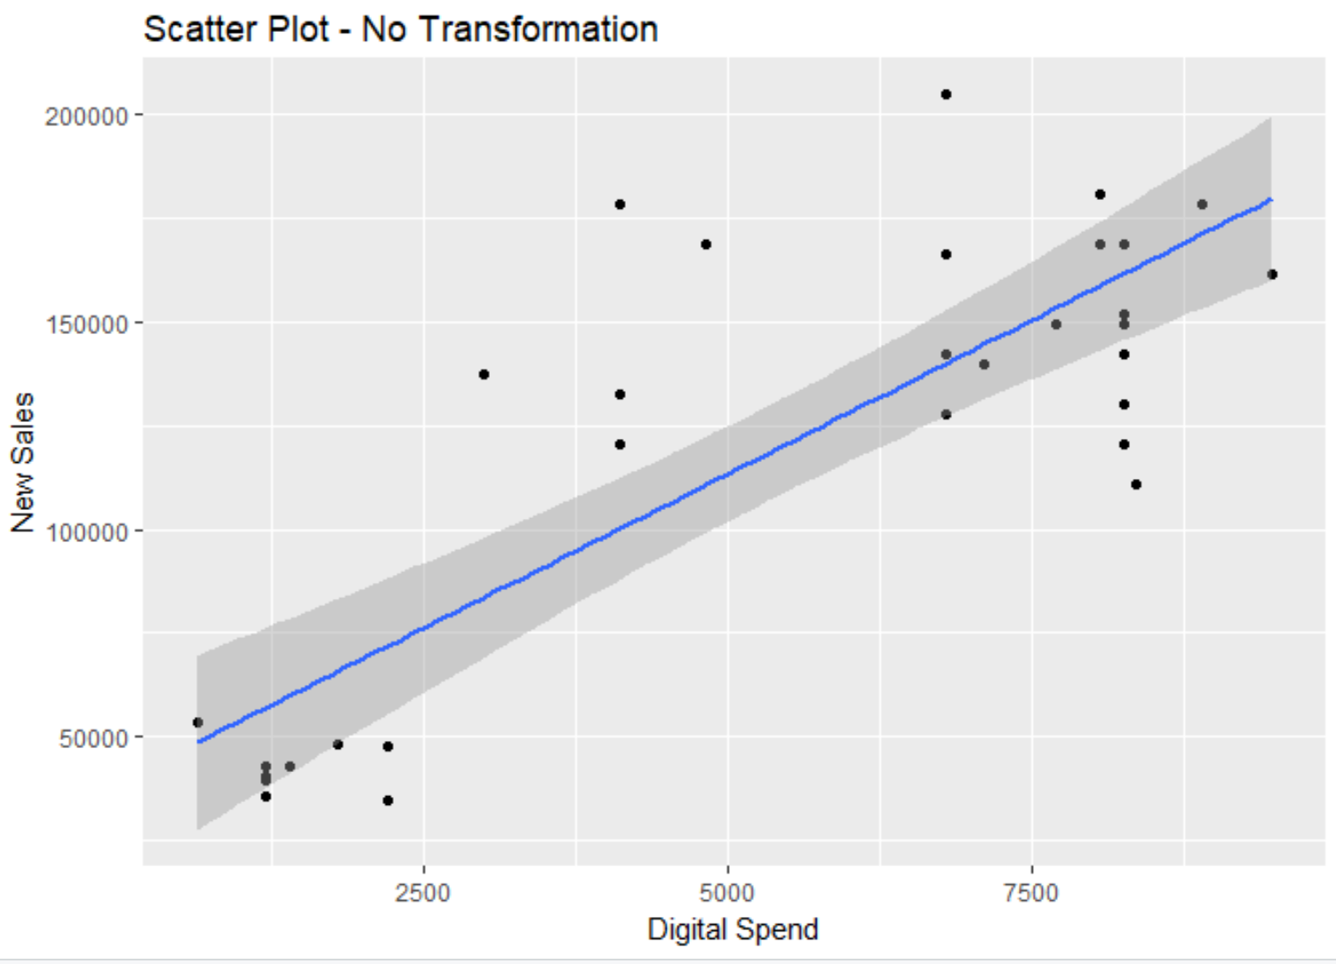
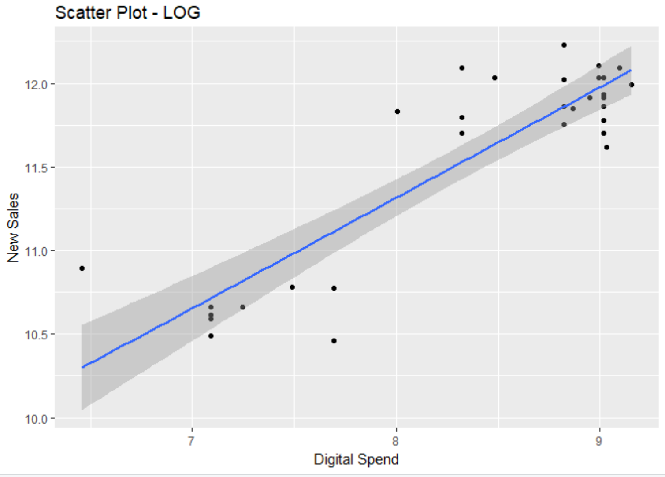
Pre-processing and exploration
The data set contained monthly avg. profit and quantity sold information for both new and used vehicles. The dependent variable was derived as the natural log of:
Avg. Monthly Profit * Units sold
After several iterations of the regression models, using brand indexes to account for competition factors and different transformations for marketing channel expenditure we ended up with two independent variables:
Total digital marketing spend
Total broadcast marketing spend
The log transformation was applied to the marketing spends to create a more defined linear relationship with profit, smoothing of extreme values and consideration of elasticity.
Final Regression Variables Used:
Dependent Variable:
Avg Monthly New Profit * New Vehicles Sold
Avg Monthly Used Profit * Used Vehicles Sold
Independent Variables:
Total digital marketing spend
Total broadcast marketing spend
Group 1: #MakeItHappen
Syracuse University - Marketing Analytics (MAR653)

Slide 5


Regression Analysis
Two models were built that contained variables for brand recognition. After evaluation, final regression models only included the significant variables.
Sales of new vehicles = LN(Digital)*0.11 – LN(Broadcast)*0.50 + 15.77
Sales of used vehicles = LN(Broadcast)*0.70 - LN(Digital)*0.11 + 4.44
Variable Evaluation
 | Coefficients | Std. Error | t Stat | P-value
Intercept | 15.768 | 6.392 | 2.467 | 0.019
Ln_Total_Broadcast | -0.505 | 0.622 | -0.812 | 0.423
LnDigital | 0.113 | 0.035 | 3.240 | 0.003
Regression Statistics
Multiple R | 0.525992494
R Square | 0.276668104
Adjusted R Square | 0.232829807
Standard Error | 0.55691063
Observations | 36
Regression Statistics
Multiple R | 0.416097597
R Square | 0.17313721
Adjusted R Square | 0.123024314
Standard Error | 0.273096404
Observations | 36
Variable Evaluation
 | Coefficients | Std. Error | t Stat | P-value
Intercept | 4.436 | 3.135 | 1.415 | 0.166
Ln_Total_Broadcast | 0.702 | 0.305 | 2.301 | 0.028
LnDigital | -0.014 | 0.017 | -0.807 | 0.425
The adjusted R square explains how much of the variability in profit can be attributed to the two marketing channels, broadcast and digital.
The t-stat and p-value show which variable is the most significant and drives the sale of new or used vehicles.
The ANOVA p-value (Significance F) shows we have a significant model for both at a 95% confidence level
Group 1: #MakeItHappen
Syracuse University - Marketing Analytics (MAR653)

Slide 6
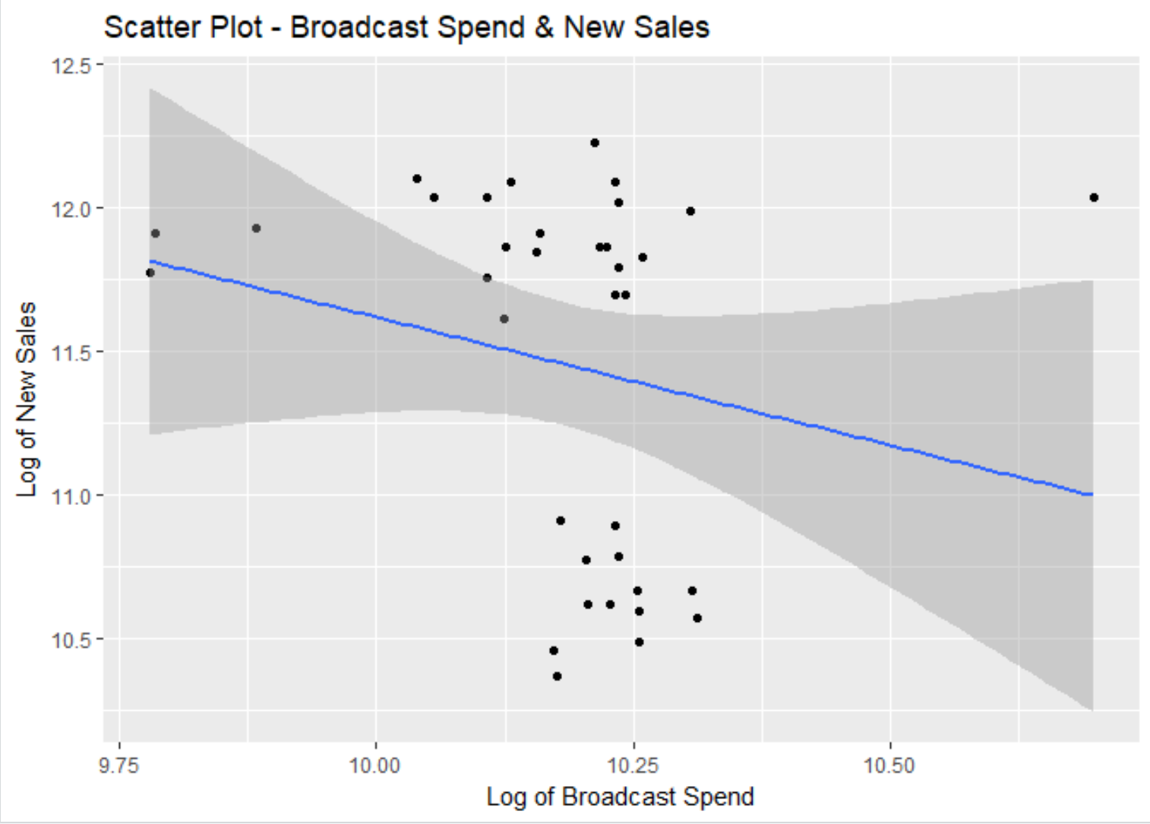
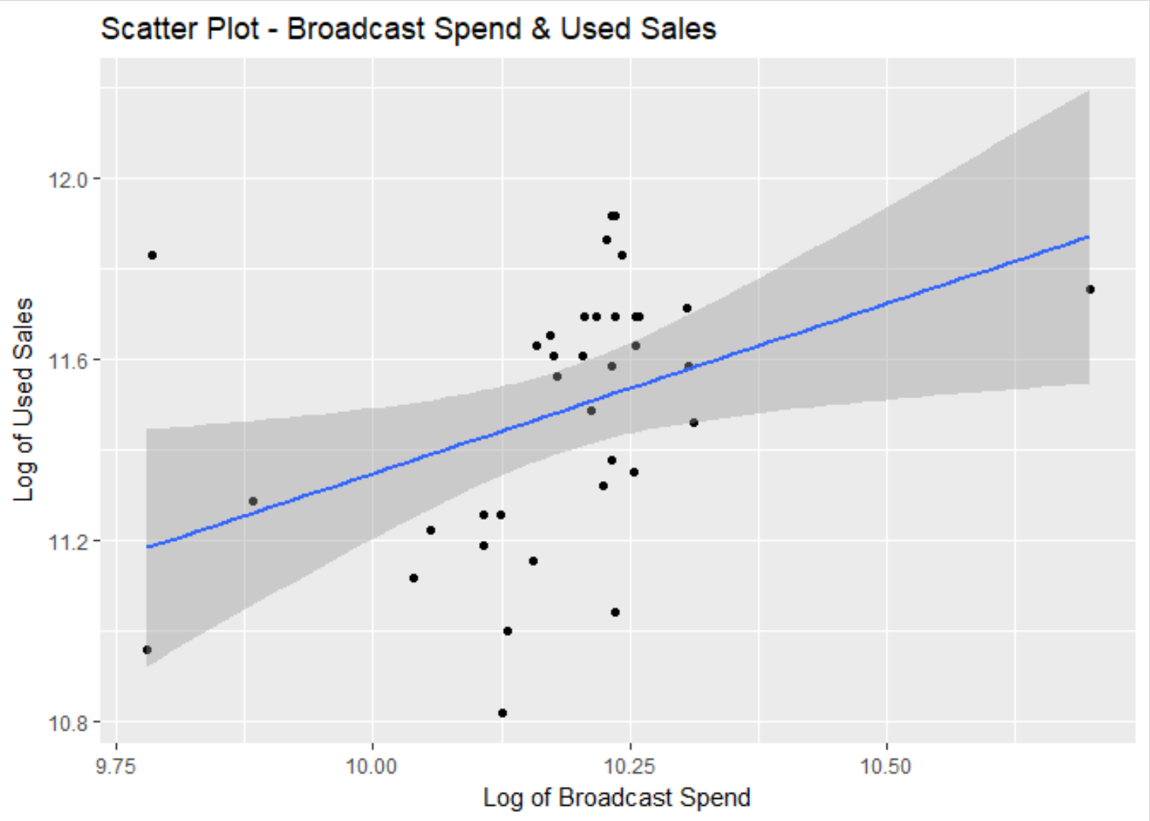
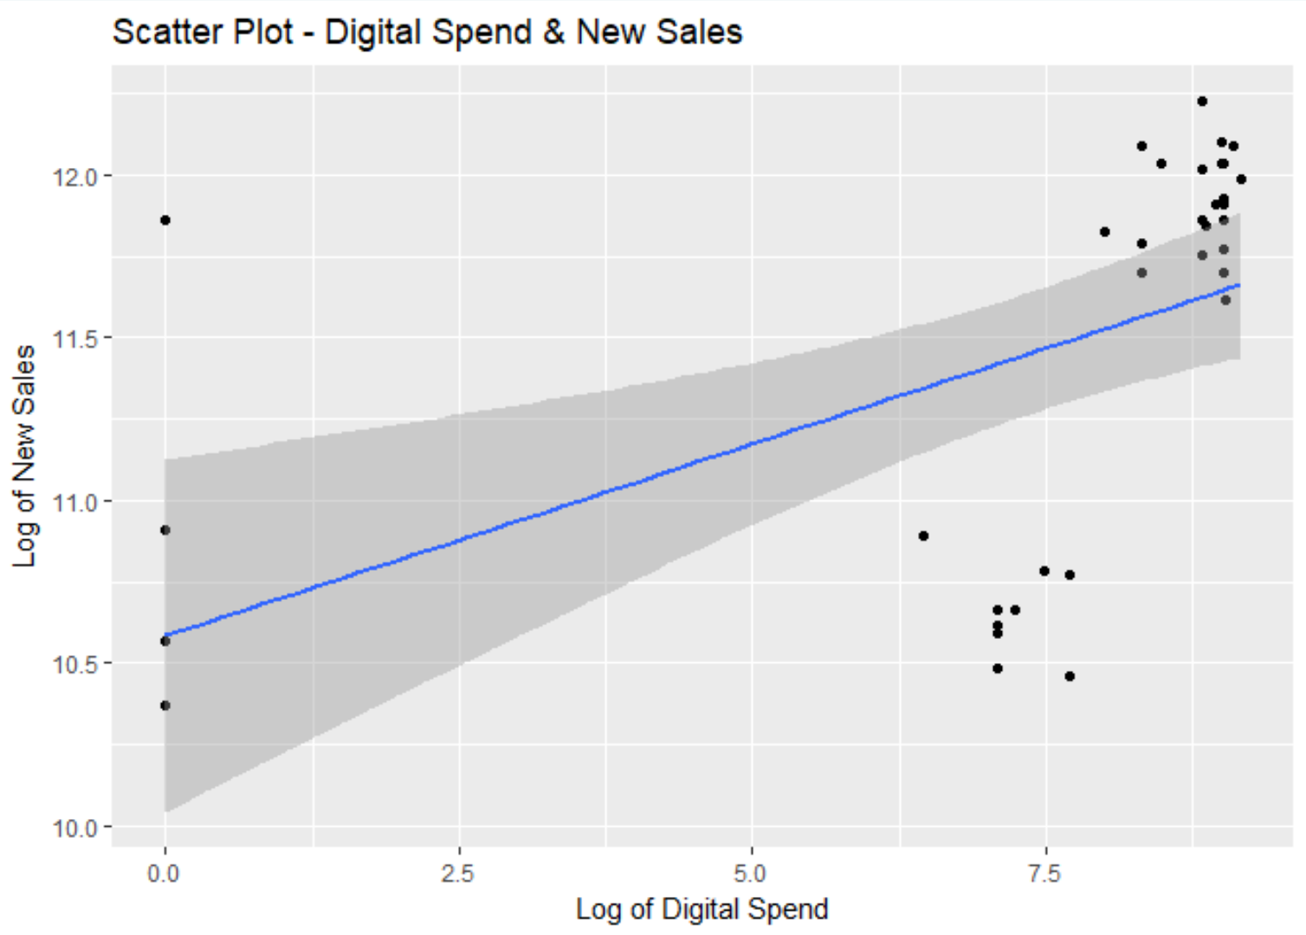
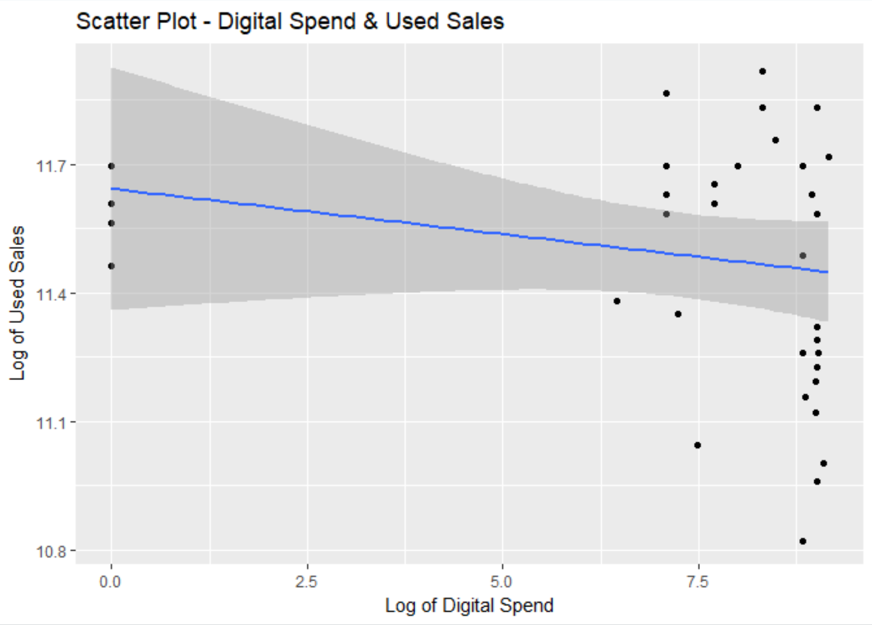
Regression Analysis
We can use scatterplots to see the relationship between our independent and dependent variables. Since our sample size is relatively small, the r-squared will be relatively small as well.
Group 1: #MakeItHappen
Syracuse University - Marketing Analytics (MAR653)

Slide 7
Regression Insights
What if the dealership did not advertise? How does marketing channel expenditure impact the bottom line?
Baseline = $42,845.68
Avg. Digital Spend = $99,654.74
Digital Impact on New Vehicle Sales (Net): $56,809.06
Elasticity: 57%
Baseline = $76.13
Avg. Broadcast Spend = $91,730.10
Broadcast Impact on Used Vehicle Sales (Net)= $91,653.97
Elasticity: 99%
Calculations:
Baseline = EXP(15.77 – Avg. Broadcast*0.50)
Avg. Digital Spend = EXP(15.77 - Avg. Broadcast*0.50 + Avg. Digital*0.11)
Digital Impact on New Vehicle Sales (Net) = Avg. Digital Spend – Baseline
Elasticity: Digital Impact on Used Vehicle Sales (Net) / Avg. Digital Spend
Calculations:
Baseline = EXP(4.43 – Avg. Digital*0.013)
Avg. Broadcast Spend = EXP(4.43 - Avg. Digital*0.013 + Avg. Broadcast*0.70)
Broadcast Impact on Used Vehicle Sales (Net) = Avg. Broadcast Spend – Baseline
Elasticity: Broadcast Impact on Used Vehicle Sales (Net) / Avg. Broadcast Spend
Group 1: #MakeItHappen
Syracuse University - Marketing Analytics (MAR653)

Slide 8
Further validation
A technique known as “Seemingly Unrelated Regression” was used to further validate our results. This model takes in the two linear models and attempts to boosts the significance by assuming correlation of the residuals for both.
Linear Model Results
 | N | DF | SSR | MSE | RMSE | R2 | Adj R2
Used_car LM | 36 | 33 | 2.461 | 0.075 | 0.273 | 0.173 | 0.123
New_car LM | 36 | 33 | 10.235 | 0.310 | 0.557 | 0.277 | 0.233
SUR System Fit Results
 | N | DF | SSR | OLS-R2 | McElroy-R2
system | 72 | 66 | 12.696 | 0.259 | 0.223
The similarity in the adjusted R-Square validates our linear regression results
Using “Seemingly Unrelated Regression” increased the efficiency, but not the model.
Group 1: #MakeItHappen
Syracuse University - Marketing Analytics (MAR653)

Slide 9
Findings & Recommendations
Due to the small amount of data, our model gave us more insight than predicting power.
DIGITAL DRIVES NEW VEHICLE SALES
Digital marketing has an incremental effect on sales overall, and is the primary driver of new vehicle sales.
Every $1 increase of digital advertising spend returns in $.11 in profit.
57% elasticity for New Vehicle Profit.
BROADCAST DRIVES USED VEHICLE SALES
Broadcast has an instrumental effect on used vehicle sales.
Every $1 dollar increase of broadcast advertising spend returns .70 cents in profit.
99.92% elasticity for Used Vehicle Profit
RECOMMENDATIONS:
Continue to advertise new vehicle offers, rebates, leases, and special promotions on digital platforms to continue to drive new vehicle sales.
Broadcast marking spend should have some allocated to advertising used vehicles.
Adding just one commercial that advertises “used vehicles under $10K” will drive more used vehicle sales alone.
Marketing = Brand Recall = Sales
Group 1: #MakeItHappen
Syracuse University - Marketing Analytics (MAR653)
Notes:
Advertising new vehicles on television drives used vehicle sales because of brand recall.
When brand recognition was included into the calculations for both new and used vehicle regressions, it was found to be not as significant as originally presumed.
The model created, gave insight to a new strategy for the allocation of marketing dollars on specific marketing channels suited to drive specific vehicle sales.
Brand recall does matter but vehicle sales are driven by broadcast and digital.

