Slide 1
Marketing Analytics Q1 2016 – Kaggle Project
Samantha Vo - Lorenza Lin - Hana Xu
Peter Bergen - Carlos Escalante Trevino

Slide 2



COMPANY PROFILE
Allstate is an insurance company. Its car insurance product package consists of 7 insurance options, each has several coverage levels.
Some option examples:
Collision (damage caused by collision with other vehicle or car rolling over)
Bodily Injury Liability (damages resulting from injury of another person when you are at fault)
Uninsured Motorist Property Damage (when an uninsured driver can’t afford to pay)

Slide 3





QUOTING PROCESS
After filling out initial info, and getting a suggested quotes, users can fiddle with the features to hit their target.
1.User provide info:
Demographic
Car Information
2. System gives quote
3. User edits features
4. If satisfied,
purchase!

Slide 4


PROJECT GOALS
After filling out initial info, and getting a suggested quotes, users can fiddle with the features to hit their target. Allstate believes that longer it takes for the customer to find their ideal quote, the more likely they are to go to different provider. It ran a Kaggle competition to get these insights.
I. Generate the best “recommended product” for each customer
Predict what coverage levels under each option the customer is most likely to choose
II. Evaluate Allstate’s data analytics practices

Slide 5
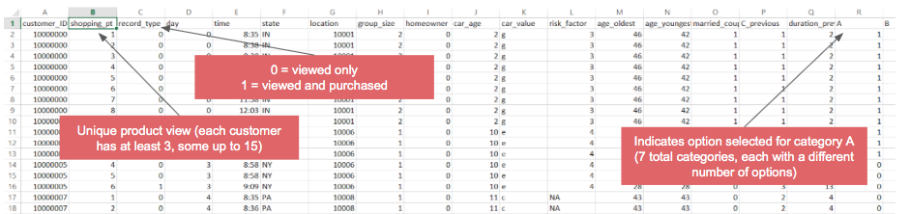
SAMPLE DATA
Kaggle submission: take a separate test file with more limited quote viewing history, then predict the product (i.e. 7-digit combination of variables A-G) that each customer will end up purchasing (two columns in submission file: customer_id and product_purchased

Slide 6

MENTAL MODEL
Our hypothesis: car status and income level should generate the biggest impact on the level of options chosen.
Newer car → more expensive options
Lots of miles driven → more expensive
Higher income → more expensive
If married → higher income + may have children → more expensive
Older age → more expensive
A second, sub-hypothesis is that preferences for the options might differ among locations.

Slide 7




PERSONA HYPHOTESIS
Intuition made us draft proto-personas based on our mental models. A few examples:
Bob, the part-timer On his late 20s, he doesn’t want to be held responsible for any liabilities but skimps a bit when protecting his own trusty 2005 Nissan Altima.
Mary, the sporty mom She is very practical, but seeks maximum protection for her and her kids, and takes all the stops to do so – she has premium protection with every bell & whistle

Slide 8
ANALYSIS METHOD
Create customer segments to understand preferences and use logistic regression to predict likelihood or selecting given options.
For Customer segmentation we k means clustering to get 5 segments We ran 22 Logistic regressions:
Y variables: options
X variables: demographic data : region, log(local population), log(population density), urbanization level, log(avg income), age of the oldest people etc.
Car information: log(car age+1), car value
Insurance history: previous duration, whether they’ve chosen option C previously

Slide 9
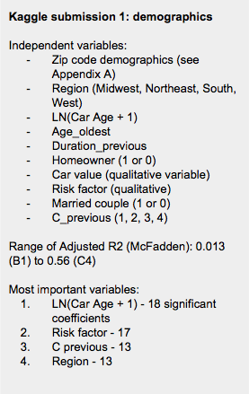
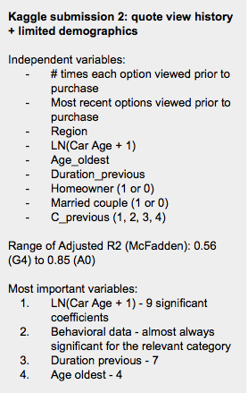
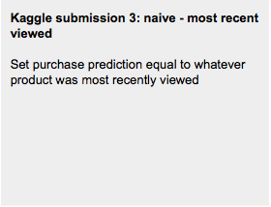
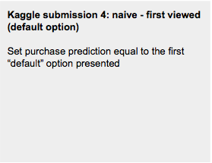
KAGGLE SUBMISSION SUMMARY

Slide 10
KAGGLE RESULTS
600 submissions (from place 400-1000) were naive predictions, all with the same exact score of 53.269%Current winning score: 53.743% - only 0.5 pps above Regression 2!
.
Regression 1 (full demographic): 1.587% (place 1,466)
Regression 2 (quote view history + limited demographic): 53.243% (place 1,112)
Regression 3 (last viewed): 53.269% (place 990)
Regression 4 (first viewed): 16.025% (place 1,396)

Slide 11






FINDINGS
Data quality played a huge role in the usefulness of the outcome of the regression.
“Default” option is very important and determines purchase
Focus on algorithms for MAX profits
Car age is the most significant factor
Poor info = poor hit rate
Previous insurance info helps for better predictions
Behavior > Demos
Notes:
1.The “default” option that Allstate’s algorithms generate is a very important determinant of what is eventually purchased - to make this competition more complete, Allstate needs to provide all of the raw data that they use to generate their default recommendations (which they would never do for obvious reasons)
2. Allstate should focus on optimizing the algorithms that generate default options in order to maximize profit
3.Past insurance policies selected are important - Allstate should do more to gather that information during the quoting process
4. With the information given, it’s practically impossible to generate better than a 54% hit rate - which means we need more info than Allstate can give us

Slide 12
LIMITATION OF DATA & NEXT STEPS
Data provided is difficult to interpret because of obtuse labeling, and is missing metrics that impact customer decisions.
Recommendation on data collection for further analysis:
Include non-customer data to get full picture (not on file)
Clearly labeled data for better recs
The breakdown the risk factor:
Driver’s information
How long has he/she been driving
No. of incidents before
Income level and credit record
Have “user id” under ”customer id”
Include chat/call information to justify whether the communication from Allstate influence customer’s decision
Information about discounts/bundle choices offered to customers
Car information:
Make/Model/Year
Usage of the car (commercial/fun/commute)
Mileage
Ownership Status(rent/owned/leased)

Slide 13
Q&A

Slide 14
APENDIX A
Data Structure: 5000 observations, 48 variables.
I. Purchase information •Customer ID •Browsed options and purchased options ( including time and day) •Number of browsed options
II. Demographic information •Marital status •Group information (size, age of the oldest/youngest person) •Homeowner •Location (including states, population density, household income, etc.)
III. Car status information •Car age •Car Value
IV. Historical record information •Previous purchase record (including coverage duration / whether they’ve chosen a specific option before)

Slide 15
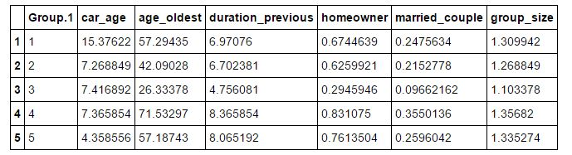
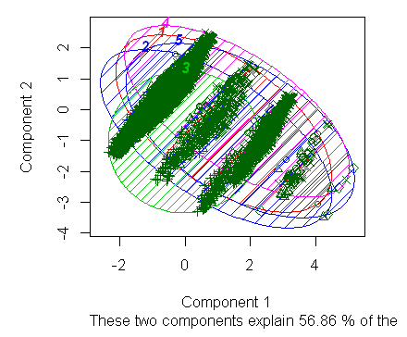
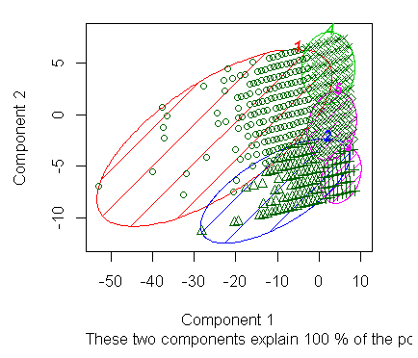
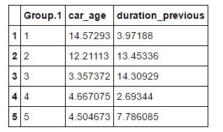
APENDIX B
We tried different approaches for the segmentation ( with different number of segments and metrics used)， but the results failed to help us generate more insight. There are many overlaps among segments. Here below are examples

Slide 16
APPENDIX C
Zip-code-level data appended for regression 1:
Log population
Log population density
Rurality index (1 = most urban; 9 = most rural)
Urban influence index (1 = most adjacent to urban area; 12 = least adjacent to urban area)
Urban commuter score (% of commuters that drive to urban areas of varying size)
Log mean household income
All data derived from http://www.ers.usda.gov
#s 1-5 are from 2003 (unable to find more comprehensive recent data)
# 6 is from 2010

Slide 17
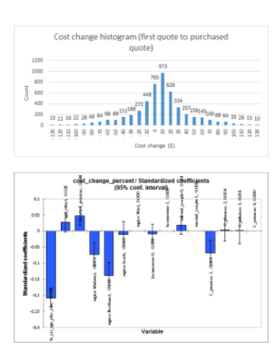
APENDIX D
Do visitors “game” the system to reduce cost, or do they change purchase options for other reasons?
No: on average, customers actually increase quote cost by 0.64% (or about $2.29) from their initial default option
This is consistent across different types of customers - most demographic variables have extremely little impact on the % change in quote cost (see table to the right)

