Slide 1


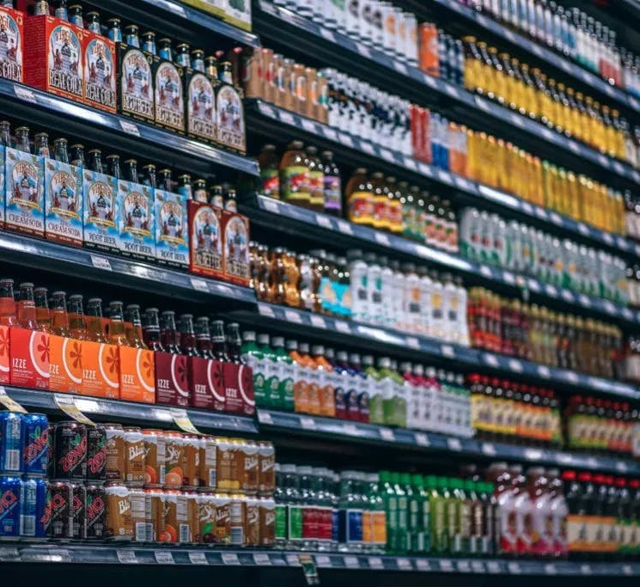
The Complete Journey
MAR-653 - FINAL PROJECT
TEAM: Group 4
Prasad Kulkarni
Sathish Rajendiran
Kanning Wu
PROFESSOR: RAJKUMAR VENKATESAN

Slide 2

Executive summary
Goal
Given our customer base of roughly 2,500 households with ~45,000 transactions over 2 years of shopping at a retailer, our goal is to segment and profile our customers based on factors such as income, shopping behavior, and demographics; then use this data to identify frequently paired items to develop a direct mail coupon campaign
Plan
We are planning to select specific segment or cluster of households which uses coupons slightly more often than the average customer. This provides the opportunity to persuade customers to purchase items they enjoy more frequently, and thus improve gross revenue.
We are planning to identify the most popular combination of items using association rule mining and analyzed the rules using the lift, confidence, support, and conviction metrics.
Based on a preset liability margin, we plan to determine the optimal coupon value that would encourage the consumer base to increase item sales frequency and overall revenue.
Tools
Excel, K-mean clustering, Association Rule Mining, Python

Slide 3
Research Objectives (Questions)
Who are potential coupon users?
What's the relationship between price, quantity and coupon value?
Which are the most frequent items sold?
What's the optimal coupon value for selected most frequent items?

Slide 4
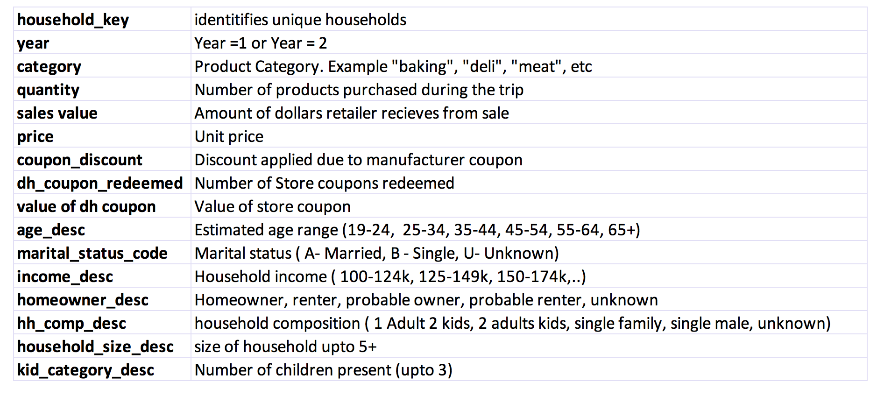
Dataset (Combination of multiple data files)

Slide 5
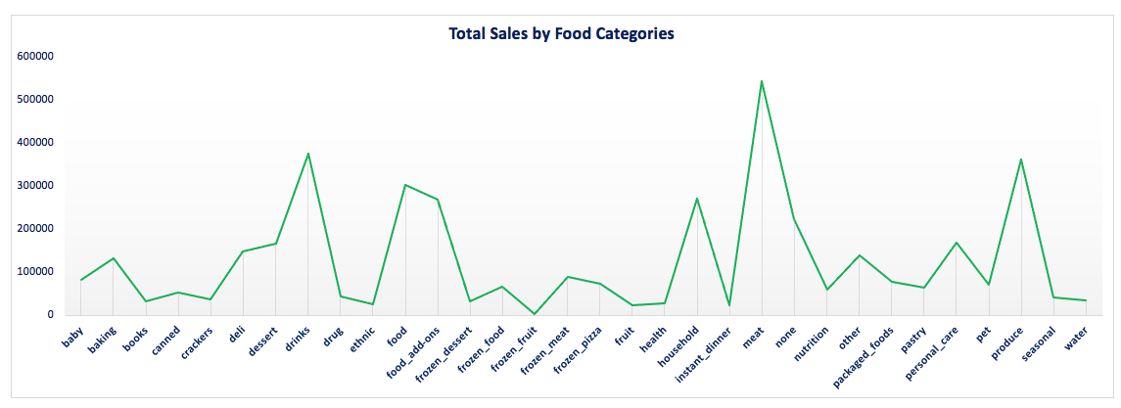
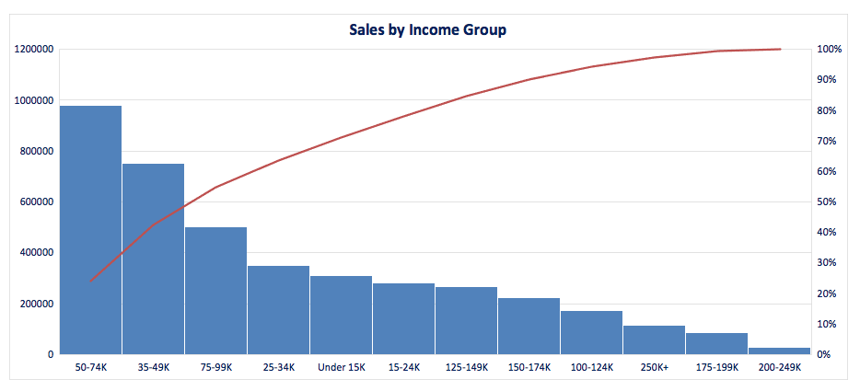
Descriptive Analysis

Slide 6
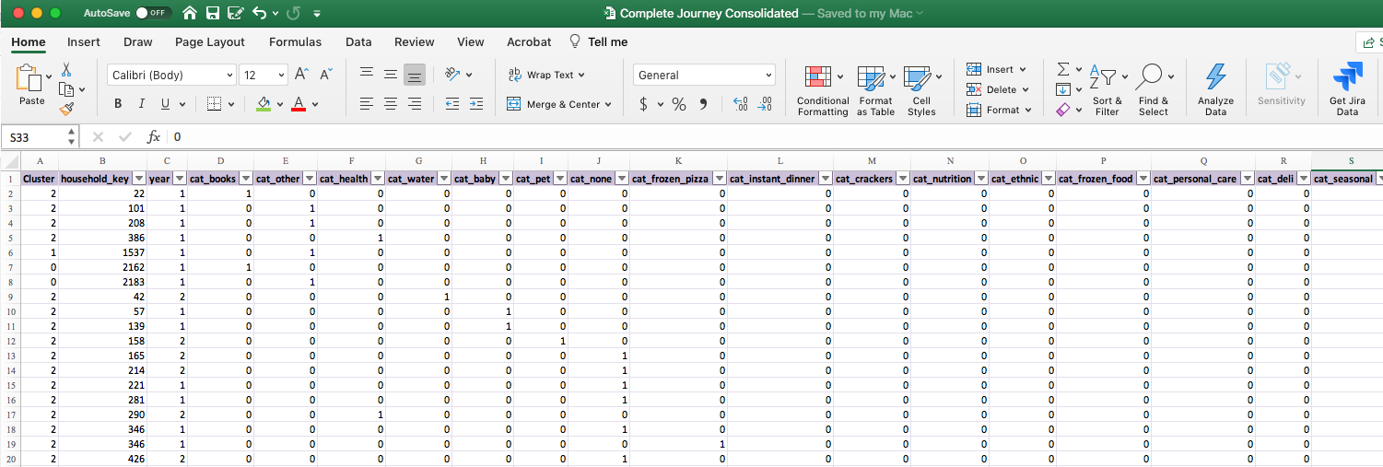
Data Transformation
The categorical columns in the original data were transformed using one-hot encoding and manual adjustment, which transforms a categorical attribute with n labels into a vector of size n-1 with only one of the values as 1 (active). The lowest-quantity column is dropped to avoid the dummy-variable trap

Slide 7
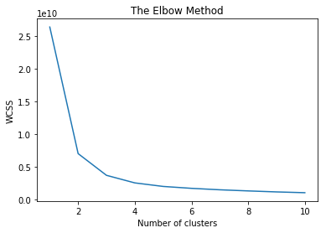
K- Number of Clusters
The Elbow Method for K means clustering was used to determine an optimal number of clusters of 3

Slide 8
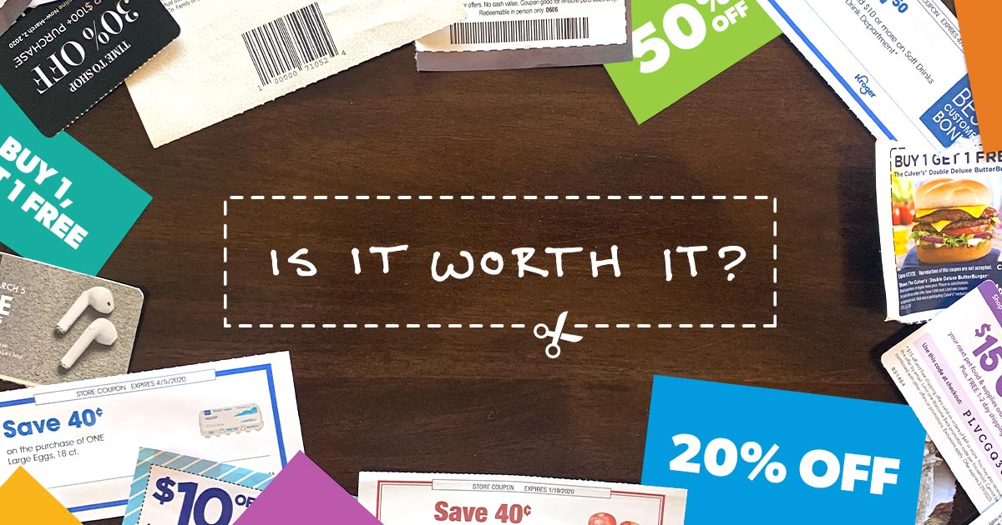
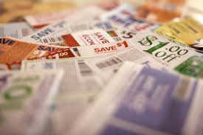
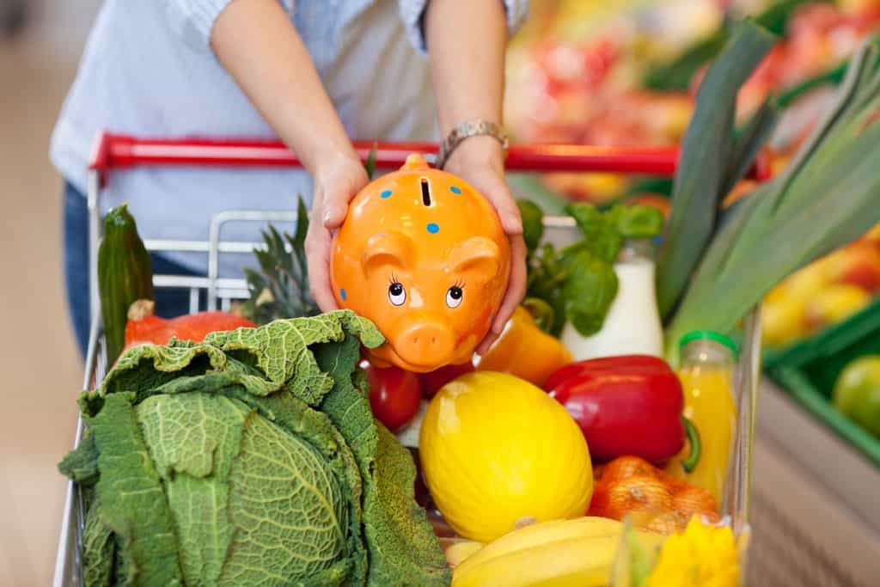
Customer Segments and Profile
Buys everything | Buys products for baby and children, and fresh food | Buys fresh food and household items mainly
Least likely to use coupons | Most likely to use coupons | Marginally more likely to use coupons
Age distribution general | Age Group 19-24 , 25-34 and few of 35-54 | Age Group 35-54
Marital Status general | Mostly Married with large families | Mostly Married

Slide 9
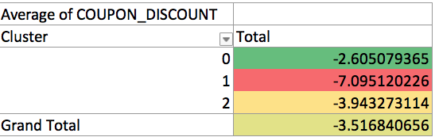
Data Findings
Focused on Cluster/Segment 2: - Average Coupon Discount of $3.94
Slightly above average coupon rate of -$3.52
Cluster 2 has 8,329 transactions out of 46,757 total

Slide 10
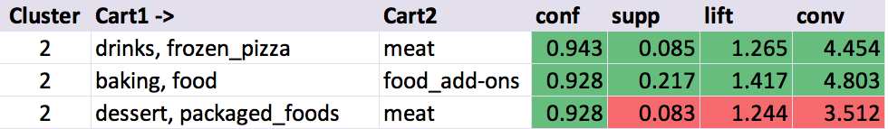
Data Findings (Apriori rule association)
Performed Apriori Rule Association
Confidence (conf): how often the rule has been found to be true
Support (supp): how frequently the itemset appears in the dataset
Lift (lift): ratio of observed support to expected if x & y were independent
Conviction (conv): ratio of expected frequency that x occurs without y
Segment (Cluster) 2:
drinks, frozen_pizza | -> | meat
baking, food | -> | food_add-ons
dessert, packaged_foods | -> | meat

Slide 11
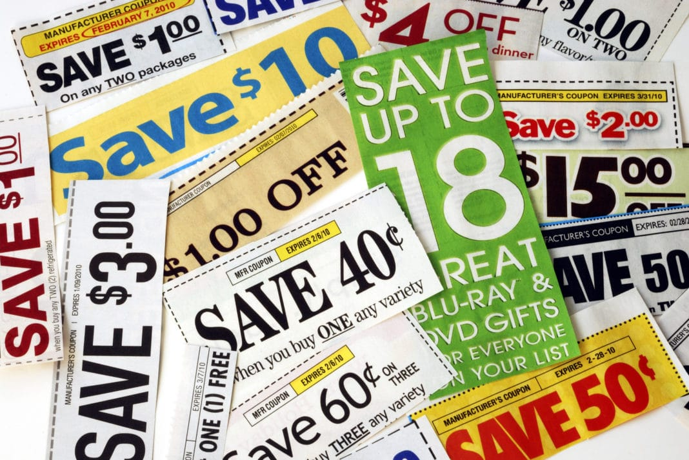
Calculating coupon value
Expected transactions:
Maximum liability:
Average price of meat:
8500
$10,000
$3.58
$0.26
7.3%
2
$1.97
$0.28
14.0%
1
Average coupon value:
Discount:
Num offers:
Average price of food add-on:
Average coupon value:
Discount:
Num offers:
Liability =
8500
*((2*3.58*MeatDiscount)
+(1*1.97*FoodAdd-OnDiscount))

Slide 12
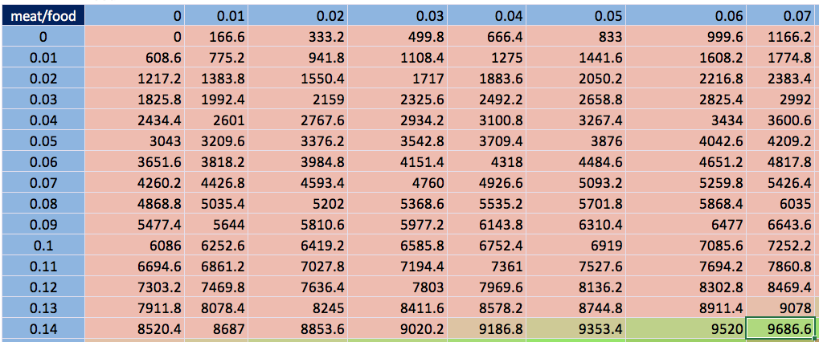
Calculating coupon value
Food Add-On Discount optimized at 7%, with a meat discount of 14%
using a sensitivity matrix.

Slide 13

Expected Lift
Average yearly sales for drinks, frozen pizza, baking, food, dessert, packaged foods, meat, and food add-ons yielded $1,062.34 in gross revenue.
In an ideal scenario with 100% participation, sales for this item averaged across the year with the modified discounts yields an estimated gross revenue of $6,803.23
This represents an ideal lift of $5,740.90, a 137 % increase in sales.

Slide 14
Recommendation
Customers identified in Cluster 2 are the target group for this promotion.
These customers tend to have smaller families, are married between 35 and 54, and use coupons slightly more often than the average customer.
If customers buy:
a drink and frozen pizza, meat is 14% off.
a baking item and any food item, add-ons are 7% off.
a dessert and a packaged food, meat is 14% off.
Promotions can be combined for redemption against one item for each coupon.
Run campaign for one month to determine if expected liability is met, and targeted customer group is responding to the promotion.

Slide 15
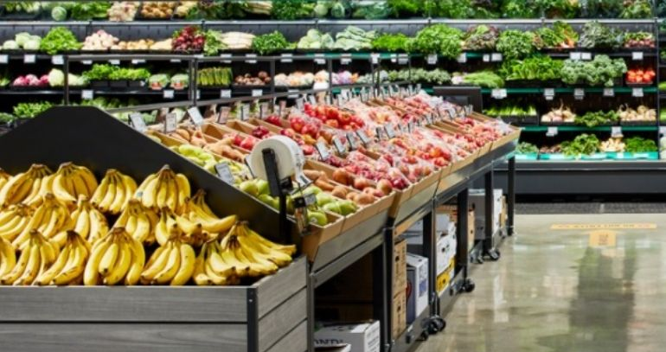

LIMITED TIME ONLY
Visit our store before 1 May 2021
to take advantage of savings:
14% off Meat
With purchase of any Drink & Frozen Pizza
or Dessert & Packaged Foods
OR
7% off Food Add-Ons
With purchase of any Baking and Food items

Slide 16
References
Data source: https://www.dunnhumby.com/careers/engineering/sourcefiles
SKLearn: https://scikit-learn.org/stable/modules/generated/sklearn.cluster.KMeans.html
Efficient Apriori: https://pypi.org/project/efficient-apriori/

Slide 17
Thank you!

